Slide 1

Emotional Intelligence: Why it Matters!
2024 Best Practices in Ministry
Dr. Beth Pester, Concordia University, Nebraska
(developed in cooperation with Katie bockelman, Lincoln Lutheran, Lincoln, NE)

Slide 2
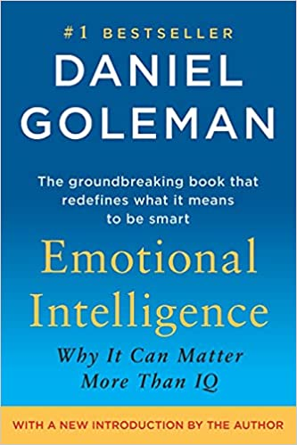
What is Emotional Intelligence (EQ/EI)?
Definition:
  “Emotional intelligence is your ability to recognize and understand emotions in yourself and others, and your ability to use this awareness to manage your behavior and relationships.”
Daniel Goleman
  Emotional Intelligence, 2005
  Four Competencies
    Self-Awareness
    Self-Management
    Social Awareness
    Relationship Management
Notes:
Definition
Discuss the competencies

Slide 3
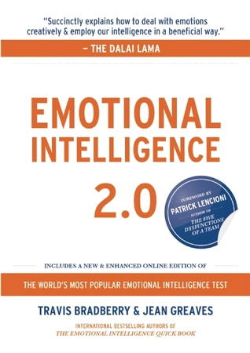
Emotional Intelligence 2.0
How do we use it?
How do we measure it?
How do we help it to grow?
Notes:
What this book’s approach was – we know what it is – how can it be useful, how can we measure it, how can we increase it? It’s NOT a fixed concept

Slide 4

How does EQ relate to our Spiritual Life?
Our Greatest Teacher
Our Best Model for Emotional Intelligence

Slide 5
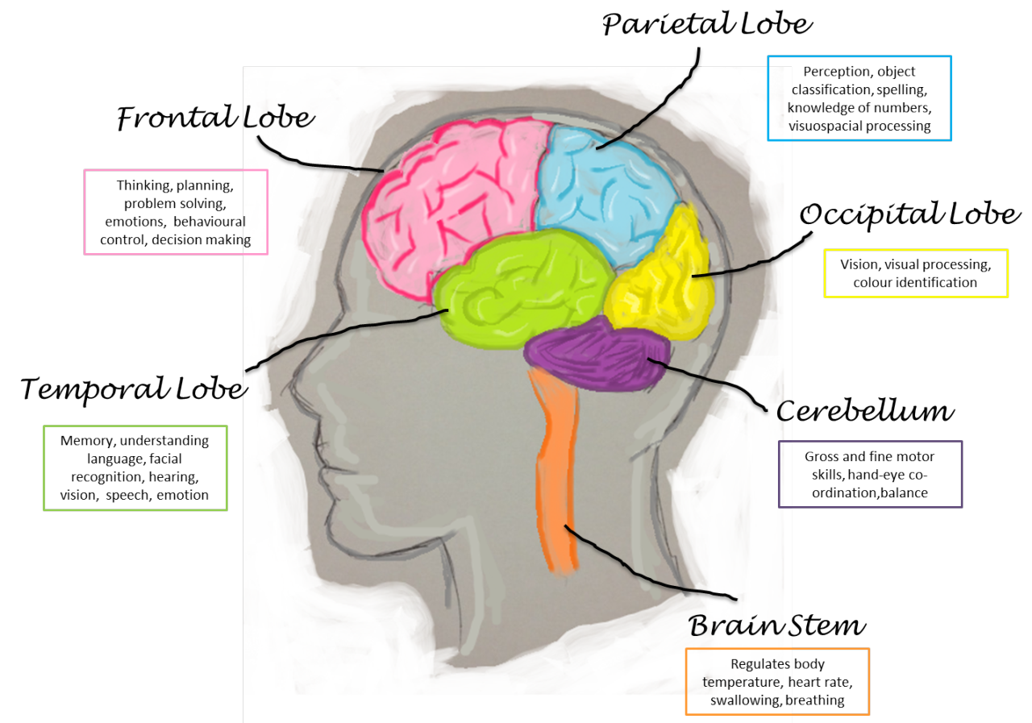
Characteristics of EI/EQ
What it IS
  Flexible – can be acquired with change and practice (unlike IQ)
  Requires connection between rational (frontal lobe) and emotional (amygdala) parts of the brain
  A different kind of “Smart”

Slide 6
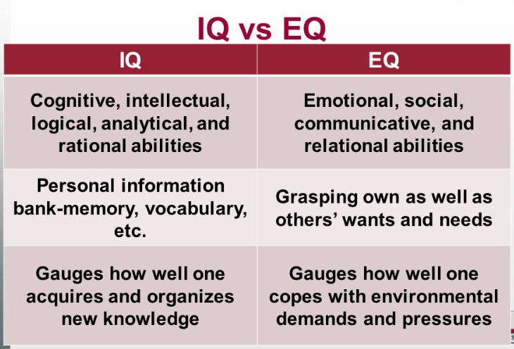

Slide 7
Why does it matter?
Personally and Professionally
Personal
  Improve interpersonal relationships
  Maintain a positive outlook and optimism
  Benefit your overall spiritual, emotional and physical health
Professional
  Improve communication with colleagues, students, parents, parishioners, friends
  Develop leadership skills
  Build problem-solving and conflict resolution skills
Notes:
58% of performance in jobs. 90% of successful people are higher in EQ – 20% of low performers are high in EQ

Slide 8

Competency #1 – Self-Awareness
Knowing one’s emotions in the moment, and tendencies across situations
Emotional awareness: Recognizing one's emotions and their effects - what happens when reason and emotion collide?
Honest and Accurate self-assessment: Knowing one's strengths and limits
Personal power: A strong sense of one's self-worth and capabilities; self confidence
Notes:
This skill shapes effectiveness in all of the others, but requires a level of vulnerability.

Slide 9
Strategies to Improve self-Awareness
Recognize your emotions, and what triggers them
Lean into the discomfort of moving toward, rather than away, from your emotions – so you can move through them
Observe the ripple effect of your emotions
See the whole picture, not just the immediate response
Visit your values

Slide 10
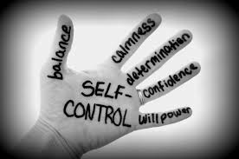
Competency #2 – Self-Management
Managing ones' internal states, reactions, and tendencies in a positive and flexible way
Emotional self-control: Keeping disruptive emotions in check
Integrity: Maintaining high standards of honesty and ethics at all times
Innovation & creativity: Actively pursuing new approaches and ideas
Initiative & motivation for action: Readiness to act on opportunities

Slide 11
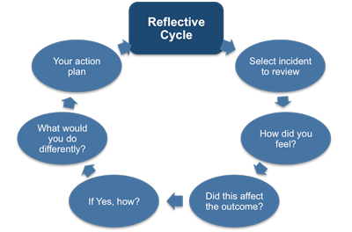
Competency #2 – Self-Management
Managing ones' internal states, reactions, and tendencies in a positive and flexible way
Resilience
  Perseverance and diligence in the face of setbacks
Drive to Achieve
  Striving to meet standard of excellence
Stress Management
  Work calmly under stress and pressure
Realistic Optimism
  Expecting success, persisting in achieving goals despite obstacles and setbacks
Being Intentional
  Thinking and acting “on purpose”

Slide 12
Strategies to improve Self-management
The value of breathing right, sleeping right
Recognize what your inner voice is telling you
Be solution-focused rather than problem-focused
Learn lessons from those you encounter
Involve others in your progress - accountability
Notes:
Research suggests we have about 50,000 thoughts every day. Those can trigger responses – being aware of this, and working to

Slide 13
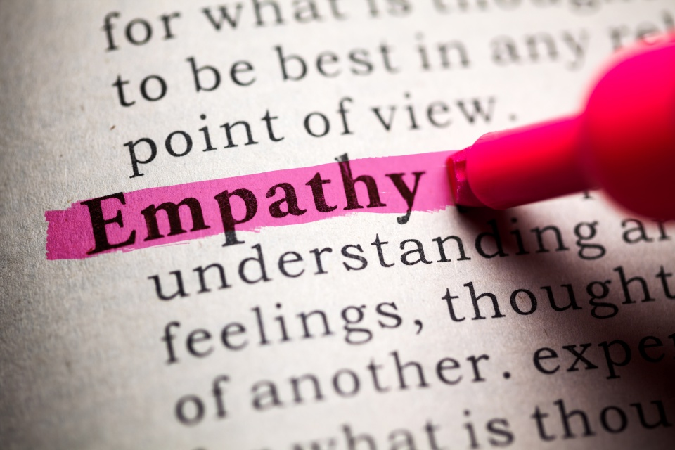
Competency #3 – Social Awareness
Awareness and understanding of others’ feelings, needs, and concerns
Empathy: Sensing the feelings and perspectives of others, and taking an active interest in their concerns
Service ethic: Anticipating, recognizing, and meeting the needs of others
Organizational awareness: Reading a group's emotional currents and recognizing leaders in the group
Notes:
Critical to this skill is observation – give your full attention to others, using a variety of senses

Slide 14
Strategies to improve social awareness
Greet people by name
Read the room
Timing is important
Clear away the clutter
Empathy – walk in their shoes
Practice active listening skills
Check for accurate perceptions
Notes:
A name is personal - you are acknowledging them as an individual and giving them value. Reading the room involves watching what perhaps is not being said

Slide 15

Competency #4 – Social Skills and
Relationship Management
Adeptness at inducing desirable responses in others – building relationships that grow and last
Developing others: Identifying others' development needs and bolstering their abilities
Communication: Listening attentively and fostering open dialogue
Influence: Utilizing effective strategies to communicate ideas and options
Conflict management: Negotiating and resolving disagreements

Slide 16
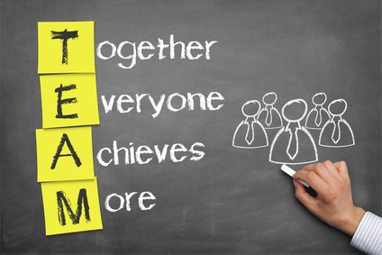
Competency #4 – Social Skills/Relationship Management
Adeptness at inducing desirable responses in others
Leadership: Inspiring, guiding and mobilizing individuals and groups
Building Bonds: Nurturing and maintaining relationships, connecting with others on a deeper rather than superficial level.
Teamwork & Collaboration: Working with others toward shared goals.
Building Trust: Being trustworthy and ethical when working and relating to others

Slide 17
Strategies to improve social skills/Relationship Management
Be open about yourself, curious about others
Avoid giving mixed signals
Acknowledge the feelings of others
Using polite phrases goes a long way
Receive feedback gracefully
Don’t avoid things that are difficult
Feedback should address the problem, not the person

Slide 18
Why it Matters……
  Jesus placed a high value on relationships.
  The vertical relationship we have with God
  He is the one who has restored our relationship with the Father through his death and resurrection.
  He continues to equip and strengthen us in our relationship with Him through the Word and Sacrament.
  When we are strengthened in our relationship with him, we are more ready to serve others. - Romans 5
  The horizontal relationship we have with others: students, parents, other staff members, our own families
  He shows us how to love others, putting their needs ahead of our own.
  He gives us examples of how to solve conflict.
  He provides other believers in His Church to encourage us. – Ephesians 4

Slide 19
References
Allen, G. (2015). A simple exercise to strengthen emotional intelligence on teams. Mind/Shift: How We Will Learn. Retrieved from http://ww2.kqed.org/mindshift/2015/06/22/a-simple-exercise-to-strengthen-emotional-intelligence-in-teams/
Belsten, L. (2009). Four-quadrant model of emotional intelligence. Retrieved from http://smartgrowth.com/pdf/four_quadrant_model.pdf
Bradberry, T. , Greaves, J. (2009). Emotional intelligence 2.0. Talent Smart.
Cherniss, C. , Extein, M., Goleman, D., Weissber, R. (2006) Emotional intelligence: What does the research really indicate? Educational Psychologist 41(4), 239-245. Retrieved from http://alliance.la.asu.edu/temporary/students/katie/MultipleIntelligenceEmotional.pdf
Goleman, D. (1995, 2002, 2005) Emotional intelligence. Retrieved from http://www.danielgoleman.info/topics/emotional-intelligence/
Waterhouse, L. (2006) Multiple intelligences, the Mozart effect, and emotional intelligence: A critical review. Educational Psychologist 41(4), 207-225. Retrieved from http://www.sfu.ca/~jcnesbit/EDUC220/ThinkPaper/Waterhouse2006.pdf
What is social and emotional learning? (2015) CASEL: Collaborative for Academic,
Social, and Emotional Learning. Chicago, Il. Retrieved from http://www.casel.org/social-and-emotional-learning/

