Slide 1
edTPA Overview and Process
Spring 2024 – Student Teaching 1
January 7th, 2024

Slide 2
Special Announcement
Please hold all applause and cheering until the end of the presentation.
Thanks!

Slide 3
Why the edTPA?
Pretty soon, you will be in a classroom where you hear:
WHY DO I HAVE TO DO THIS?
WHY IS THIS IMPORTANT?
CAN I USE THE BATHROOM?

Slide 4
Why the edTPA?
Nationally recognized, valid and reliable performance assessment for student teaching
Represents best practice in teaching: planning, instruction, and assessment
Emphasis on reflection
Data driven instruction era
Meets accreditation requirements
18 states have either adopted statewide policies requiring a performance assessment for aspiring teachers or are actively considering such a step.
Assist with your licensing in other states
Today, more than 800 teacher preparation programs in some 41 states and the District of Columbia are using edTPA at different levels.

Slide 5
Which edTPA handbook will I complete?
Early Childhood Inclusive: Early Childhood or Elementary Literacy (depends on placement)
Elementary Education: Elementary Literacy
K-12 Special Education: Special Education
Middle and Secondary: Your content area (there are specific handbooks for middle level vs secondary – select one class period for your focus, be strategic)
Religious Education: Middle or Secondary History/SS
K-12 Music: Performing Arts
K-12 Art: Visual Arts
Are you completing your ELL placement first? – Depending on your placement, you can choose either the English as an Additional Language edTPA or your content area.

Slide 6
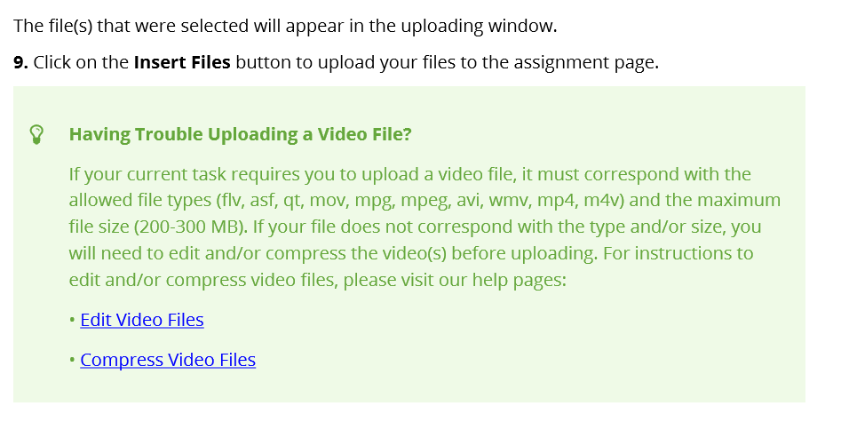
Chalk and Wire / Anthology
You will work through Chalk & Wire to complete and submit your edTPA.
You will register through Pearson to obtain an authorization code for this process.
Please log on to your Chalk and Wire account.
C&W edTPA user guide:
Posted on our website

Slide 7
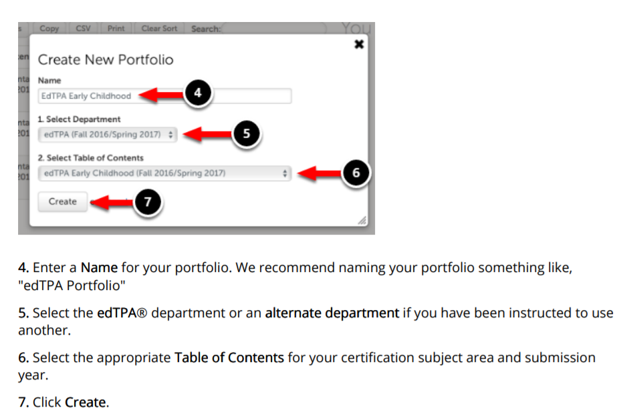
C&W
If you are unsure which handbook you will use, you can create more than one portfolio to look through!

Slide 8
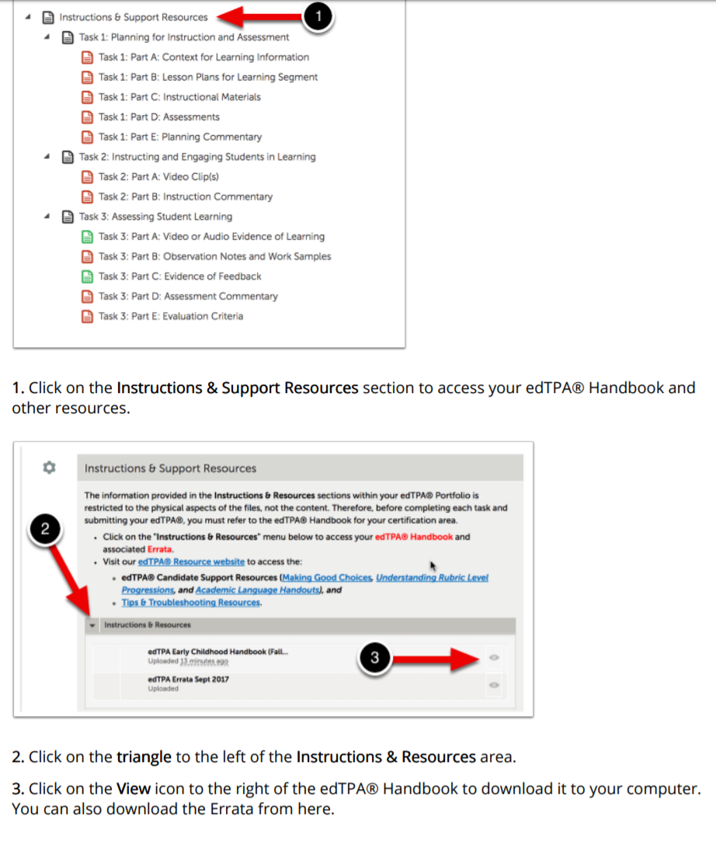
C&W - Resources
Utilize the resources provided by C&W
Work directly on these templates. Use the information from the handbooks and template first!
Download and type directly on these templates and save frequently. You can upload to C&W when you are finished with each task.
See the user guide for instructions.
The sections will turn green you have all the items uploaded.
Evidence of feedback will be green already

Slide 9
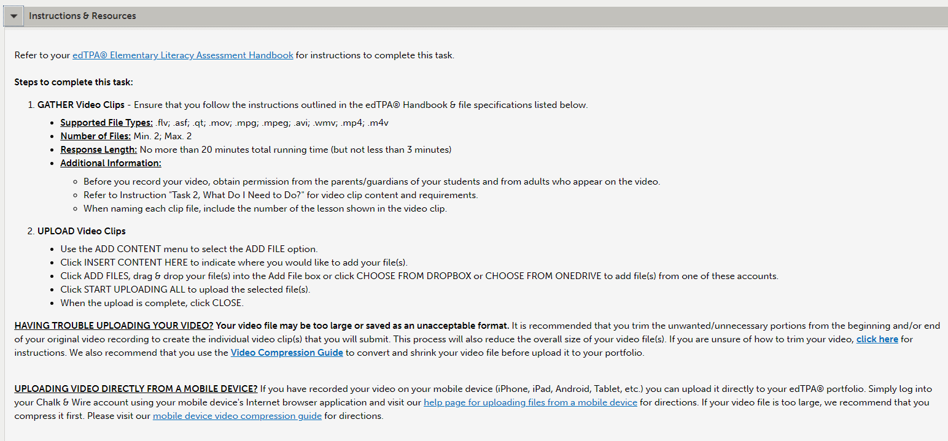
C&W - Resources
Other resources posted on our website.
Video suggestions from C&W

Slide 10
C&W - Resources
Create an edTPA folder on your computer
Download your handbook
Download each template
Task 1: Context for Learning & Planning
Task 2: Instruction
Task 3: Assessment
Type and save directly on the template documents on your computer (it might be helpful to save these files on some type of cloud-based service)
Upload completed templates to C&W as you finish each (This is not your “final” submission. You can always delete files and reupload.)

Slide 11
edTPA Overview
While the tasks are the same for each content area, requirements and prompts vary based on content area and grade level.
*Special Education, Early Childhood, and PE are slightly different
Task 1:
Context for Learning
Planning
Task 2:
Instruction (3-5 lessons; video recording; keep student work examples)
Task 3:
Assessment
Read through each task requirement ahead of time. There are certain artifacts you must collect for each task, so you need to be prepared.

Slide 12
Task 1 : Planning
There are 2 templates related to Task 1
Context for Learning
Planning Commentary

Slide 13
Task 1 : Context for Learning
This is key! Just focus your information in this section related to the students in your edTPA group.
For middle / secondary teachers, this will just be one section / period.
Your handbook will outline the minimum number of students required for your edTPA focus. This means you could just focus on a small group for your edTPA.
About the Class Featured in this Learning Segment
About the Students in the Class Featured in this Learning Segment
In this section, you provide important information about your students and school. This provides context for the assessor of your edTPA and forms the foundation for your planning.
Public vs Private
Scripted Curriculum?
Online only?
Etc.

Slide 14
Task 1 : Planning
Previous students who have complete the edTPA shared that Task 1: Planning takes the longest.
Read the handbook carefully.
Review expectations of task 2 and 3 to assist with writing task 1.
Select a class (your handbook defines the minimum number of students for a class)
Select 3-5 consecutive lesson sequence for the focus of the edTPA
This does not have to be an entire unit!
In this task, you will describe the central focus of your edTPA lessons, using the information from your context for learning.
You will explain your instructional choices, as well as your plan to monitor student learning.
Special emphasis on: language demands, syntax, and discourse.
See glossaries at the back of your handbook.

Slide 15
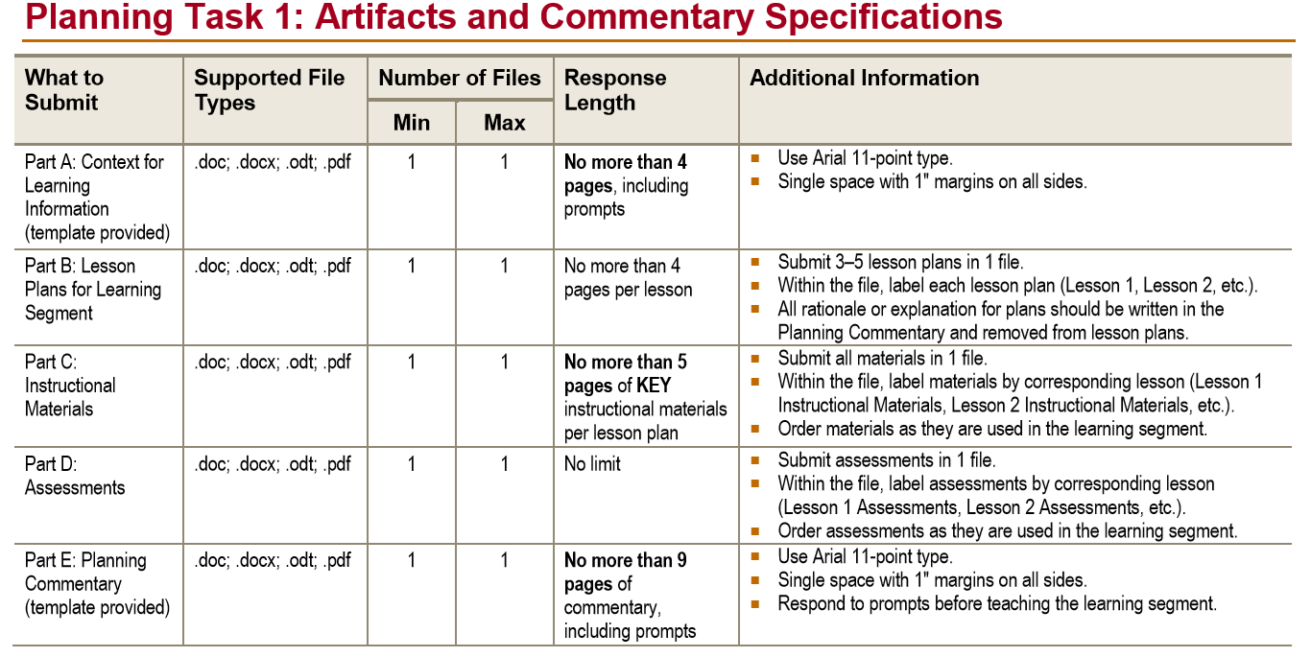
Task 1 : Planning
Complete prior to teaching your lessons!
When you submit your planning commentary, you will also include:
The lesson plans
Instructional Materials
Assessments
See your handbooks for specific details and requirements.
Previous students who have complete the edTPA shared that Task 1: Planning takes the longest.
Read the handbook carefully.
Review expectations of task 2 and 3 to assist with writing task 1.

Slide 16
Review Time
Skim through your handbooks
Find Task 1
What questions do you have?

Slide 17
Task 2: Instruction
Based on the teaching of your 3-5 lessons
Provide video evidence to support your responses over the following areas:
Promoting a Positive Learning Environment
Engaging Students in Learning
Deepening Student Learning during Instruction
Analyzing Teaching
Each content area has different requirements for the number of clips, the length of the clips, and the focus of the clips.
Consult your handbook!
This information should influence your planning.
Example from Elementary Literacy

Slide 18
Videoing Requirements
You must obtain permission from each student in order to include them in the video segment and use examples of their student work.
Permission forms can be found on the CUNE education website:
http://wp.cune.edu/educationdepartment/edtpa/
Please insert your name into the letter before sending out to your students
Spanish version is also available
If you need the permission form in different languages, copy and past the form into Google Translate or an AI tool, or use a visual cue guide.
You are responsible for monitoring who returned permission forms and keeping a record of these forms.
When all permission slips are completed or when you have completed videoing, you must email the completed forms as one file to Dr. Kerschen – Keith.Kerschen@cune.edu

Slide 19
Videoing Requirements
This is something to work on right away.
If a student returns a permission slip with a “no” or does not return a permission slip, they cannot be featured in the video clips that you submit to Pearson.
If students do not wish to be videoed, they are still expected to take part in the normal classroom activities.
Be strategic about where they sit
Blurring faces is not a viable option
If the show up in your video, just don’t submit clips that they are in.
Each content area has different requirements for the minimum students needed for video evidence and the length of the clips.
Consult your handbook
Video tips and resources can be found on C&W and the CUNE education website

Slide 20
Videoing Requirements
You may use your own device, a device from the school, or a Swivl from CUNE to record.
What is the process for checking out a Swivl from Mr. Landrey? You may check out a Swivl system from Mr. Landrey in Thom 103b
Register a free Swivl Cloud account using your CUNE.ORG e-mail address: https://cloud.swivl.com/register/
Make an appointment with Landrey to check out a Swivl system and get some basic training.
A Swivl system consists of a Swivl base and microphone, an iPad, and a stand.
Recordings will be uploaded to your Swivl Cloud account.
You may keep the Swivl system up to 7 days.
If you have any questions, please contact Mr. Landrey Peter.Landrey@cune.edu

Slide 21
Task 3: Assessment
This section focuses on the student learning during your 3-5 lesson sequence.
You will analyze an assessment that measured student learning on one of your key assessments related to your objectives.
Whole class learning
Focus students learning (see handbooks for the number of focus students)
For most handbooks, you will select 3 students (who you have permission slips from) based on the patterns of learning in the assessment you gave.
For Early Childhood and SPED, you will identify these focus students in Task 1 (since there are a few more observations etc).

Slide 22
Task 3: Assessment
You will submit:
Commentary
Student Work Samples (the actual assessment that the students completed)*
Evidence of Feedback (you must provide evidence of your feedback)
Evaluation Criteria (how you determined student mastery (rubric etc.).
*SPED, PE, and Early Childhood will be slightly different

Slide 23
Task 3 Assessment
Keep copies of all student work samples (make copies)
Double check if you are required to submit video evidence.
Determine a plan on providing feedback for students
Can be written directly on student work samples
Can be videoed
Consider planning for this during your Task 1.
(Lowest scoring task thus far)

Slide 24
Review
Briefly skim your handbooks for Task 2 and 3
Highlight or underline expectations / requirements
Video clip length
Content Vocabulary
Class Size
See the sections “What do I need to do?”

Slide 25
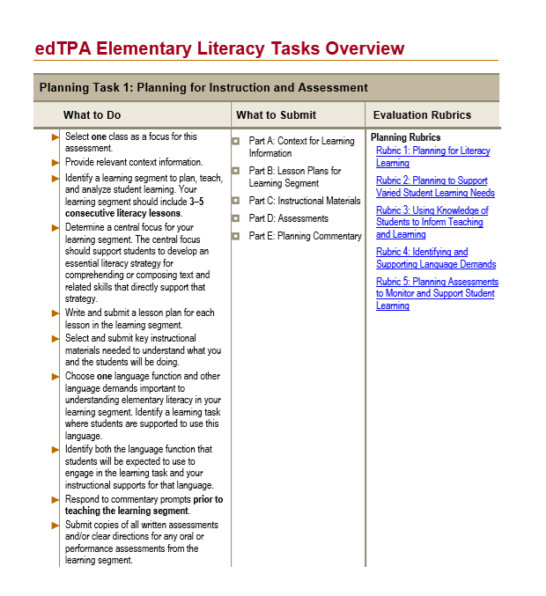
Navigating the handbook and templates
There are links built in that take you to specific parts of the handbook.
Task Overviews @ the beginning of each handbook.
Review expectations for each task ahead of time!
Allows for more efficient planning and ensures you collect all necessary artifacts and evidence.
Review rubrics for score expectations.

Slide 26
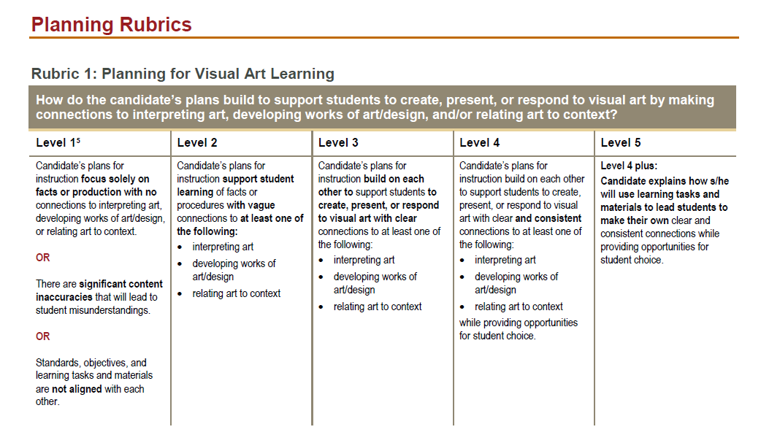
Rubrics – Can be found in your handbook
15 rubrics (5 for each task) – A score of 1 – 5 for each rubric
World Languages – 13 rubrics

Slide 27
Rubrics
15 rubrics (5 for each task)
World Languages – 13 rubrics
Rubric | Prompt
Rubric 1 | Planning Commentary – Prompt 1
Rubric 2 | Planning Commentary – Prompt 2, 3
Rubric 3 | Planning Commentary – Prompt 2, 3
Rubric 4 | Planning Commentary – Prompt 4, Lesson Plans
Rubric 5 | Planning Commentary – Prompt 5, Lesson Plans, Assessment Materials
Rubric 6 | Instruction Commentary – Prompt 2, Video Clips
Rubric 7 | Instruction Commentary – Prompt 3, Video Clips
Rubric 8 | Instruction Commentary – Prompt 4a, Video Clips
Rubric 9 | Instruction Commentary – Prompt 4b, Video Clips
Rubric 10 | Instruction Commentary – Prompt 5, Video Clips
Rubric 11 | Assessment Commentary – Prompt 1, Student Work Samples, Evaluation Criteria
Rubric 12 | Assessment Commentary – Prompts 2a-2b, Evidence of Feedback
Rubric 13 | Assessment Commentary – Prompt 2c, Evidence of Feedback
Rubric 14 | Assessment Commentary – Prompt 3
Rubric 15 | Assessment Commentary – Prompt 4

Slide 28
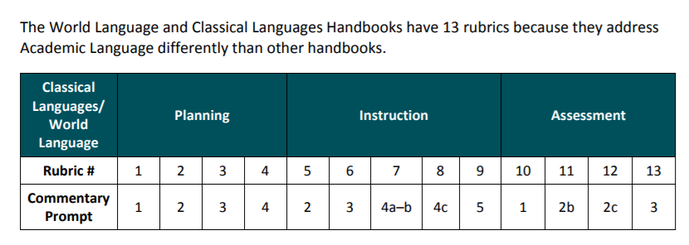
Rubrics
World Languages – 13 rubrics

Slide 29
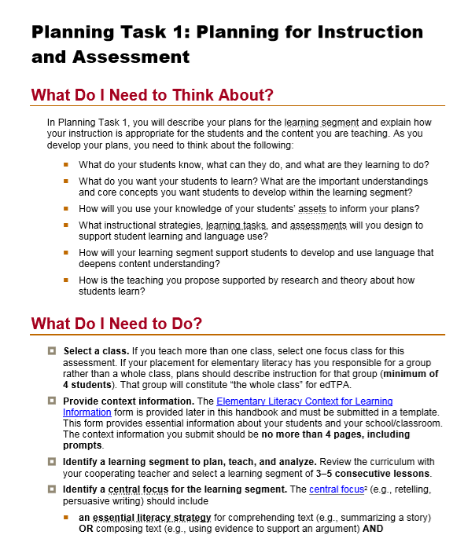
Navigating the handbook and templates
Next, each task is broken down and prompts from the templates are included.
Each task will have connections to the specific content area.
EX:
Rubrics are included after each task.
The document, “Understanding Rubric Progressions” on C&W outlines which rubrics correspond to the specific prompt questions.

Slide 30
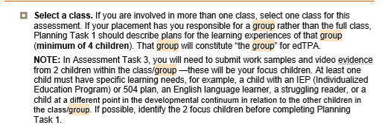
Navigating the handbook and templates
Read carefully. The handbook contains all the details and requirements necessary.
Ex: Video clip requirement for Elementary Literacy:
Ex: Early childhood number of students requirement:
Each content area and/or grade level requirement may be different for these areas. Work with others using the same handbook.

Slide 31
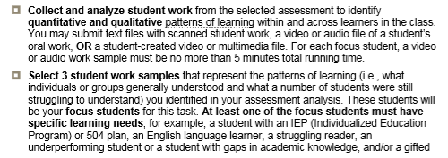
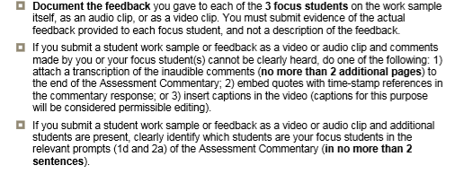
Navigating the handbook and templates
Read carefully and plan ahead!
Example: Task 3 (Assessment) from Secondary Social Studies/History:

Slide 32
Navigating the handbook and templates
Confused about what to submit or include? Refer to the evidence charts at the end of the handbooks or on C&W.

Slide 33
Navigating the handbook and templates
Glossary for terms and definitions located at the end of the handbook:

Slide 34
edTPA Support
C&W has built in resources
Suggests which file types to include, Making Good Choices document, advice for videoing and trimming
We will look at these on the writing day!
Video support
There are a few swivels to check out from Concordia
Use resources at your school or your own devices
Resources are also posted on the CUNE education website: https://wp.cune.edu/educationdepartment/edtpa/task-2-instruction-video-suggestions/
Support during seminars
Work with your fellow student teachers
I will visit seminars for registration information
THE EDTPA REPRESENTS YOUR TEACHING. THEREFORE, WE CANNOT PROVIDE SPECIFICS ON WHAT TO WRITE OR READ THROUGH YOUR RESPONSES FOR FEEDBACK.

Slide 35
edTPA Support
Rubrics
The rubrics outline expectations for each prompt. Use the rubrics to help you plan for and answer each prompt.
edTPA Office Hours – THOM 214D
Tuesdays: 3:45 – 5:30 from January 16th and ending February 27th
By appointment (Can meet via Blackboard Collaborate, just let me know!)
Optional Writing Days – THOM 111 and 113
Saturday, February 3rd, 9:00 – 12:00
Saturday, February 17th, 9:00 – 12:00
Sunday, February 25th, 3:00 – 6:00
Your cooperating teacher
Can assist with providing some of the context for learning information, permission slips and technology support.
They are not to provide you with examples of what to write or to revise your prompts
Share with them this process, keep them in the loop!

Slide 36
edTPA Support
edTPA Work Day: Monday, February 12th
Excused from student teaching that day (inform your cooperating teacher well in advance)
THOM 111-113 is reserved on campus (9:00 – 5:00)
9:00 – 12:00 is mandatory: information will be provided for transferring your edTPA to Pearson
You cannot wait until this day to start writing. Spending two hours each week on the prompts should have you well on your way.

Slide 37
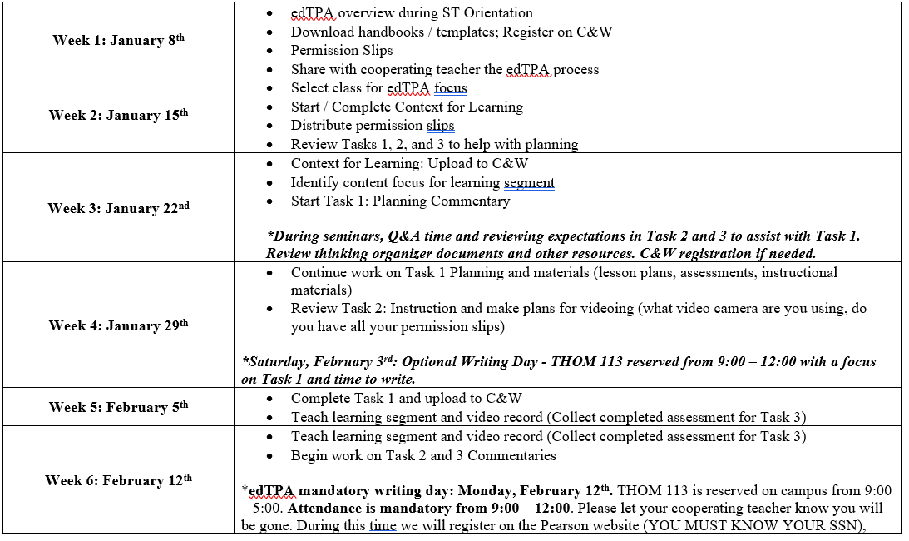
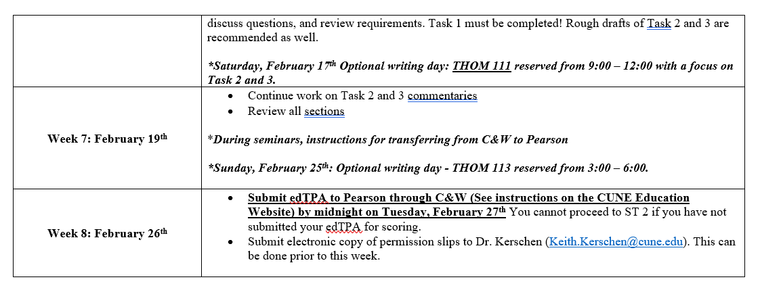
edTPA Timeline
edTPA Due Date: Tuesday, February 27th @ midnight
*Transferred from C&W to Pearson and submitted for scoring!
YOU CANNOT PROCEDE TO STUDENT TEACHING II IF YOU FAIL TO SUBMIT YOUR EDTPA FOR SCORING!
The schedule for videoing is a suggestion. Depending on your placement, you may video sooner or later. This suggested schedule is to help you keep on track.

Slide 38
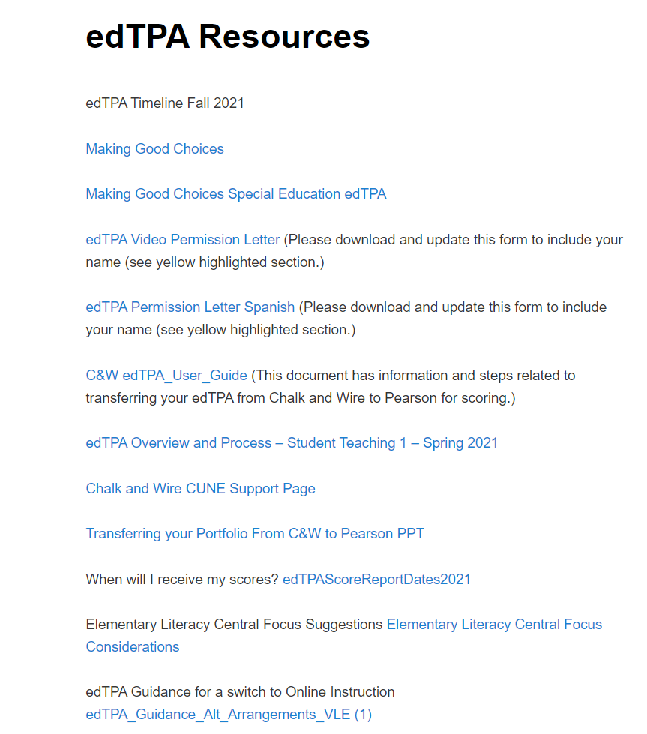
Resources on the website
https://wp.cune.edu/educationdepartment/edtpa/
Resources Tab:
Elementary Literacy: See this document to assist with planning your central focus.
Virtual Learning Guidance:

Slide 39
Resources on the website
https://wp.cune.edu/educationdepartment/edtpa/
Thinking Organizers and Prompt Resources Tab:
These thinking organizers are to help you craft your prompts for the commentaries. Your commentaries should be in narrative form, but these documents can help you organize your thinking!

Slide 40
Resources on the website
https://wp.cune.edu/educationdepartment/edtpa/
Understanding Rubric Level Progressions
Breaks down the score requirements for each rubric. Provides some examples.

Slide 41
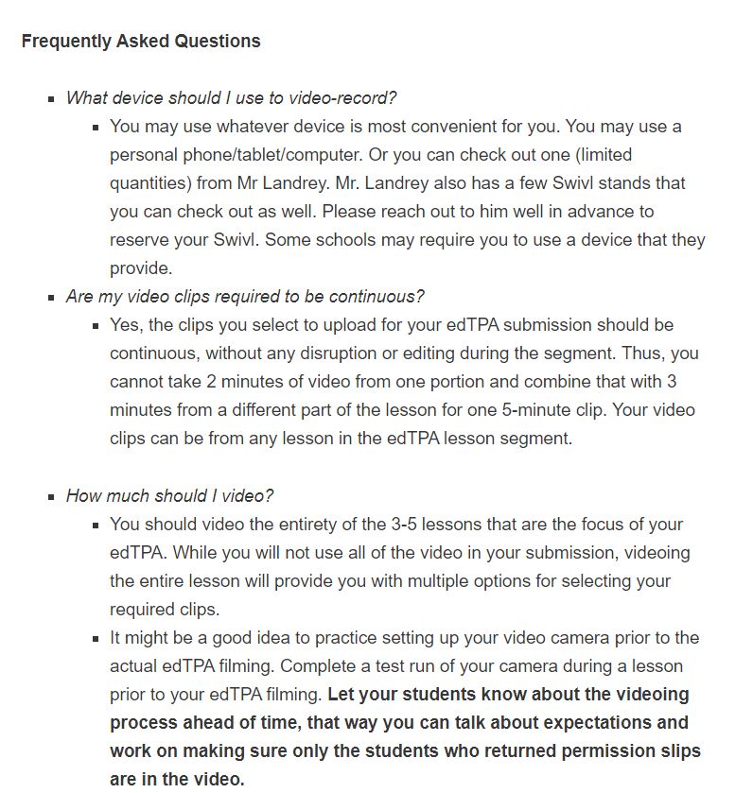
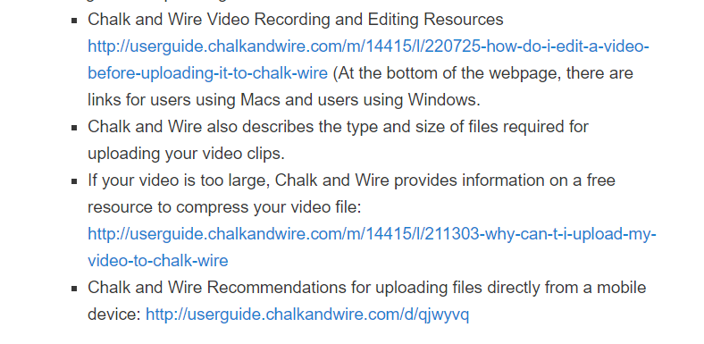
Resources on the website
https://wp.cune.edu/educationdepartment/edtpa/
Video Suggestions Tab:

Slide 42
Resources
YOUR HANDBOOK IS THE BEST RESOURCE!
Please utilize the office hours and Saturday writing days
If you have questions, check your handbook first. edTPA questions should come to me, not your supervisor. Seminars will provide additional support.
Waiting to email about concerns or finishing on time the week before the due date is not acceptable!
Reach out early with questions or concerns!

Slide 43
Chalk & Wire / Anthology
You will work through Chalk & Wire to complete and submit your edTPA.
You will register through Pearson to obtain an authorization code for this process.
More information will be provided during seminars

Slide 44
What can I do now?
Review the handbooks and templates
Remember, you will type your responses directly on your templates and then upload to C&W
Refer to the timeline/schedule (add to your calendars!)
PLAN AHEAD! ---What does each task require?
Follow the suggested due dates
This is a lot of information to manage and organize! You can do it! This is great preparation for your future classroom.

Slide 45
What can I do now?
In the first few days in the classroom, explain the process to your cooperating teacher.
Middle/Secondary: Start identifying a class period for the edTPA
Work on the Context for Learning
Permission slips

Slide 46
I’ll be back…..TOMORROW
Jot down any questions that you may have. I will be back to answer questions and go over additional information. Please bring your handbooks and templates.
As you move forward, utilize the handbooks, your peers, and the edTPA office hours. Feel free to email me as well. If it is a question that can be answered by the handbook (ex: “How long should my video be?” I will respond, “Check the handbook.”)
For content specific questions, work with your seminar professor and reference your notes from methods.
Unless you are math, then reach out to me!
This PowerPoint will be posted to the CUNE education department website.

Slide 47
Advice from edTPA completers..
Work on it a little bit at a time every week, don't freak out too much about it.
Try to videotape as soon as possible, and try to work on writing a little bit each week. Upload documents as you finish them to make the submission process easier. Use the resources online to get an idea of how much you should be writing for each question. DO NOT PROCRASTINATE…..This is NOT something you want to leave until the last minute. Keep everything your students turn in until you know for sure what you are using for the assessment examples. Once you know that, do not give their work back until you have submitted the edTPA. You never know when you will need them to fix a glitch or formatting error prior to submission.
Knock out Context for Learning as soon as you can. Take a good look at what is required on the instruction and planning commentaries before you plan your learning segment. Have the planning commentary done by the time of the edTPA writing day, and you will be in good shape.

Slide 48
Advice from edTPA completers..
Do the Context for Learning as soon as you get a feel for your classroom. Then make sure to do you Planning Commentary BEFORE you teach (you should do this, but you really need to do it before teaching).
The Planning Commentary takes the longest, so be prepared.
A Swivl works really well for capturing all the required footage.
Make a list for everything that needs to be done in order to help you feel less overwhelmed.
When watching the videos, make a chart with the requirements listed in the rubrics. As you watch the videos then you can mark each time you see those requirements with the time stamps. This will help you know which footage to use.

Slide 49
Advice from edTPA completers..
Plan ahead and do not sit around and wait for things to happen. Set aside time to dedicate to edTPA on your own time, outside of school. Create a timeline for yourself for when you want to get certain sections done. Give your best but do not lose sight of what truly matters, your students.
Start early, be proactive, and do not stress too much but enough to get it done with enough time.
Some advice I would give is to not put off this project until the end because you will be spending hours on it. Another piece of advice would be to expect to spend 3 or 4 hours on edTPA pretty much every weekend. Thirdly, try and get your lesson plans done as soon as possible so that you can get started on the other tasks in the project. Lastly, figure out a plan for students who don't have video permission; it is very frustrating to go back and edit faces out.
Bro, calm down, you'll be fine... also though, get started early... just do it. If you can videotape during week 3 or the beginning of 4, that'd be really helpful for you, just sayin.. Also, look at multiple examples. That's helpful too.

Slide 50
I will be back tomorrow afternoon to review and answer questions.

