Slide 1
edTPA – TASK 3 – Transferring your Portfolio for scoring

Slide 2
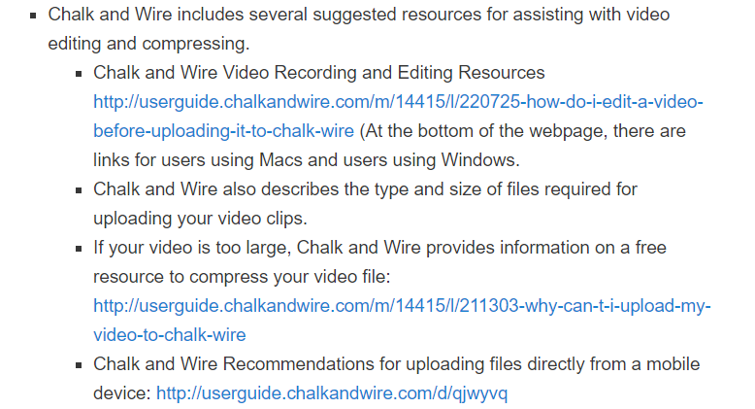
Video Clips
Make sure the audio is easy to understand
Provide transcripts if necessary
Focus on the clip emphasis listed in the handbook.
Please email me your permission slips!
Video Resources from the CUNE website. Also see resources on C&W

Slide 3
Video Clips
If your video file is too large to upload to C&W, and the resource they provided did not work, try the following for compressing your video:
https://handbrake.fr/downloads.php
There are some video guides online that can walk you through this process.
See the links on our website: https://wp.cune.edu/educationdepartment/edtpa/task-2-instruction-video-suggestions/
Google, “handbrake edTPA”
I also have some handouts that could help
Make sure you make an extra copy of your video just in case.
If you use this resource, review your compressed video for quality.

Slide 4
Video Support – Compressing your video files

Slide 5
Deadlines
Optional Writing Days: Sunday, February 25th from 3:00 – 6:00
Tuesday, February 27th @ midnight – edTPA Submission Due (You may submit your portfolio before this deadline)
Submit to Pearson
Email permission slips to Dr. Kerschen
Chalk and Wire Support (outside CUNE):
Chalk and Wire: ChalkandWire@cune.edu
CUNE Chalk and Wire Support: http://wp.cune.edu/chalkandwireresources/support/

Slide 6
Submitting your edTPA Procedures
See the Chalk & Wire “edTPA User Guide” on the website

Slide 7
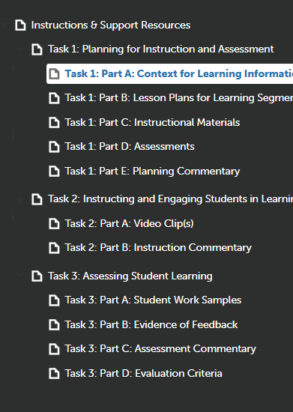
Submitting your edTPA Procedures
When you have uploaded all the necessary files and documents to C&W, the icons (under each Task title line) in your table should all turn green.
GREEN

Slide 8
Submitting your edTPA Procedures
Click on any section from the Tasks.
Click on the “Transfer To Pearson” button
You only have to do this once, not for each section!
The submit button will not be an option for you.
You must make sure you entered your Authorization Key before submitting your edTPA. This is what was sent to you when your registered on the Pearson website during our writing day.

Slide 9
Submitting your edTPA Procedures
Once the submission process starts, it can take anywhere from a few hours to 48 hours for your transfer to be completed.
You will receive an email from Pearson when your transfer process is complete (Check your junk folder) (you can always log in and check as well)
Once you receive this email, you need to log on to Pearson to complete the process.

Slide 10
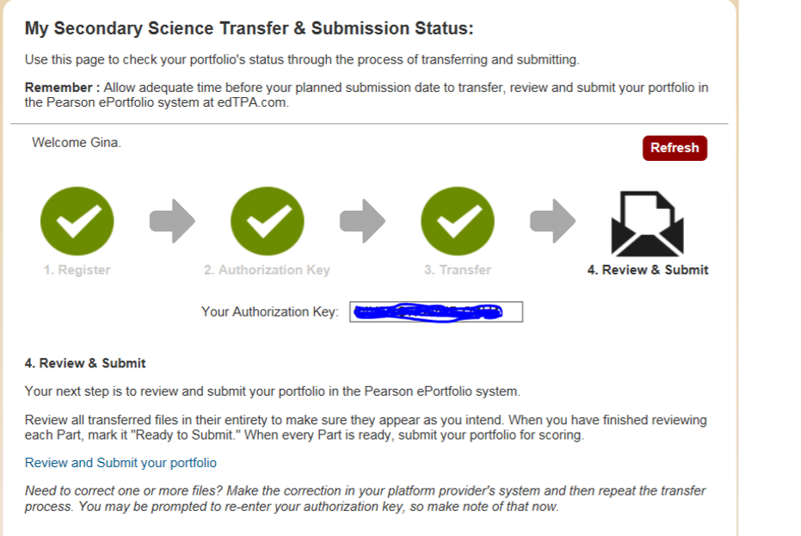
Submitting your edTPA Procedures
Once you log on to Pearson, you will be asked to double check your files one last time prior to submitting for scoring.
WHEN REVIEWING YOUR FILES, IF YOU NOTICE A MISTAKE OR NEED TO CHANGE SOMETHING, PLEASE GO BACK TO CHALK AND WIRE, UPLOAD THE CORRECT FILE, AND START THE TRANSFER PROCESS OVER AGAIN

Slide 11
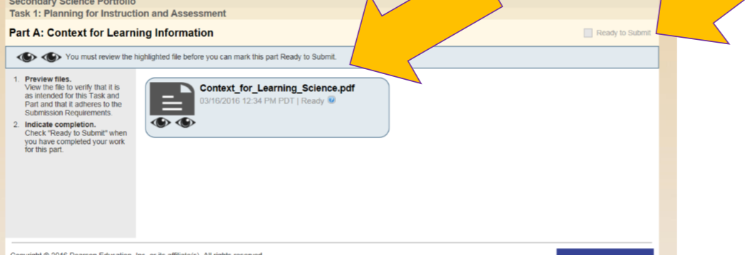
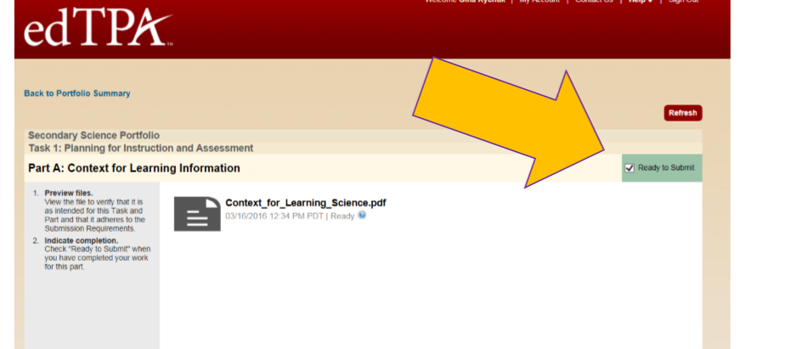
Submitting your edTPA Procedures
Double check each file on Pearson, watch your video clips again, etc.

Slide 12
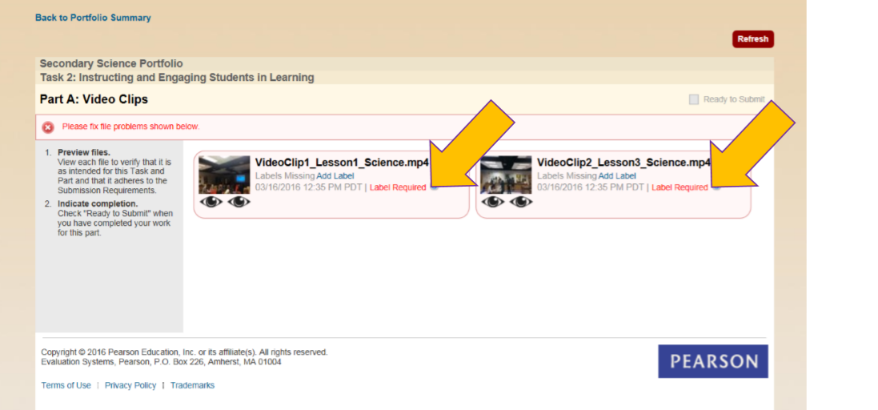
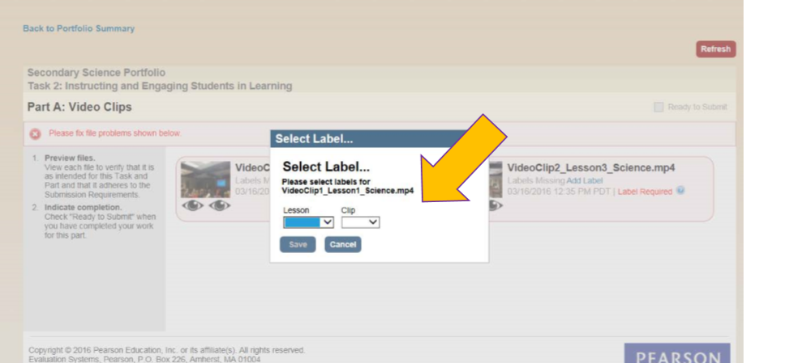
Submitting your edTPA Procedures
Some files (videos etc) will require you to label them in Pearson.

Slide 13
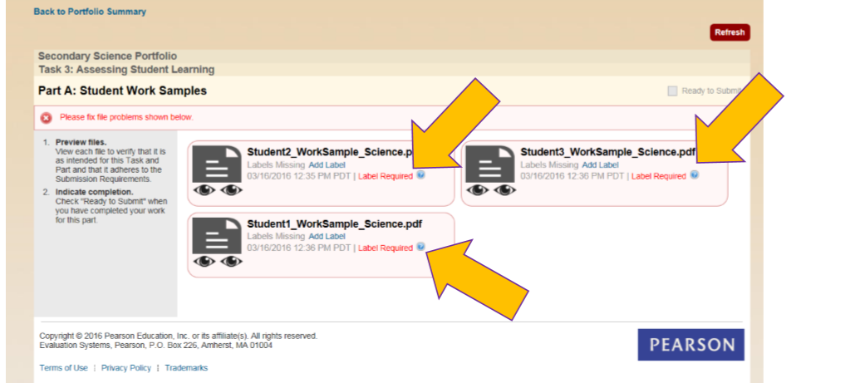
Submitting your edTPA Procedures
Some files (assessment items etc) will require you to label them in Pearson.

Slide 14
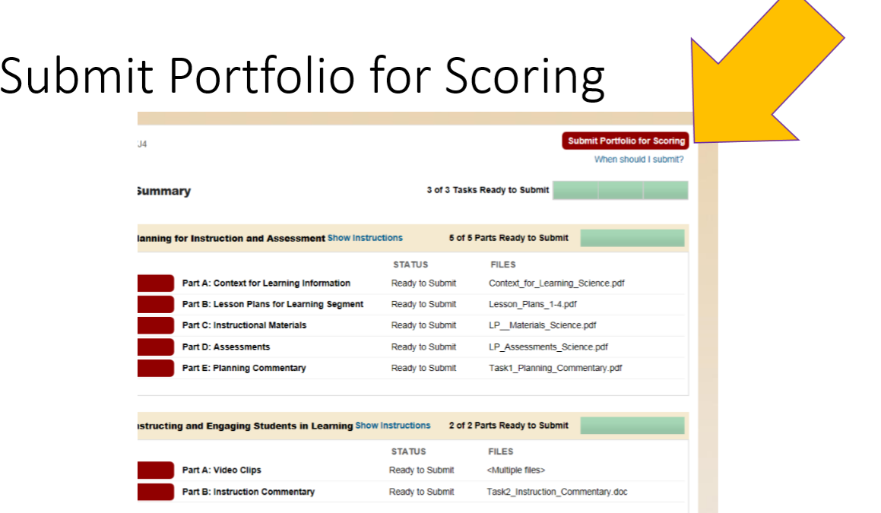
Submitting your edTPA Procedures

Slide 15
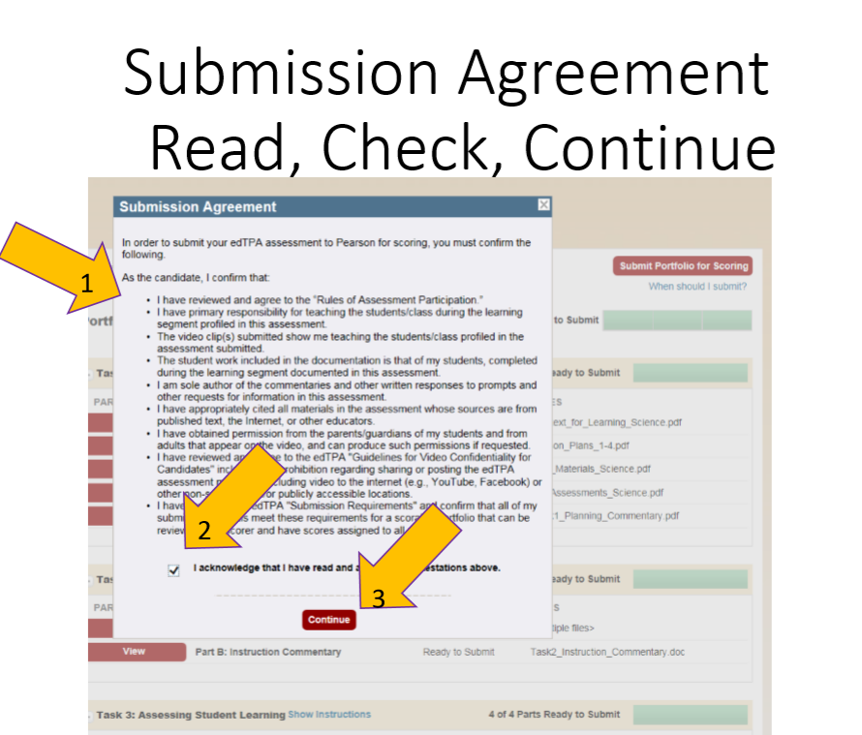
Submitting your edTPA Procedures

Slide 16
Submitting your edTPA Procedures

Slide 17
Task 3: Reminders
Evaluation Criteria

Slide 18
Task 3: Reminders
Review your handbook
Typically, you are focusing on one single assessment from your 3 days related to the central focus
Whole class analysis
Focus student analysis
Feedback
Consider an assessment that gives you rich evidence. It’s okay if there is mixed performance.

Slide 19
When will I receive my scores?
What do I do when I receive my scores?

Slide 20
Deadlines
Optional Writing Days: Sunday, February 25th from 3:00 – 6:00.
Tuesday, February 27th @ midnight – edTPA Submission Due (this includes transferring and submitting on Pearson)
(You may submit your portfolio before this deadline)
Submit to Pearson (after transferring from C&W)
Email permission slips to Dr. Kerschen
Chalk and Wire Support (outside CUNE):
Chalk and Wire: ChalkandWire@cune.edu
CUNE Chalk and Wire Support: http://wp.cune.edu/chalkandwireresources/support/

