Slide 1
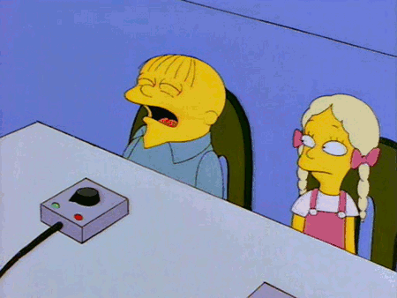
edTPA writing day
February 12th, 2024
Spring 2024

Slide 2
Valentine’s Day https://www.youtube.com/watch?v=eWuAIS7Vs_M https://www.youtube.com/watch?v=7bPbhCWtZmM https://www.youtube.com/watch?v=q7SEXTShB04

Slide 3
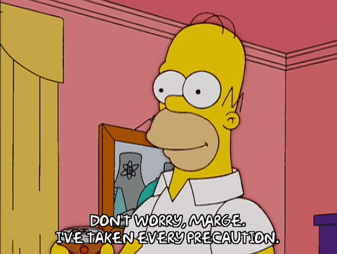
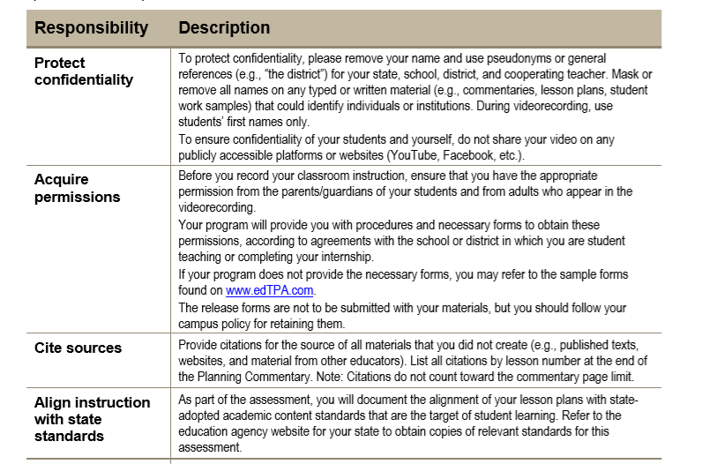
Professionalism Reminder
Do not include the names of your school, cooperating teacher, or students in your responses.

Slide 4
Professionalism Reminder
Plagiarism: Please make sure your responses are original. edTPA runs all submissions through a system that compares your responses to previous edTPA submissions. Any issues will result in receiving no score and I will be notified.

Slide 5
When will I receive my scores?
This is also posted on our website.
What do I do when I receive my scores?

Slide 6
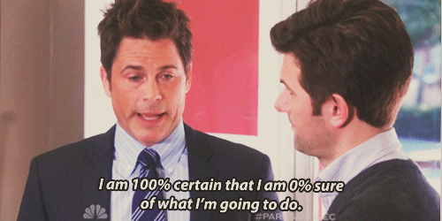
Other Reminders
Permission Slips
Email to Dr. Kerschen in 1 file
Can complete this today using our copiers
Make sure the numbers on your Context for Learning match your results in Task 3
If not, explain why (if you had absent students etc)
Review the focus of the video clips described in your content area
Collect student work

Slide 7
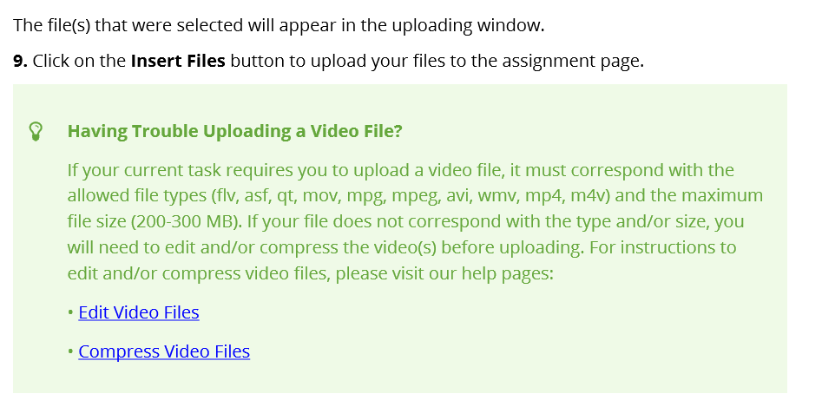
Anthology
The service formerly known as C&W
You will work through Chalk & Wire/Anthology to complete and submit your edTPA.
Upload your documents and files directly to C&W
Your files are not submitted until you transfer your portfolio from C&W to Pearson
We will register through Pearson to obtain an authorization code for this process.
C&W edTPA user guide:
Posted on our website

Slide 8
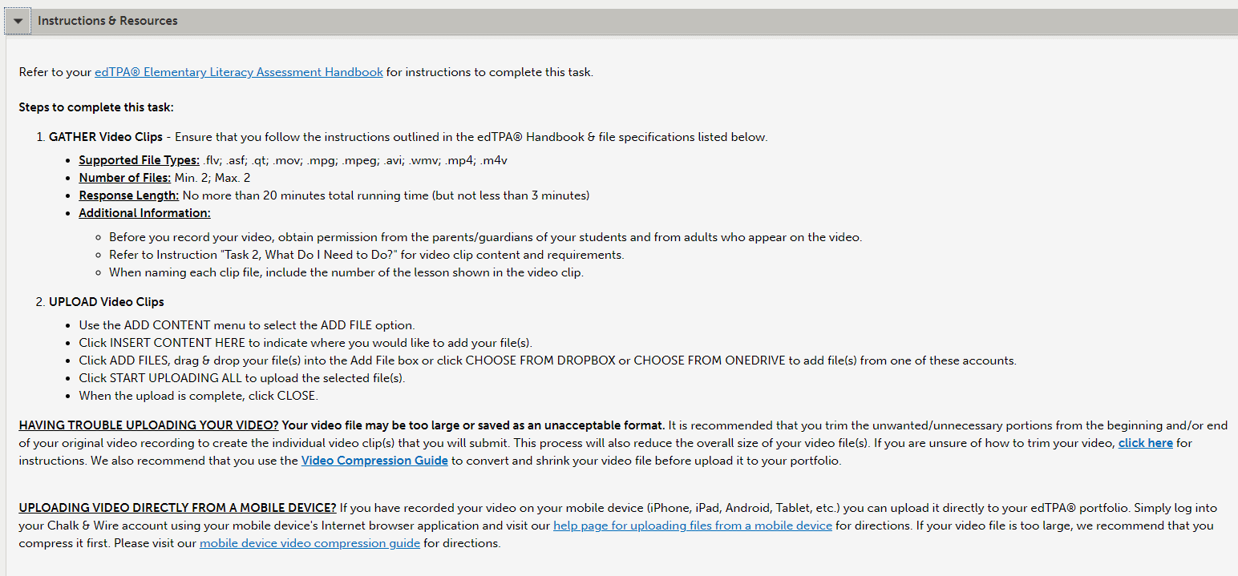
C&W – Resources – Please use!
Other resources posted on our website.
Video suggestions from C&W

Slide 9
Video Support – Compressing your video files
Make sure your video clips meet the length requirement set by your edTPA handbook
Some students have issues with the file size of the video clip when uploading to Anthology (they outline the size of the file they will accept)
If your video file size is too big to upload, there is an option to “compress” your video files, Anthology provides some options:

Slide 10
Video Support – Compressing your video files
Other resources can be found on the CUNE education website, under edTPA – Video Suggestions
One common software that has worked for students in the past for compressing their video files: Handbrake
There is a user guide posted on the CUNE education website with steps for Handbrake
Under edTPA, Video Suggestions

Slide 11
Video Support – Compressing your video files

Slide 12
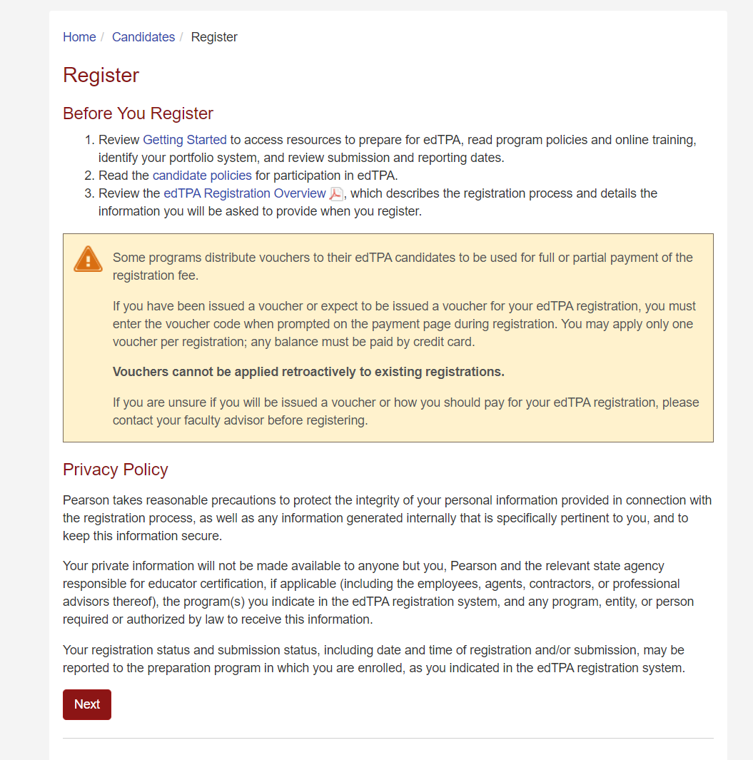
Pearson Registration
When you upload all your documents to C&W, you will then transfer your files to Pearson for scoring.
Google: Pearson edTPA Registration

Slide 13
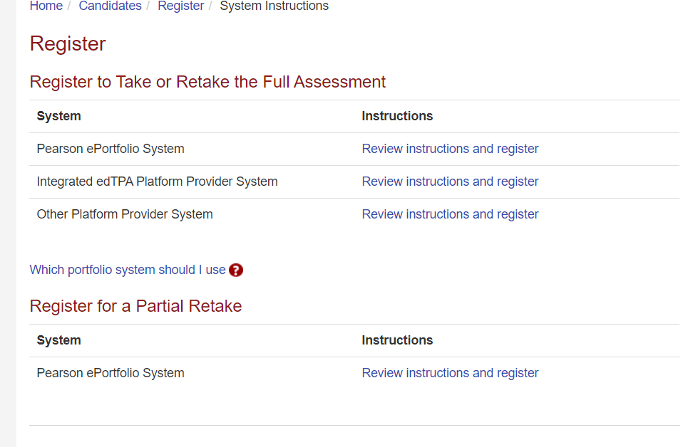
Pearson Registration
Select Integrated edTPA Platform Provider

Slide 14
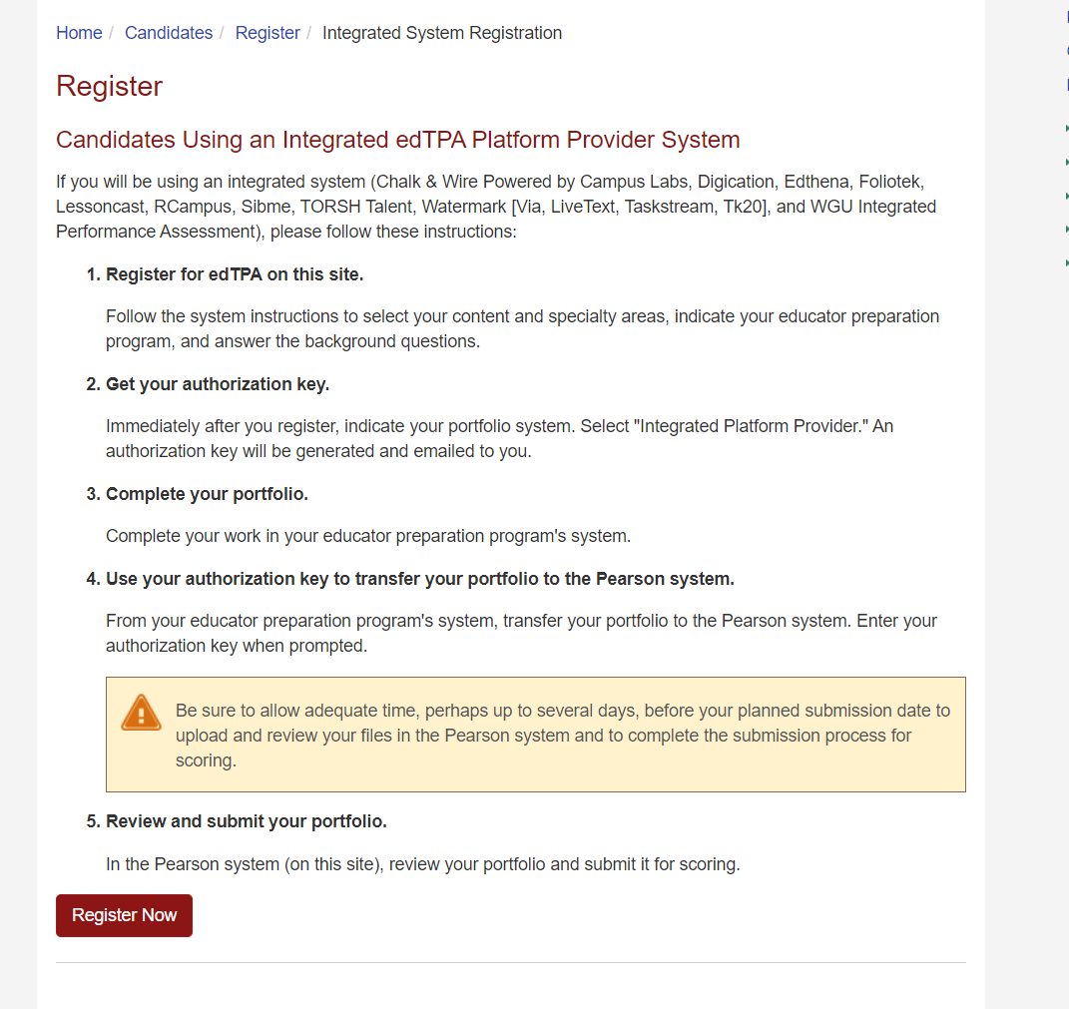
Pearson Registration

Slide 15
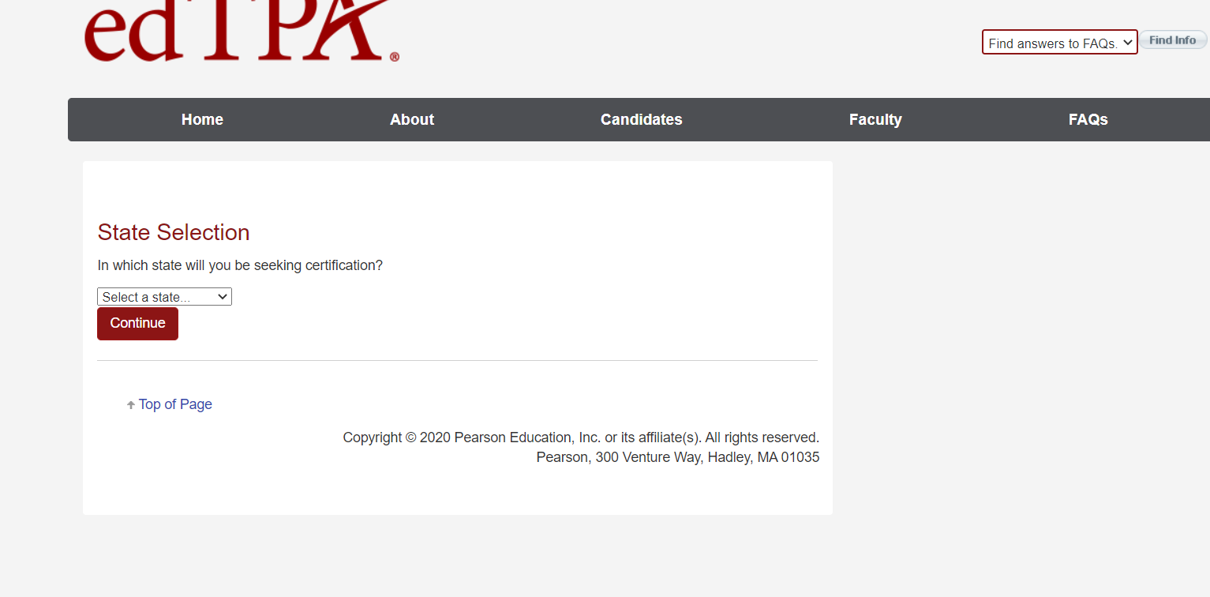
Pearson Registration

Slide 16
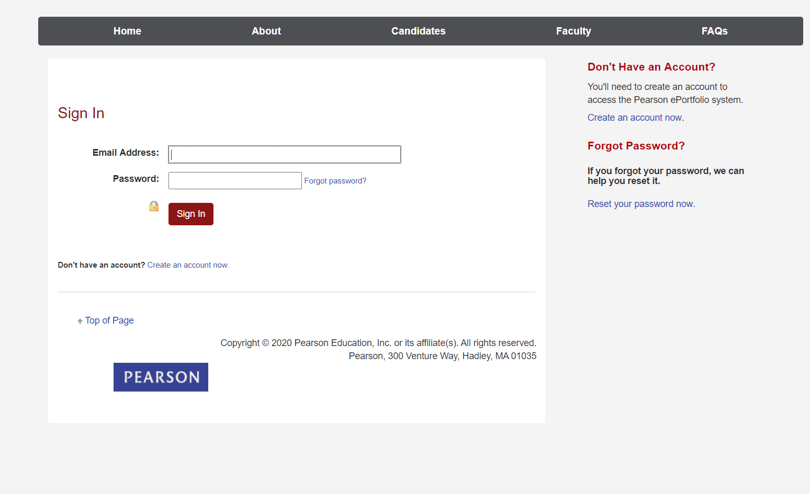
Pearson Registration
Select, “Create an account”

Slide 17
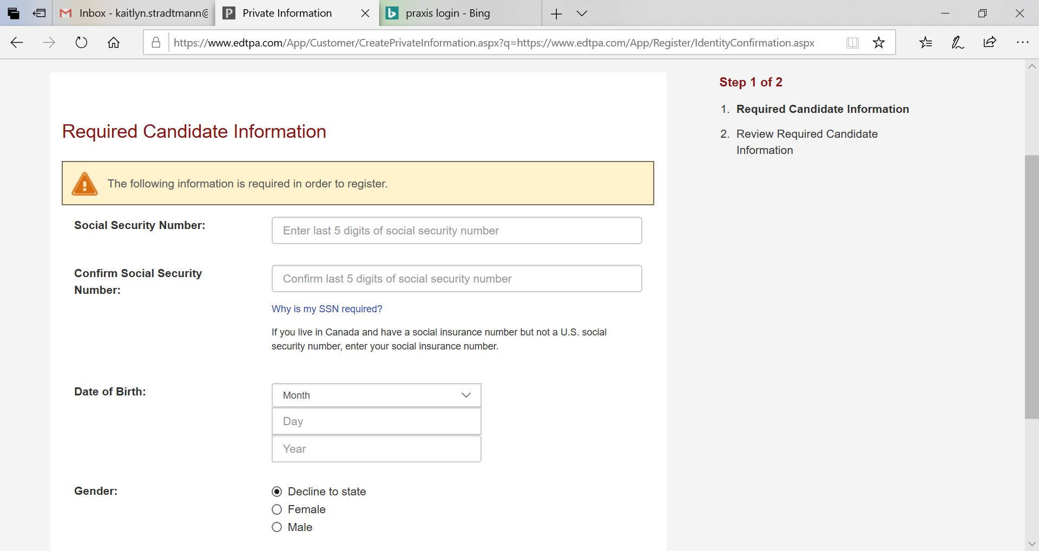
Pearson Registration
Last 5 digits only

Slide 18
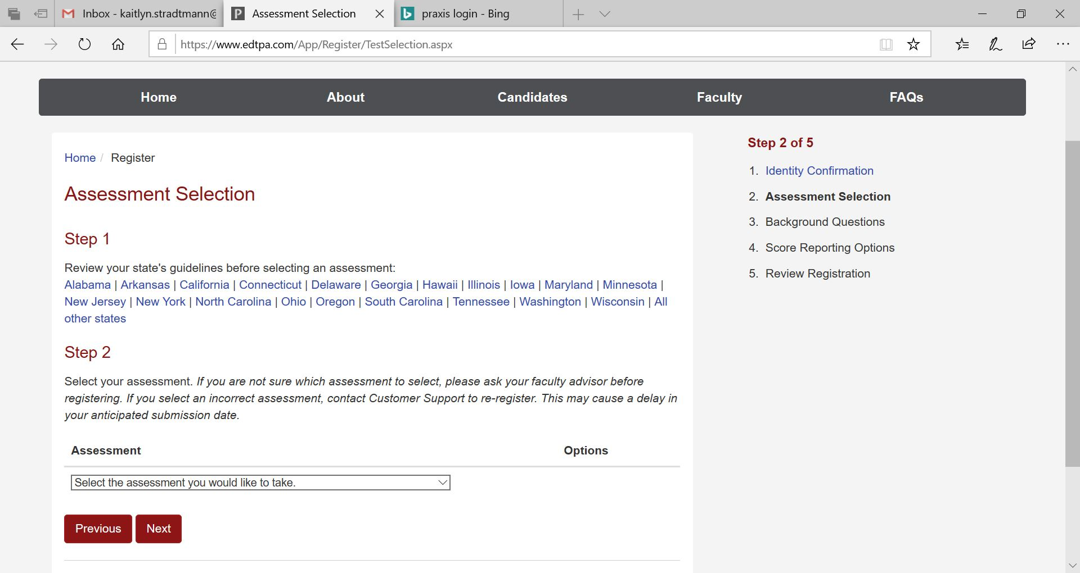
Pearson Registration
THIS MUST MATCH THE SAME PORTFOLIO SELECTED FOR C&W!

Slide 19
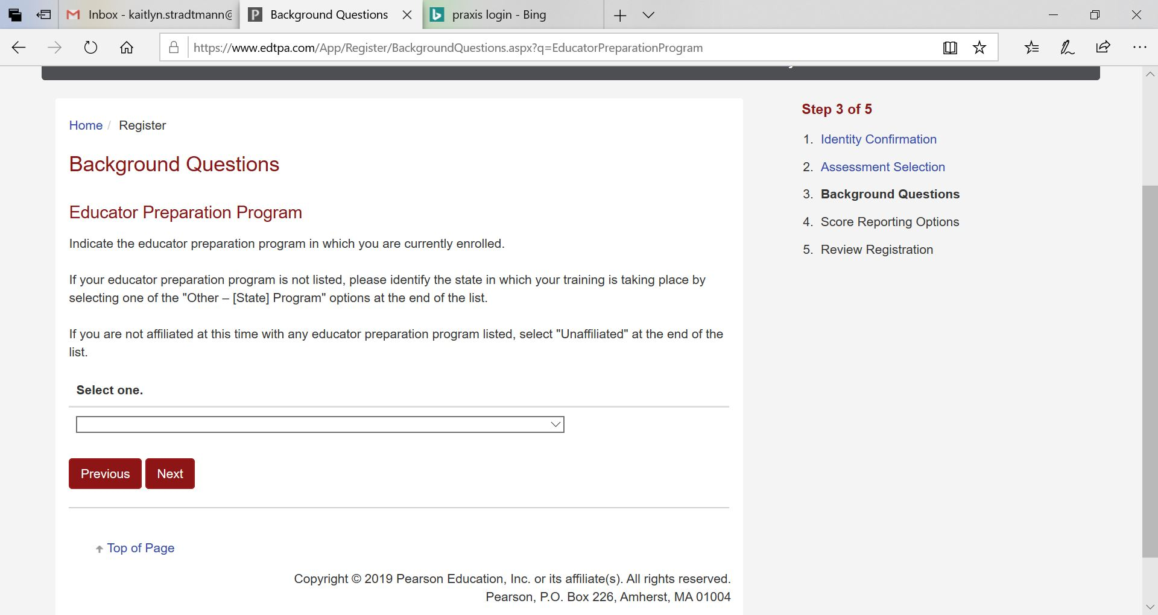
Pearson Registration

Slide 20
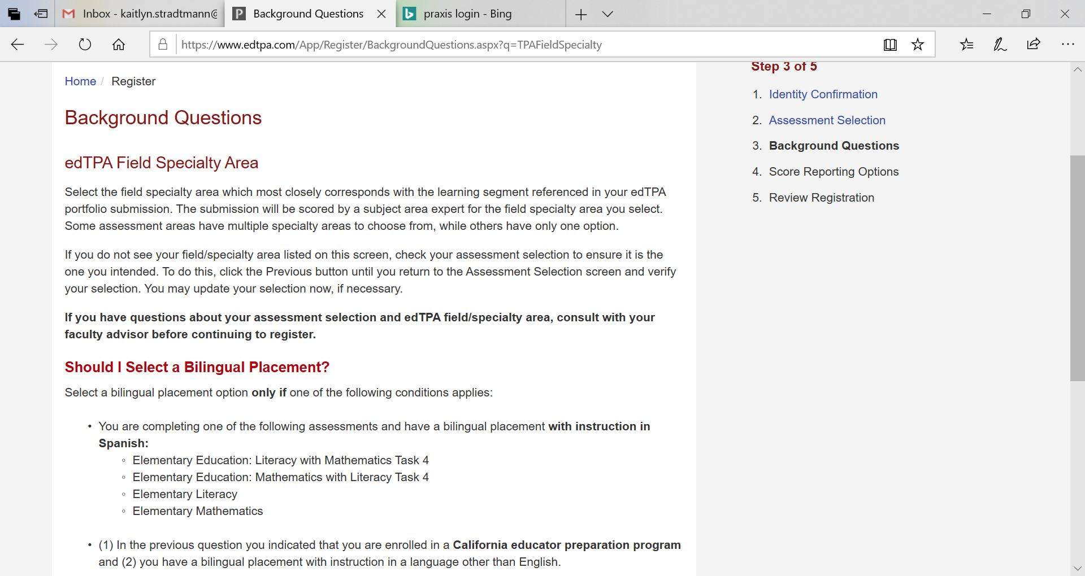
Pearson Registration

Slide 21
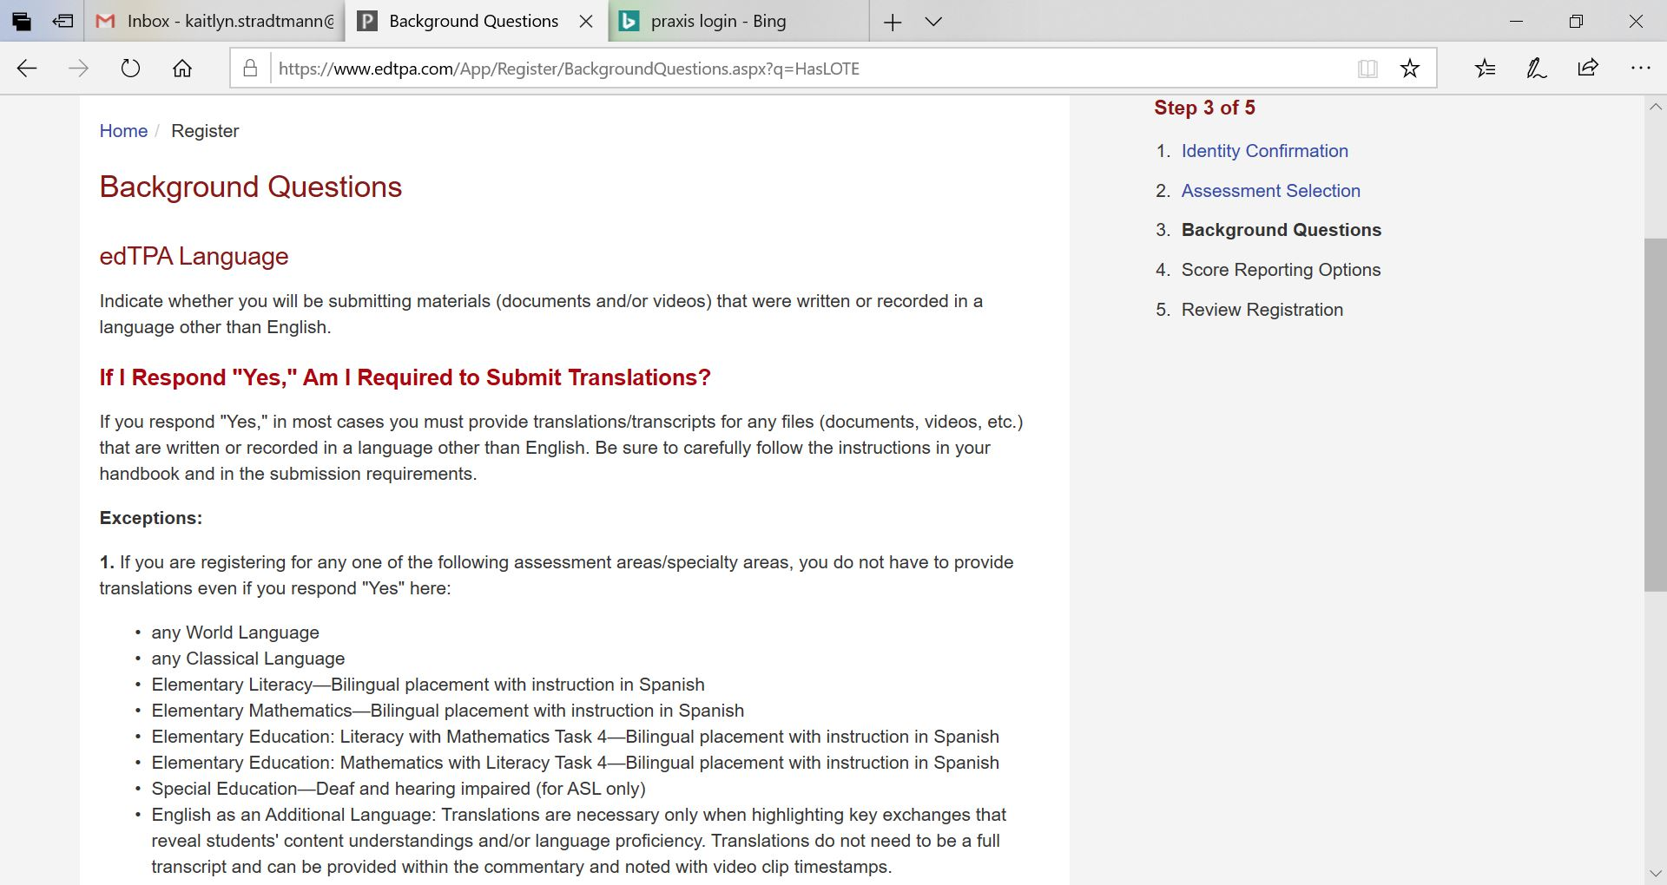
Pearson Registration

Slide 22
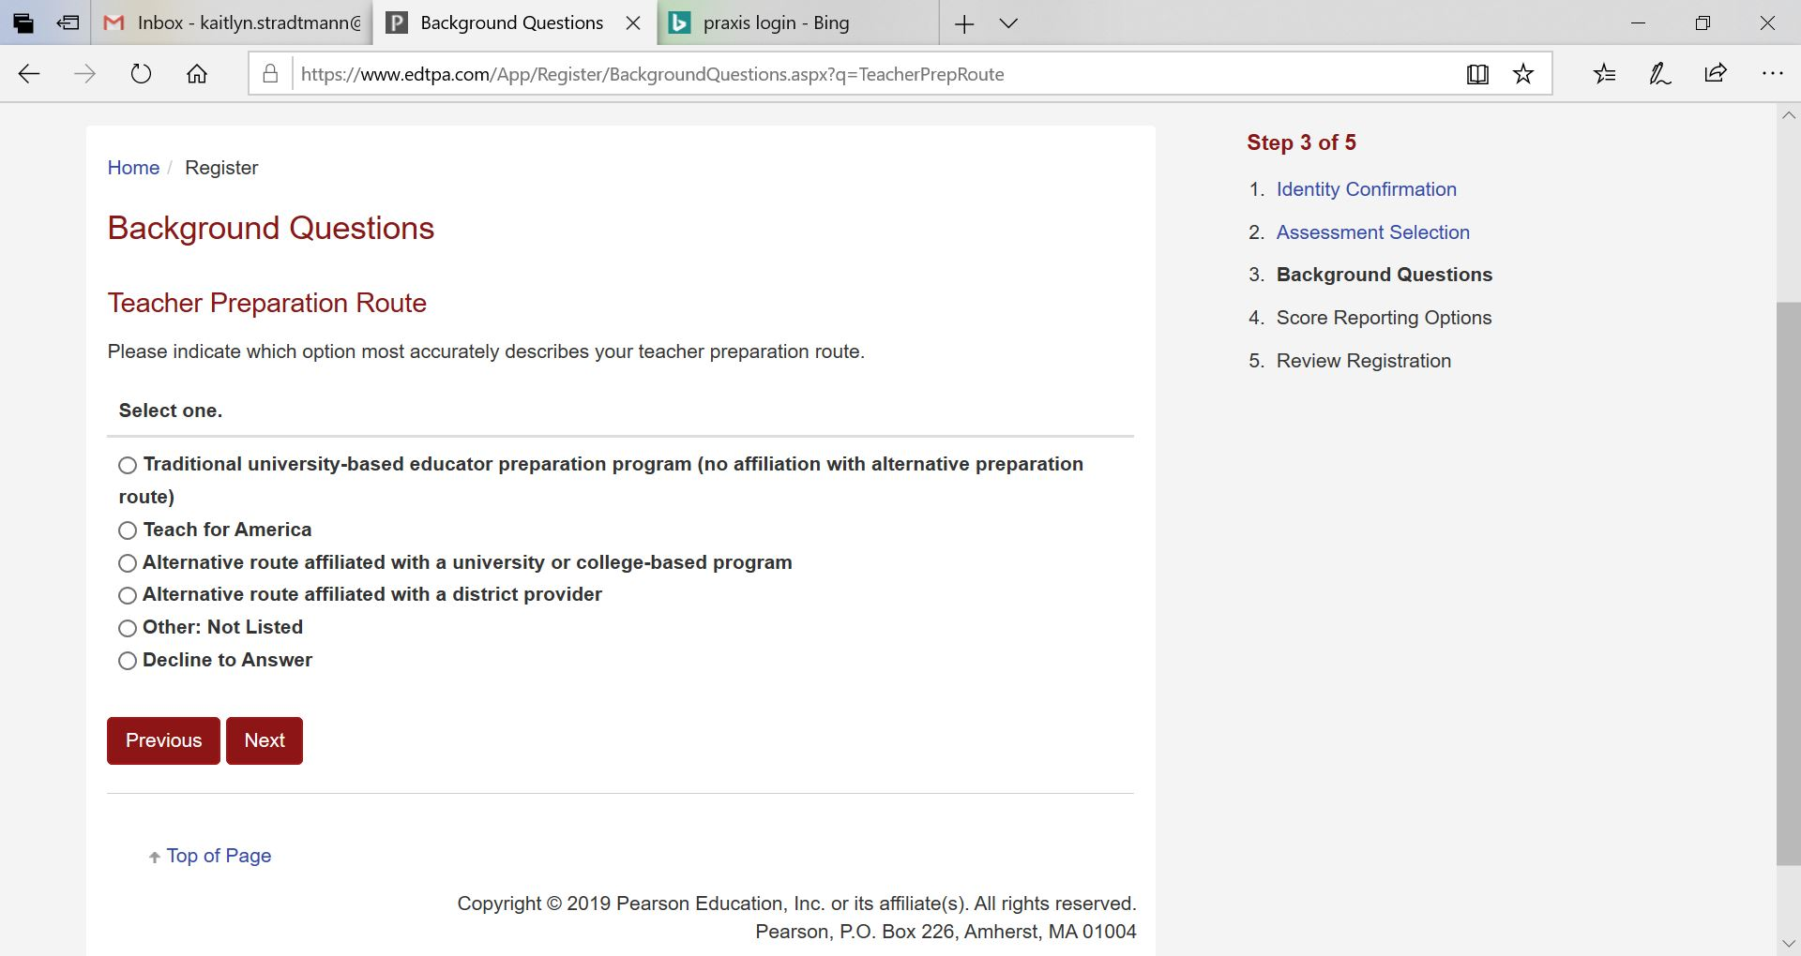
Pearson Registration

Slide 23
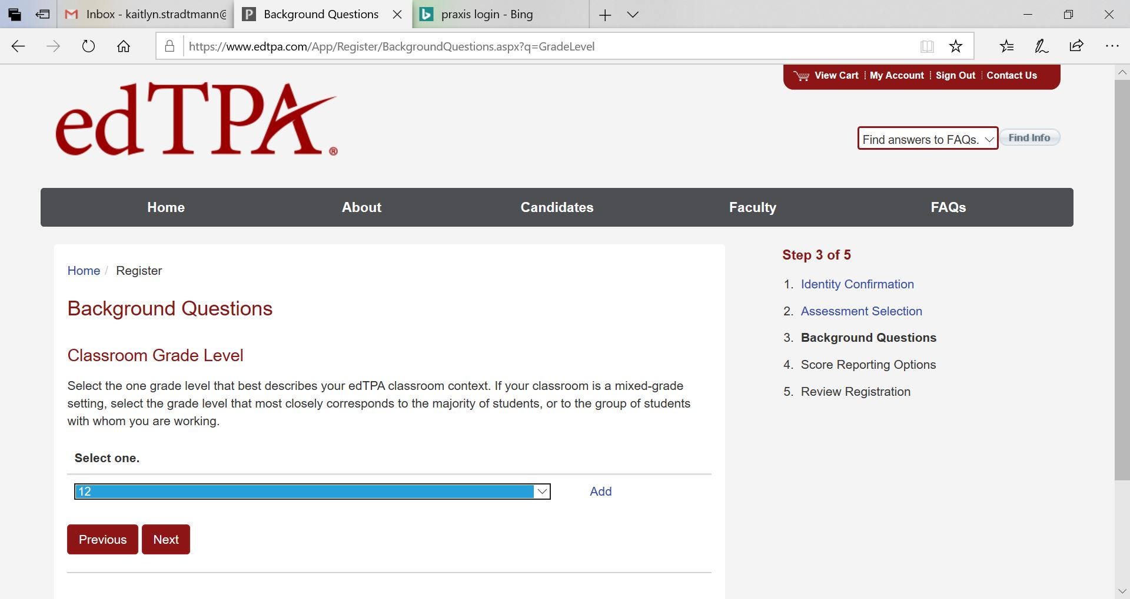
Pearson Registration

Slide 24
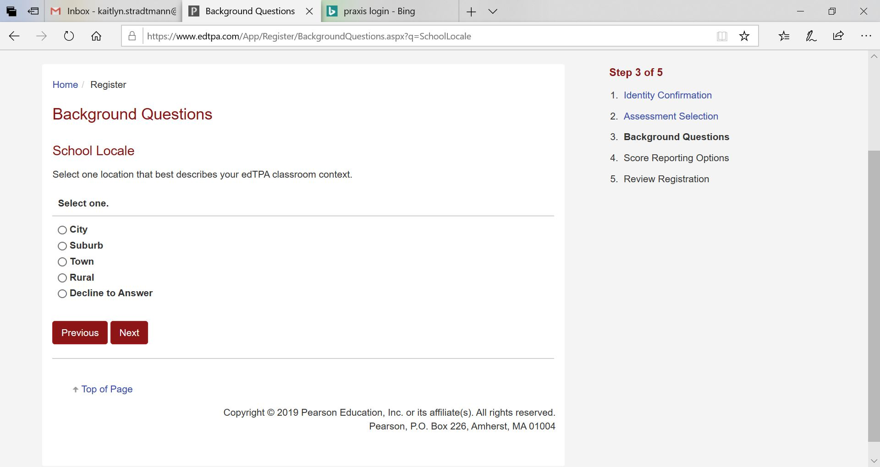
Pearson Registration
Match with your context for learning

Slide 25
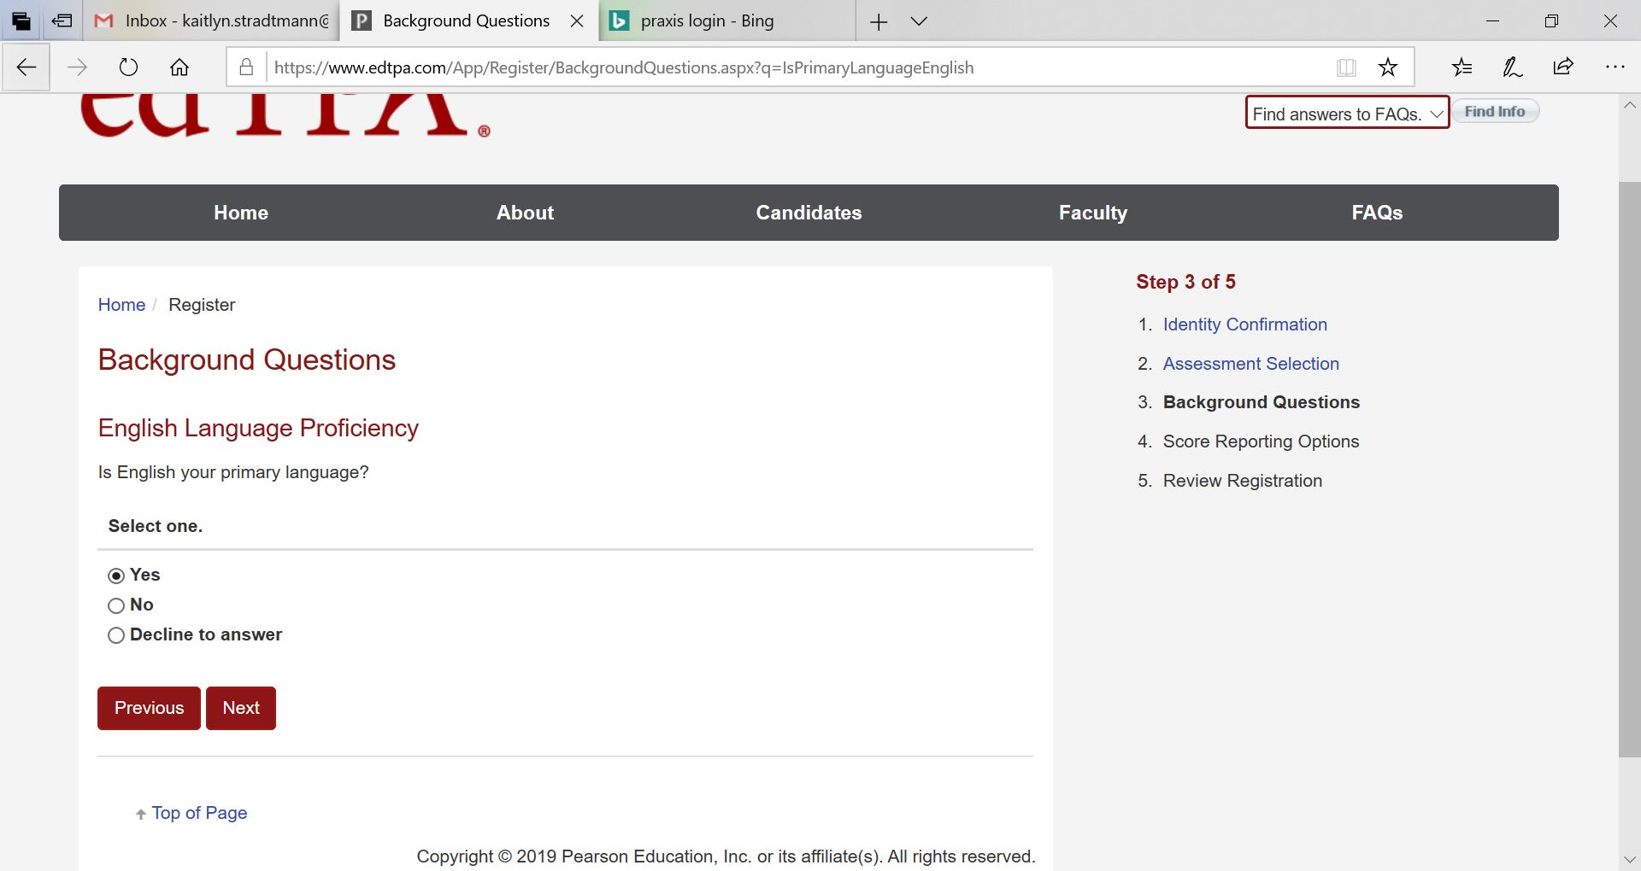
Pearson Registration

Slide 26
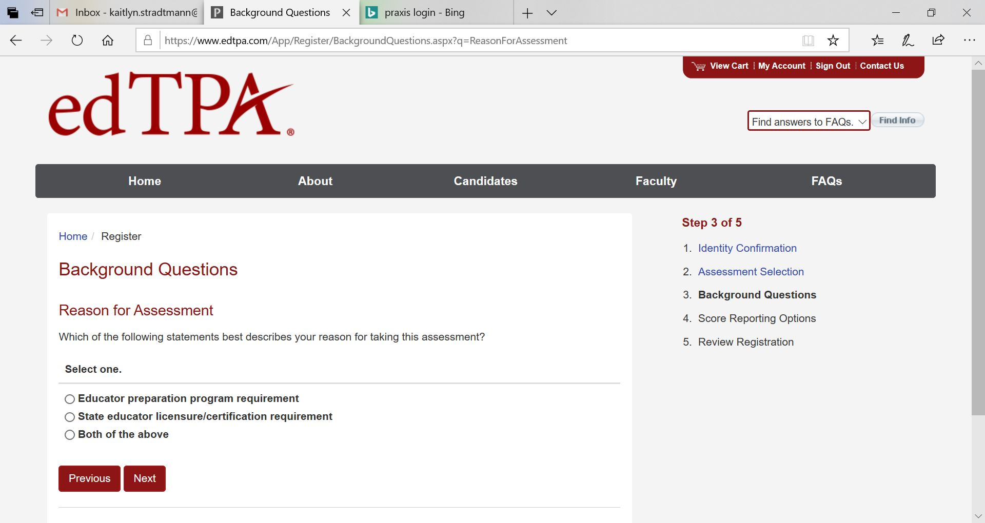
Pearson Registration
Select, Educator Preparation Program Requirement

Slide 27
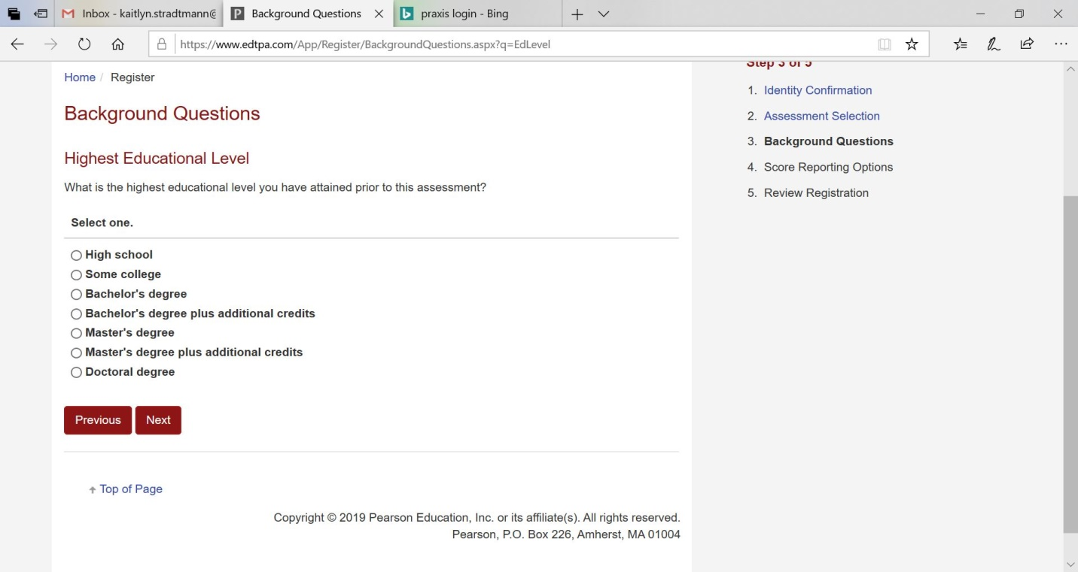
Pearson Registration

Slide 28
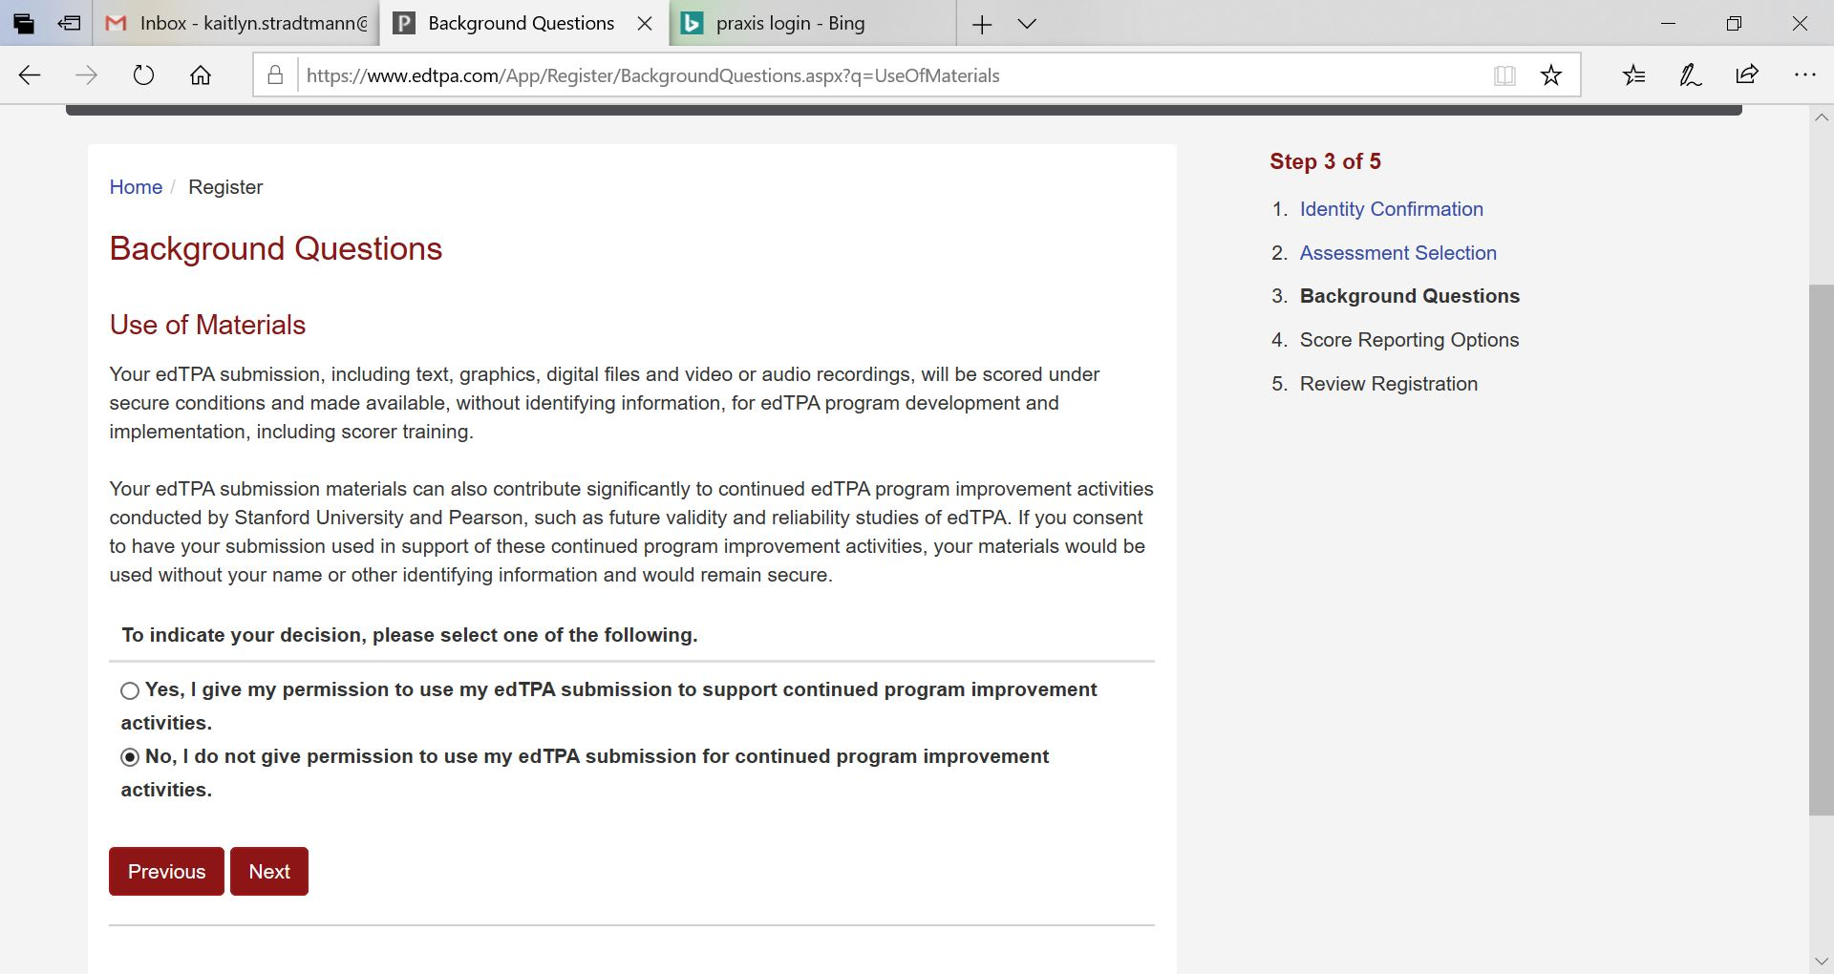
Pearson Registration
PLEASE SELECT NO

Slide 29
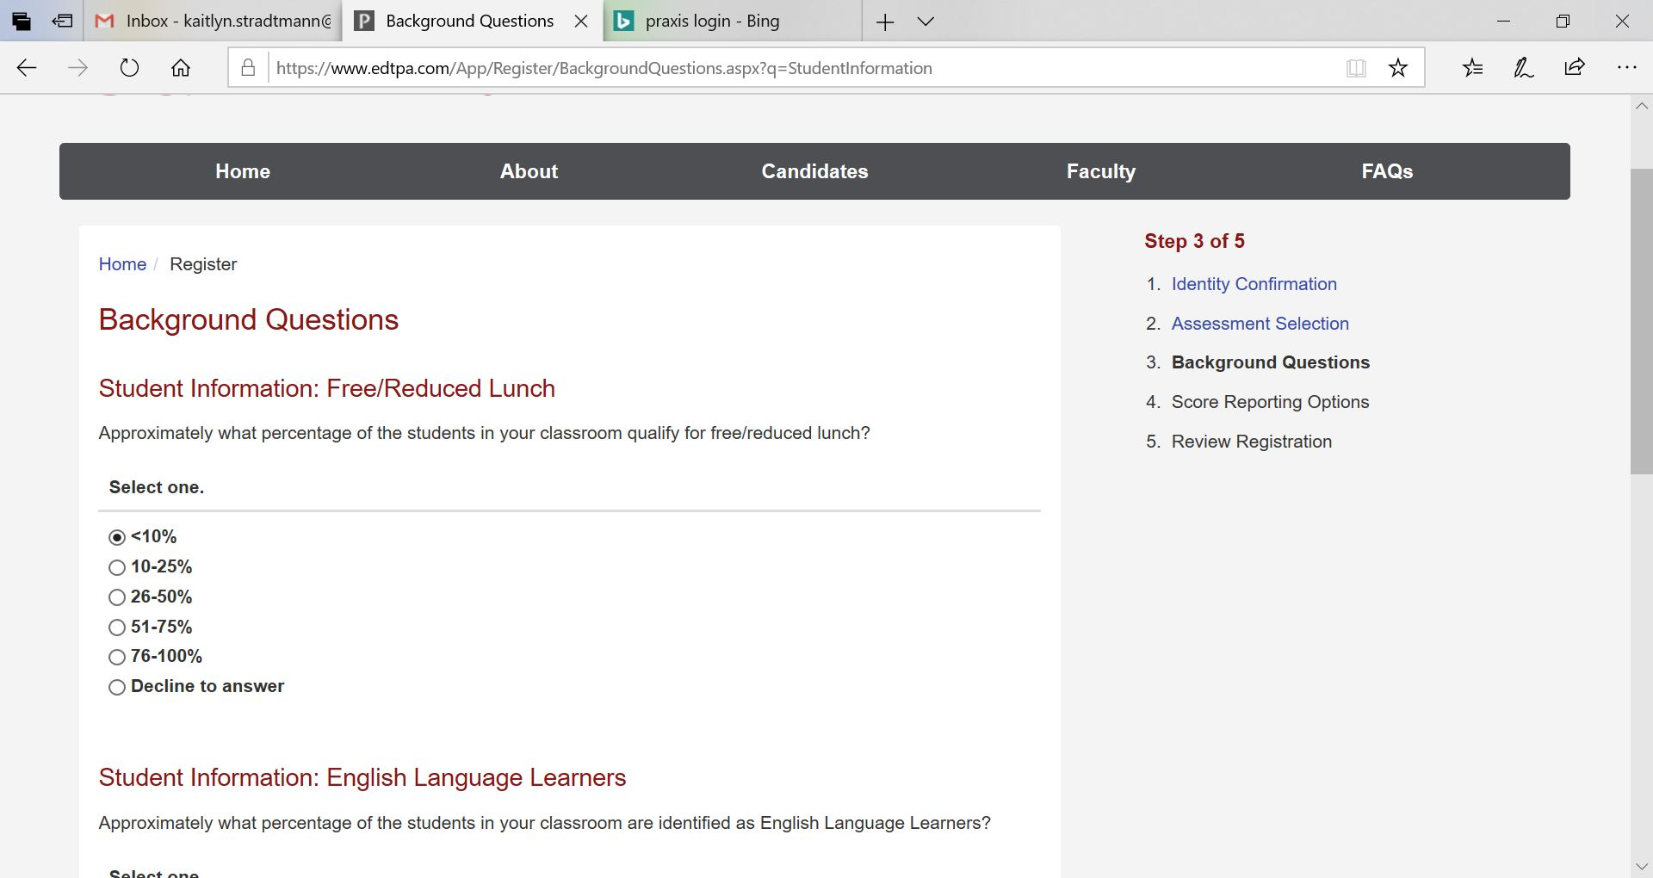
Pearson Registration

Slide 30
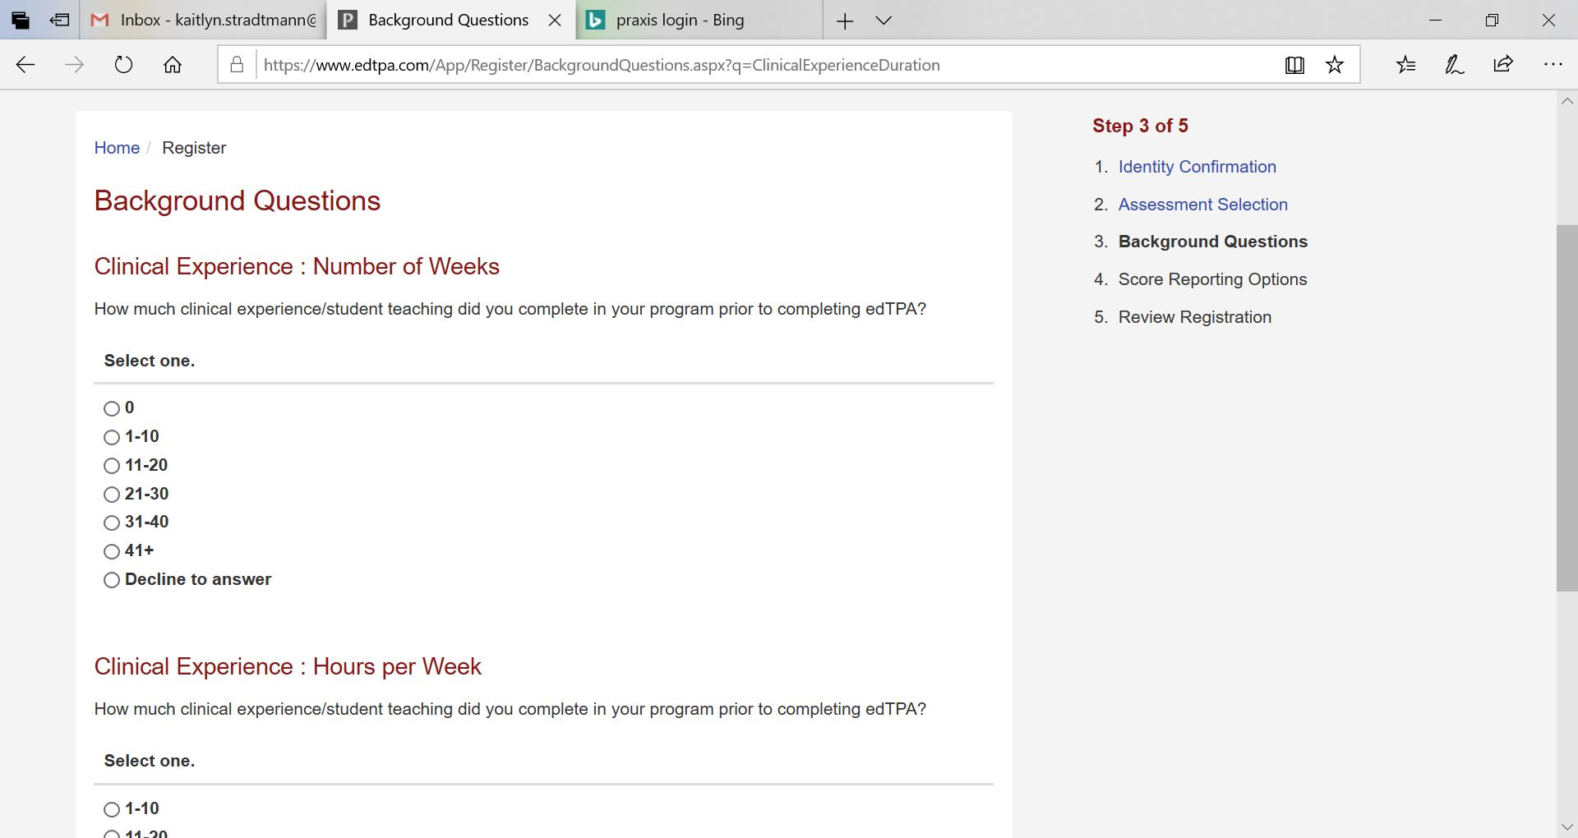
Pearson Registration

Slide 31
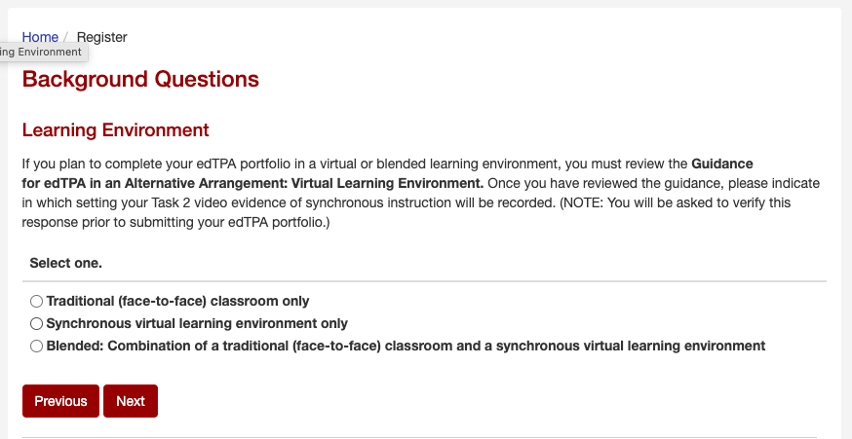
Pearson Registration

Slide 32
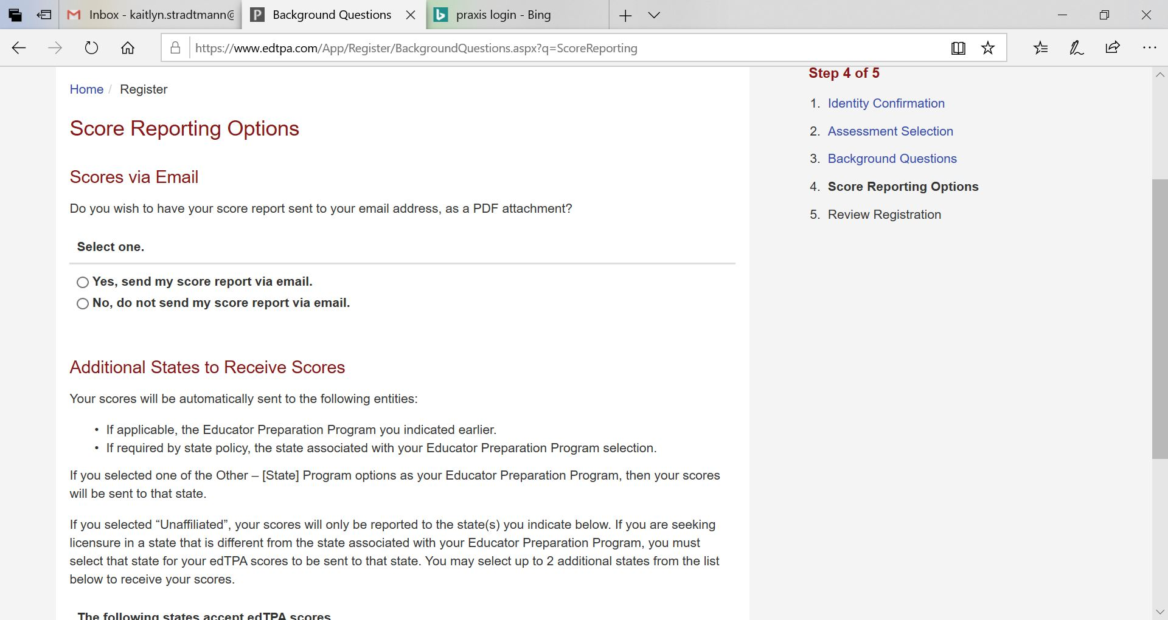
Pearson Registration

Slide 33
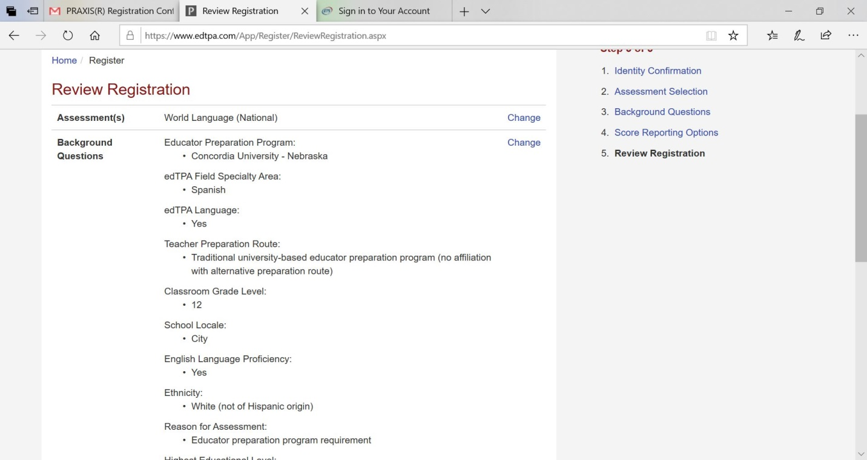
Pearson Registration

Slide 34
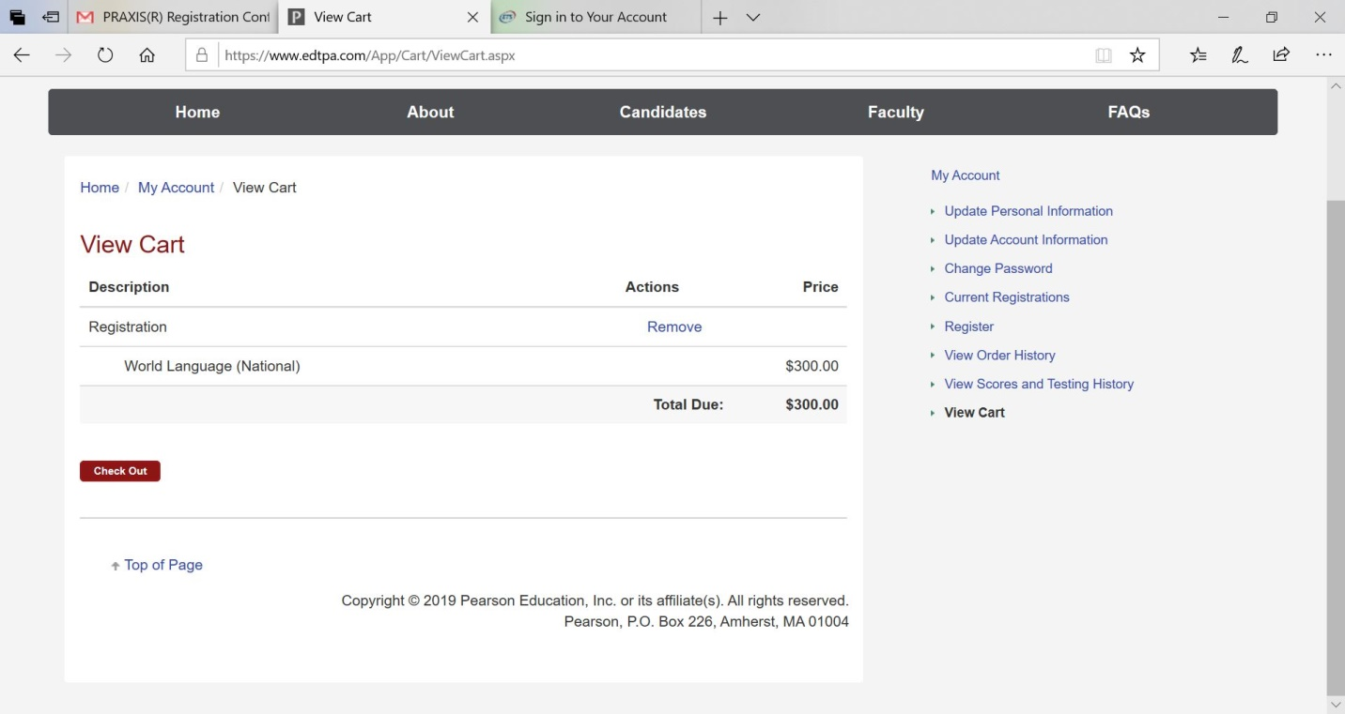
Pearson Registration

Slide 35
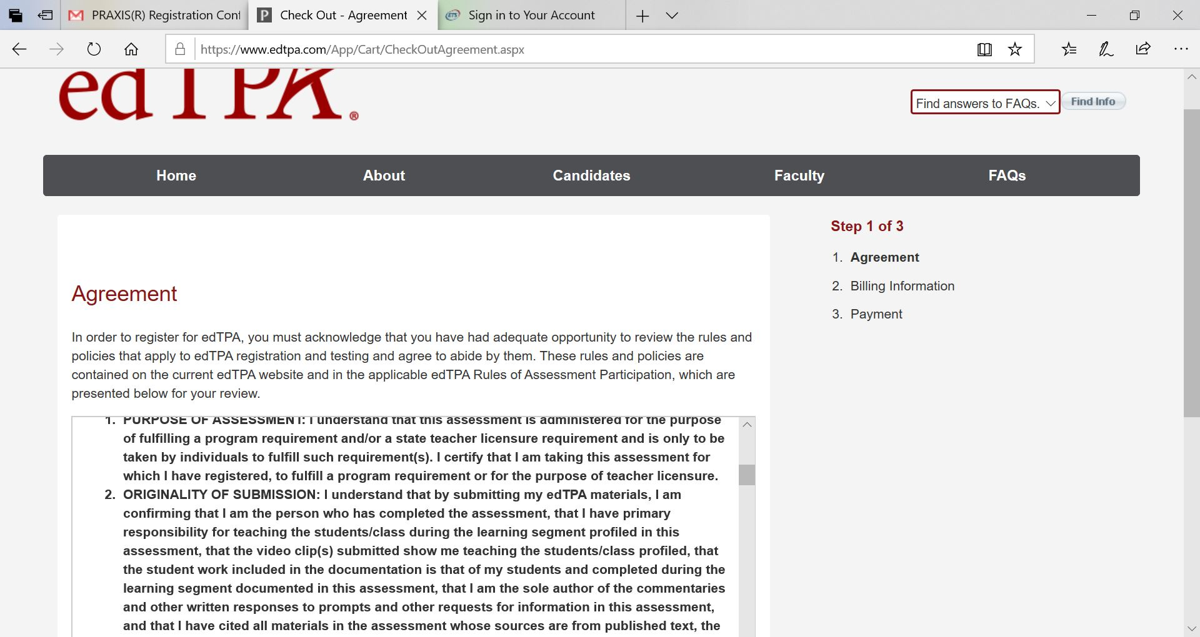
Pearson Registration

Slide 36
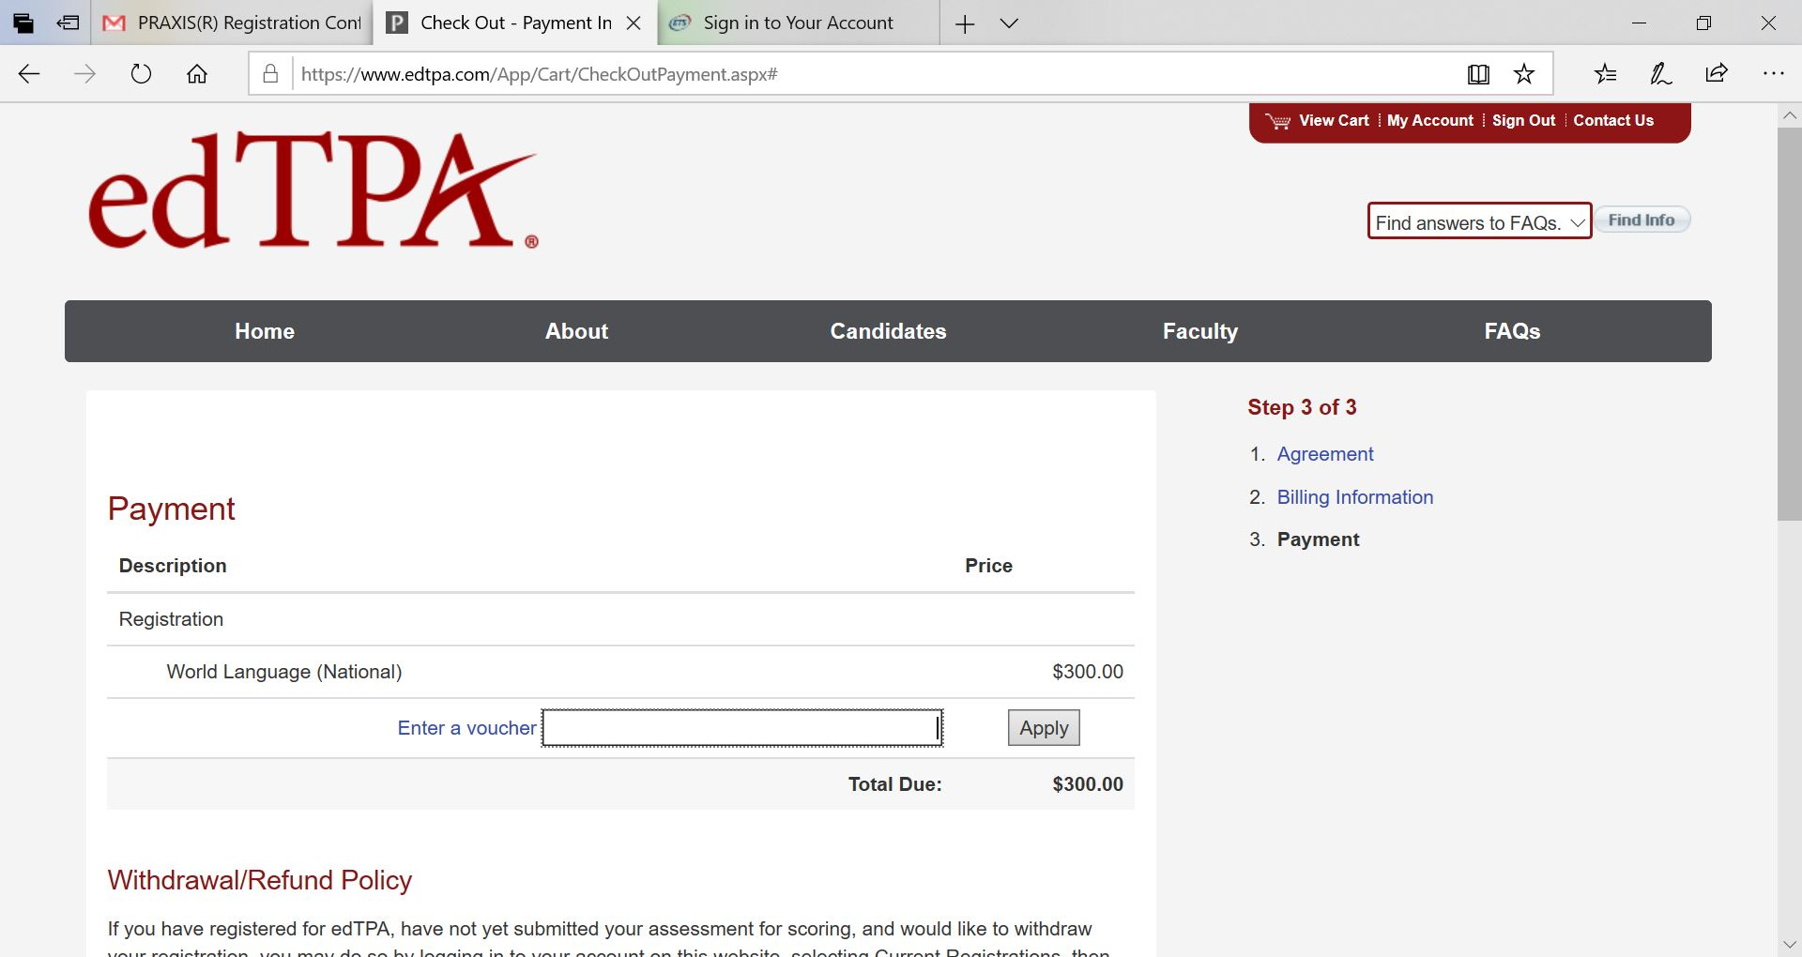
Pearson Registration
Enter your edTPA voucher code

Slide 37
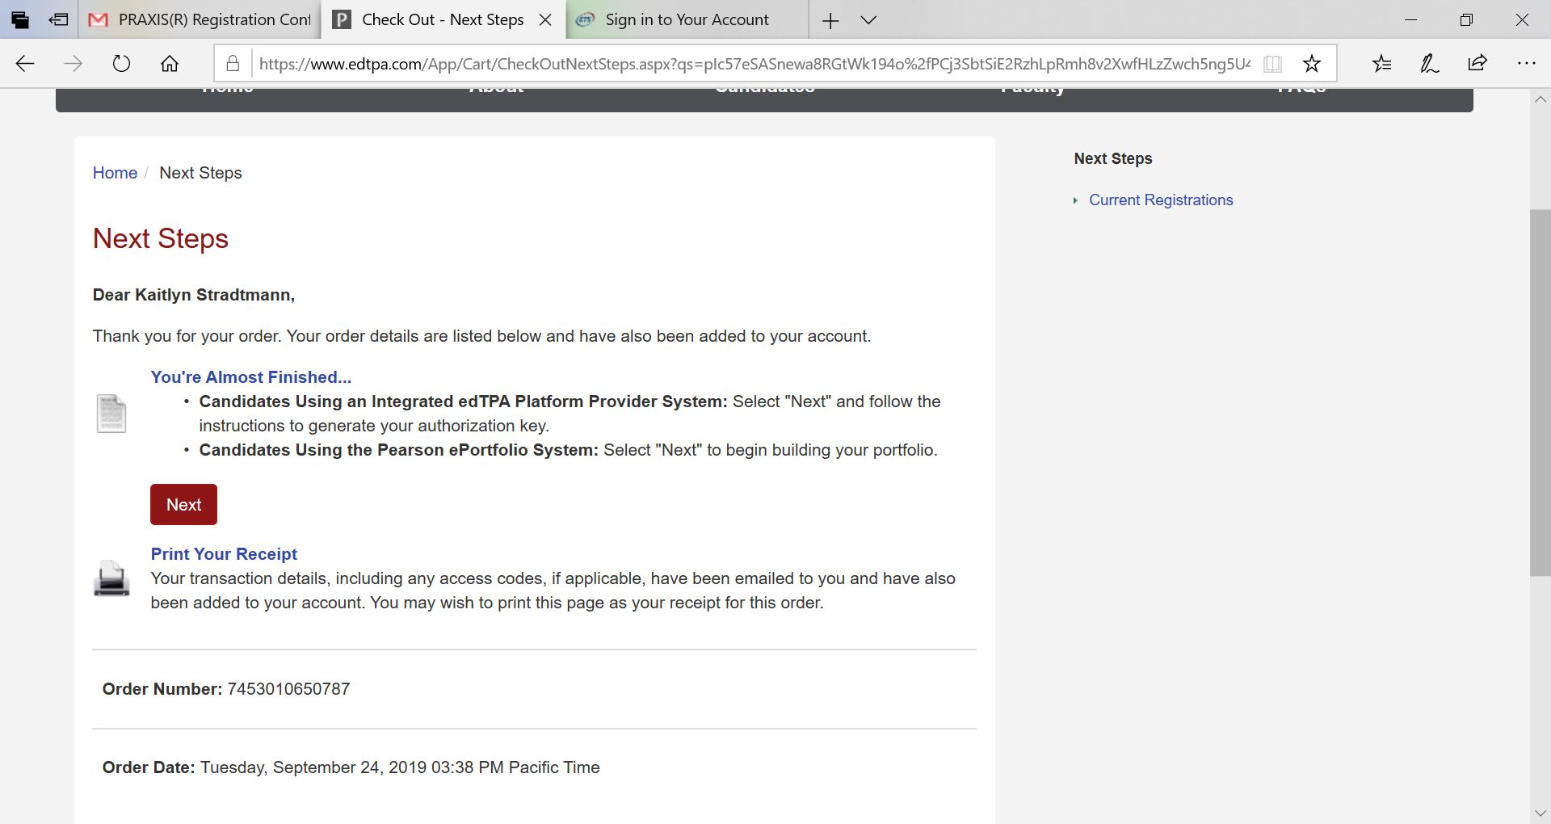
Pearson Registration

Slide 38
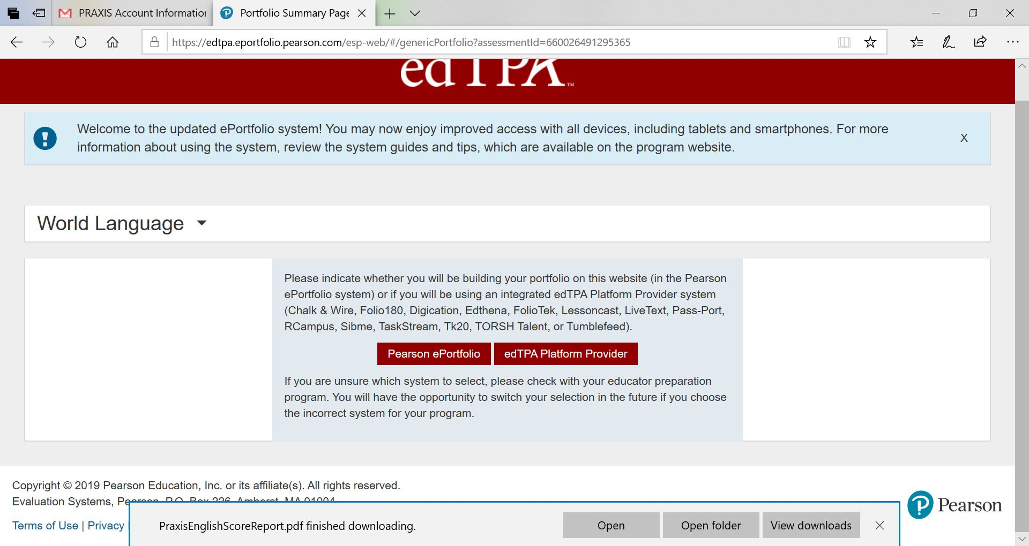
Pearson Registration
Select edTPA Platform Provider
Next, they will give you an authorization key you will need to enter in Anthology/C&W

Slide 39
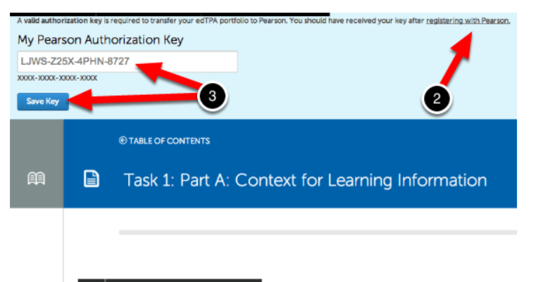
Authorization Key
You must enter the authorization key you received after registering on the Pearson website.
Select any section in your edTPA portfolio and you will be prompted to enter your authorization key.

Slide 40
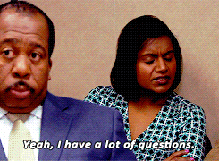
Pearson Registration
I will be going over details on how to transfer your portfolio from C&W to Pearson during seminars on February 21st (we will have combined seminars that day).
If you want to submit your edTPA before then, let me know.
Please view the Chalk & Wire user guide for assistance

Slide 41
Timeline Review
*Saturday, February 17th: Optional Writing Day: THOM 111 reserved 9:00 – 12:00
*Wednesday, February 21st: Visit seminars for questions and transferring your edTPA for scoring
*Sunday, February 25th: Optional writing day: THOM 111 and 113 reserved from 3:00 – 6:00 PM

Slide 42
Timeline Review
Week of February 26th – Submit edTPA to Pearson through Chalk & Wire (See instructions on the CUNE Education Website)
Submit electronic copy of permission slips to Dr. Kerschen (Keith.Kerschen@cune.edu) This can be done prior to this week.
edTPA SUBMISSION (including emailing permission slips to Dr. Kerschen) DUE DATE – Tuesday, February 27th @ midnight. You cannot proceed to Student Teaching 2 if you have not submitted your edTPA for scoring.

Slide 43
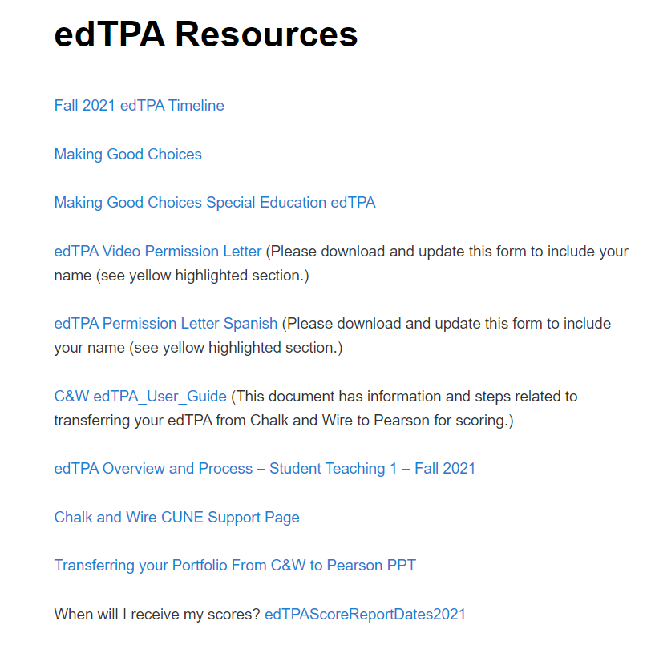
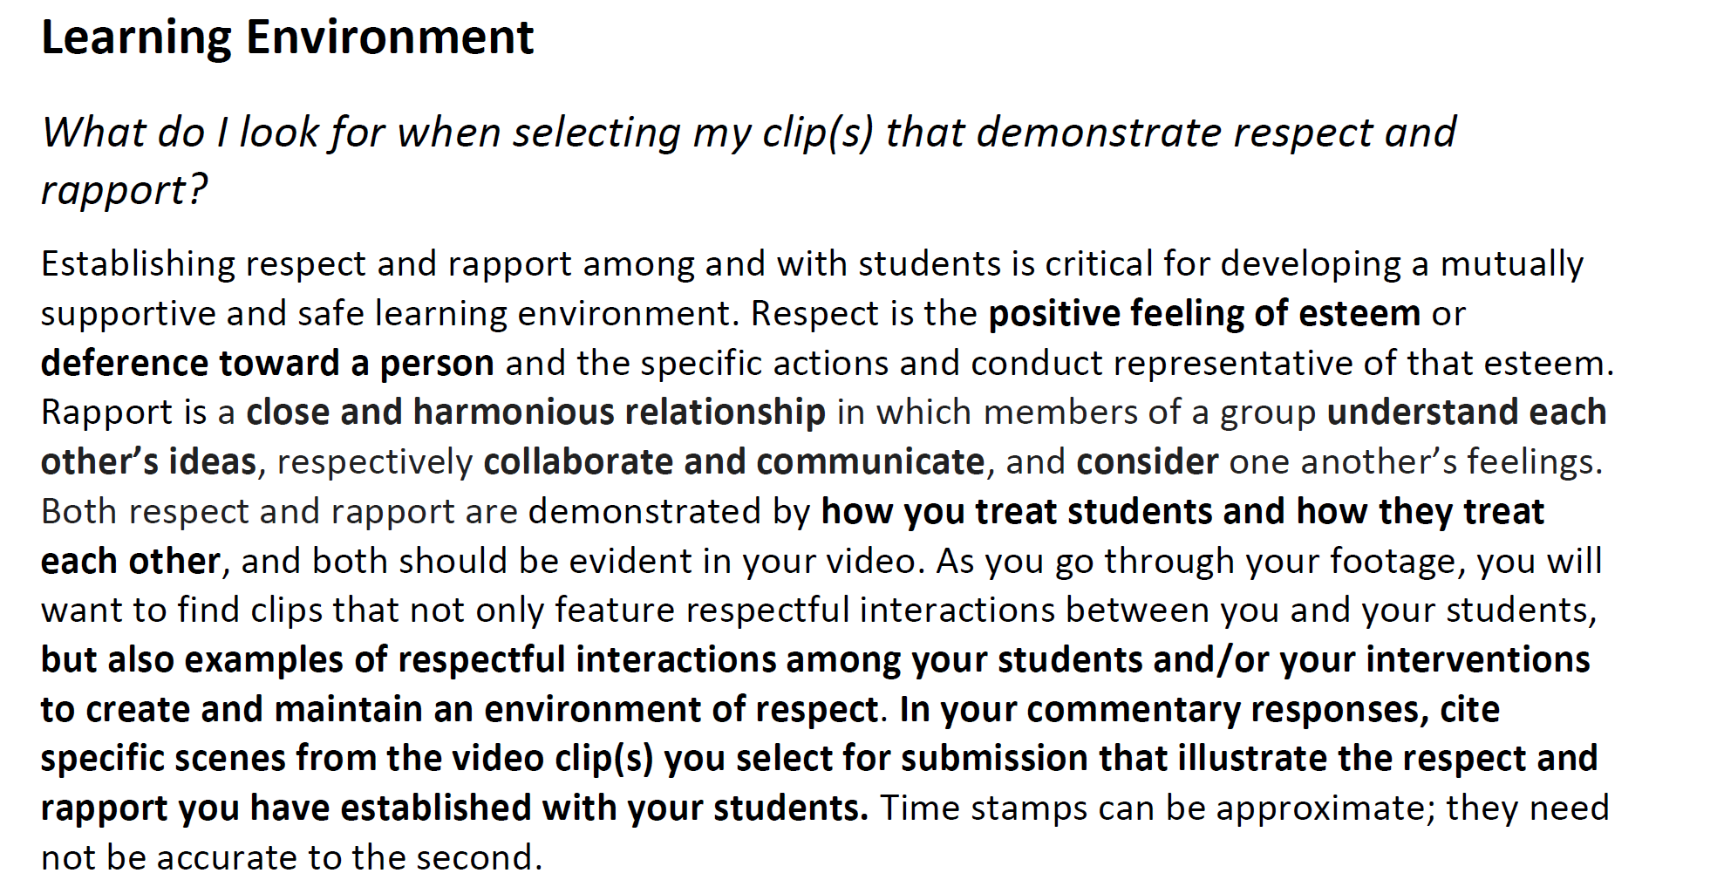
Additional Resources…
Making Good Choices Document

Slide 44
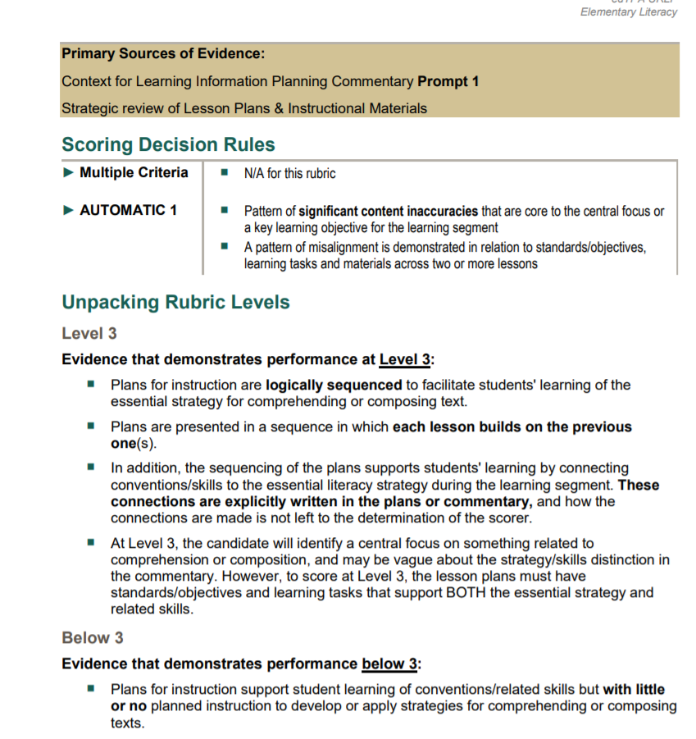
Additional Resources…
Rubric Level Progressions

Slide 45
Video Reminders
Permission slips needed for students featured in the clips you submit to the edTPA.
If a non-permission slip student appears in your video, just don’t use that specific clip!
Try avoiding identifiable information (first and last names together, name of the school, etc).
Make sure you can hear you and the students in your clip. Might need to include a transcript if necessary.
You need to be seen in the clips

Slide 46
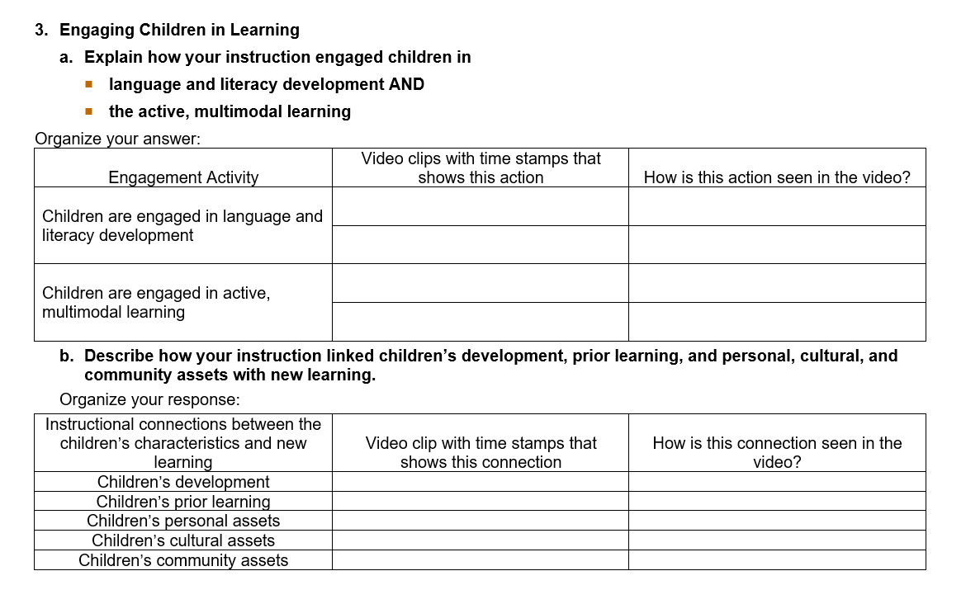
Prompt Writing Support
Thinking Organizers and Rubric Progression guides posted on our website
Example from Early Childhood
Your commentary should still be in a narrative form, but the thinking organizers can help you get started and organize your responses.

Slide 47
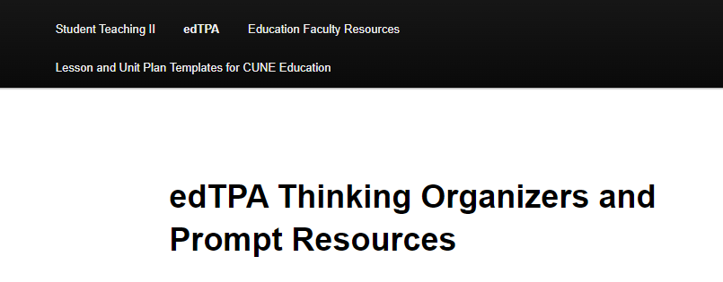
Prompt Writing Support
Rubric Progression Documents: Break down rubrics and expectations
Each content handbook has a Rubric Progression Document
Under the edTPA link on our website, “edTPA Thinking Organizers and Prompt Resources.”

Slide 48
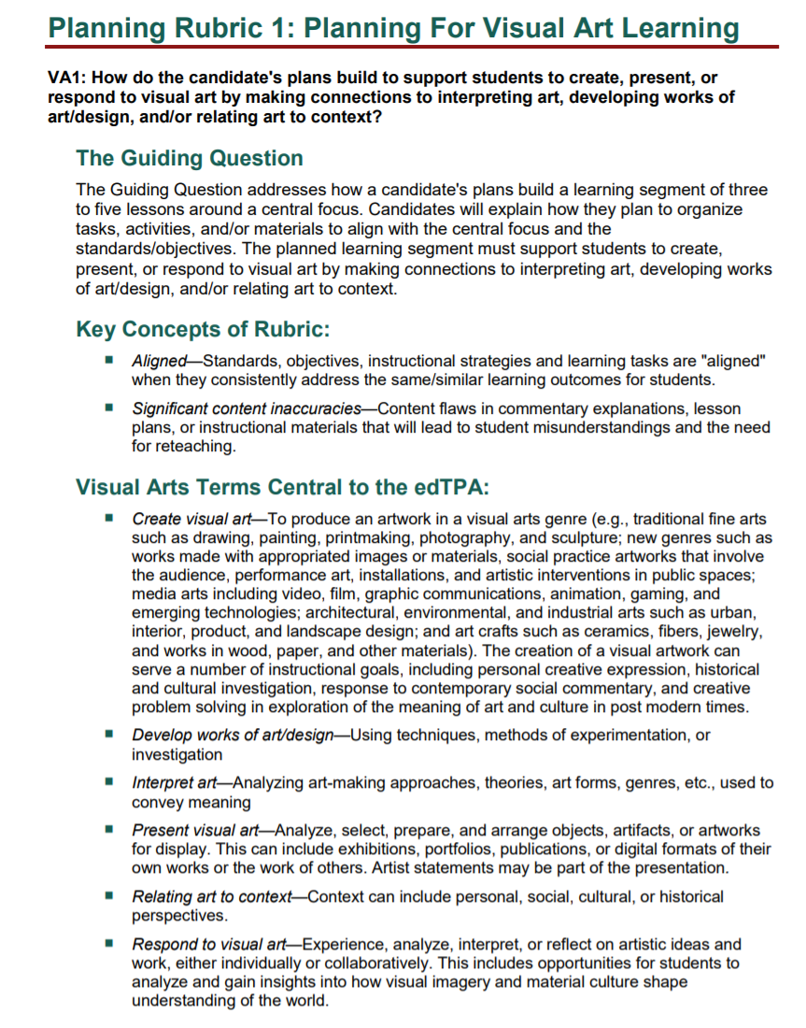
Prompt Writing Support

Slide 49
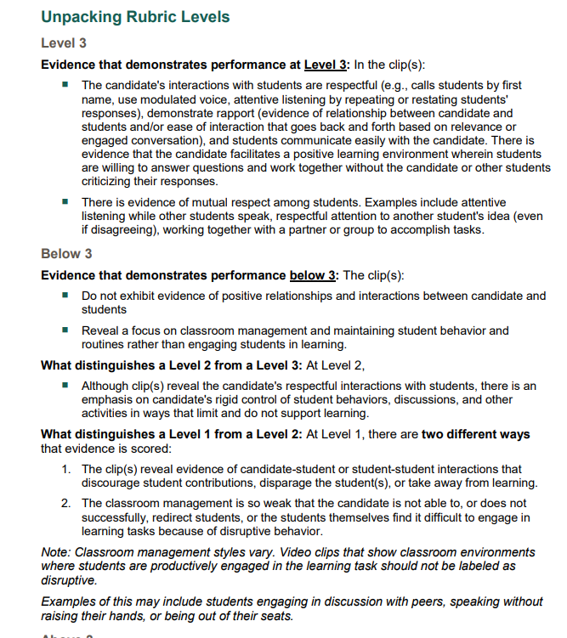
Prompt Writing Support

Slide 50
Prompt Writing Support

Slide 51
Prompt Writing Support

Slide 52
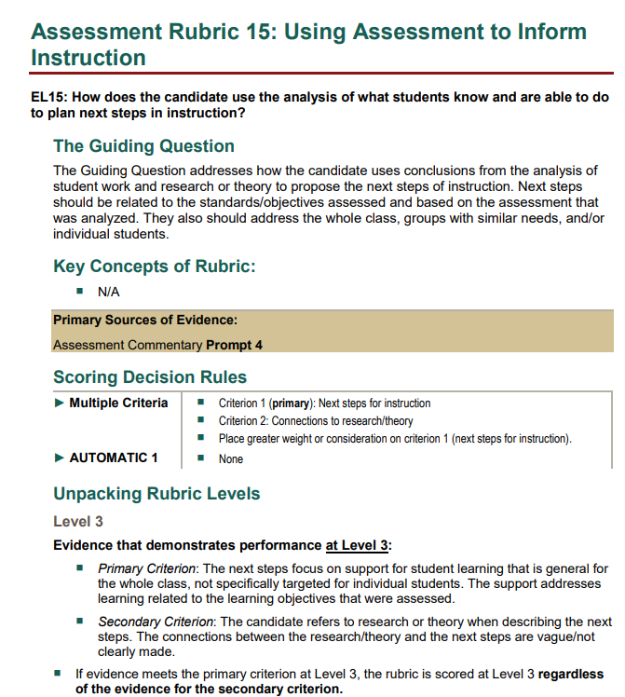
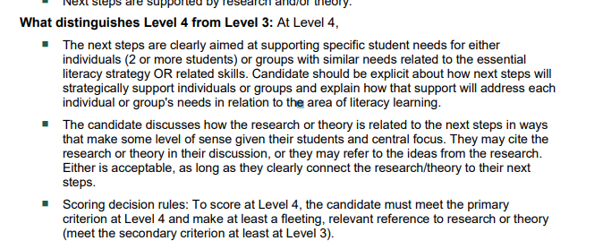
Prompt Writing Support

Slide 53
How to Write for edTPA
Decompose the Prompt
Structure the Response
Use the Words of the Prompt
Use the Rubric
Reference the glossary!

Slide 54
Referencing Video Evidence
1.Which lesson or lessons are shown in the video clips? Identify the lesson(s) by lesson plan number.
Sentence starters:
“The lesson shown in the clips is Lesson #_______”
OR
“The lesson shown in Clip 1 is Lesson _______ and the lesson shown in Clip 2 is Lesson ________.”
2.Promoting a Positive Learning Environment
a. How did you demonstrate mutual respect for, rapport with, and responsiveness to students with varied needs and backgrounds, and challenge students to engage in learning?
Organize your answer:
Characteristic of Positive Learning Environment | Video segment(s) with time stamps that demonstrates this characteristic | How does this clip demonstrate this characteristic?
Mutual respect for students
Rapport with students
Responsiveness to students’ needs
Challenging students to engage in learning

Slide 55
Referencing Video Evidence
Use the language of the prompt!
[ I demonstrated mutual respect for, rapport with, and responsiveness to students with varied needs and backgrounds many times and at several points of instruction. Marzano (2000) states that “incorporating visuals, images… to reinforce concepts and vocabulary” is an important instructional strategy along with “using questions, cues, and advanced organizers to help students tap into their background knowledge to make sense of information”. I incorporate these into my teaching during clip 1 Lesson 1 to engage students, increase responsiveness, and scaffold student learning while working towards meeting the learning targets and central focus for the learning segment. In clip 1 Lesson 1, I demonstrate mutual respect, rapport, and responsiveness to students my giving them visuals and images, and advanced organizers to help students make sense of information. I also develop and enhance meaning of inference, schema, and evidence through the use of those visuals. In clip 1 I also promote a positive environment by bringing up background knowledge that students may have and relating their childhood to the learning today. I allow students to share if they watched Blue’s Clues as a kid (Clip 1 at 3:26-3:40) because it expounds on both their background knowledge, sets up a rapport of childhood memories being important to the learning today, and it provides students a quirky piece of information to remember that “clue” as in “Blue’s Clues” is the definition for evidence”. I challenge students to engage in learning by doing random call and when I ask students to share inferences that can be created by looking at the poster of Kermit the Frog on the wall (at this time). All of the observing of material object that students can touch and the posters has very much appealed to my visual and kinesthetic learners. I have also had students orally provide their inferences and modeled by own in order to engage my auditory leaners. In clip 3 Lesson 3, I have students rate their understanding level of creating text inferences using a rating on their thumbs. Students know that I care about their learning and understanding thus, I ask them if what I am saying makes sense and is understandable. By telling my students I care about their learning, they become unafraid to ask questions and are willing to share their confusions.]
Reference video evidence!

Slide 56
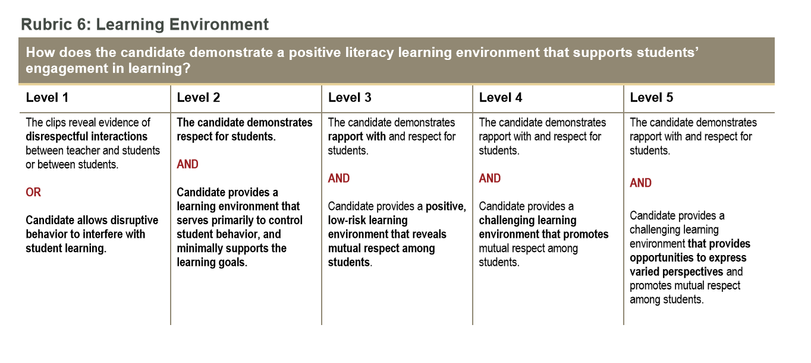
Referencing Video Evidence

Slide 57
Referencing Video Evidence
Deepening Student Learning during Instruction
Refer to examples from the video clips in your explanations.
a. Explain how you elicited and built on student responses to promote thinking and apply the essential literacy strategy using related skills to comprehend OR compose text.
[In clip 1 lesson 1, at 7:50, I have a student state “I’m guessing he’s on a stage” which was an inference that this student created based off of her observations of the class poster. I used this opportunity to elicit and build on the student’s response to promote thinking and apply the essential literacy strategy using related skills to comprehend and compose inferences. At the point when she said this, I was only asking for observations, but she had already been thinking ahead and had used her prior knowledge and experience of creating inferences based off observations. I used this inference and opportunity at 8:30 to introduce students to sentence stems which are what I provided to support students in their creating of inferences based off observations and utilized in both lesson 1, 2, and 3. I also allow students to think time and time to work with a partner to create inferences using the sentence stems. After I allow students time to work on these inferences, I make my way around the room and check in on students and informally asses that students are or are not using the sentence stems correctly or understanding how to create an inference using them.
In clip 2 Lesson 3 at 6:30, I elicited and built on student responses to promote thinking and apply the essential literacy strategy using related skills to comprehend or compose a text when a student states that they don’t quite understand what I am saying or how I am creating a text inference without a sentence stem. I provided the student and the class with another teacher modeled example and explained why and how I made that inference in a different way than I had the first time. I talked through my observations and the words that I am comprehending from the text. I also link prior experience to feeling nervous and “watching a clock” that I believe the student could relate to and form a memory from. Next, I again asked the student, after the model, if they understood making text inferences without using stems a little better the second time. I then have students directly report how they are feeling about creating text inferences. Most of my students report that they are still a little unsure about creating text inferences so I again complete another modeled example and begin to hand out the lesson activity. ]

Slide 58
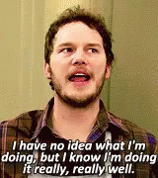
Task 3 – Assessment
Refer to your handbooks! It will explain the number of assessments.
Make sure the you analyze the same assessment for all students in Task 3
Upload examples from your focus students
Pick your focus students based on the results of the assessment. Identify ones that fall in different categories of success (excluding ECH and SPED handbooks). You must have permission slips from your focus students.
Must match the assessment you analyzed for the whole class
Plan for feedback to the students

Slide 59
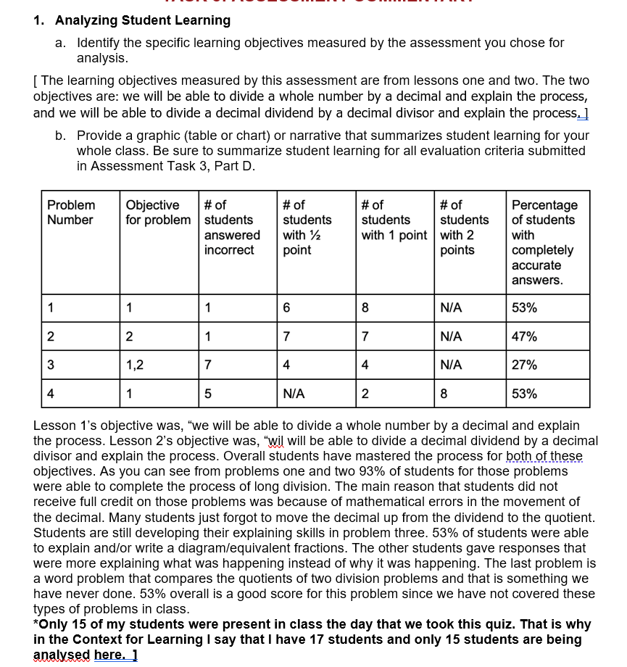
Task 3 – Assessment

Slide 60
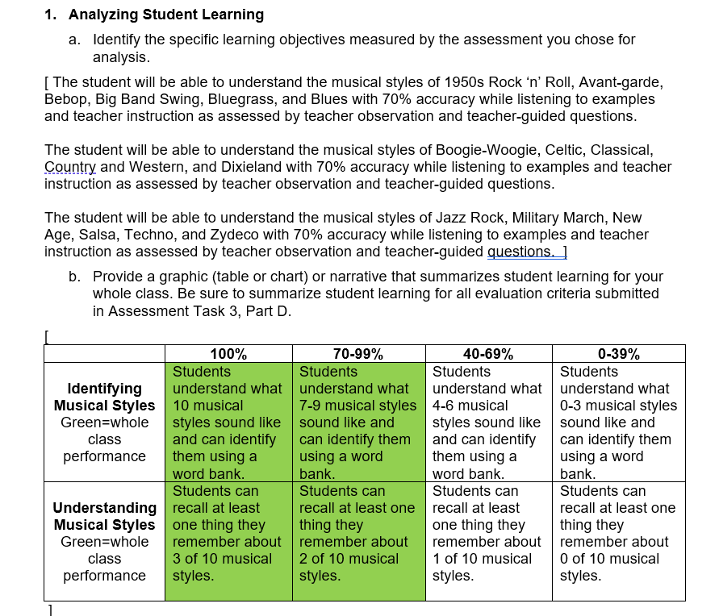
Task 3 – Assessment

Slide 61
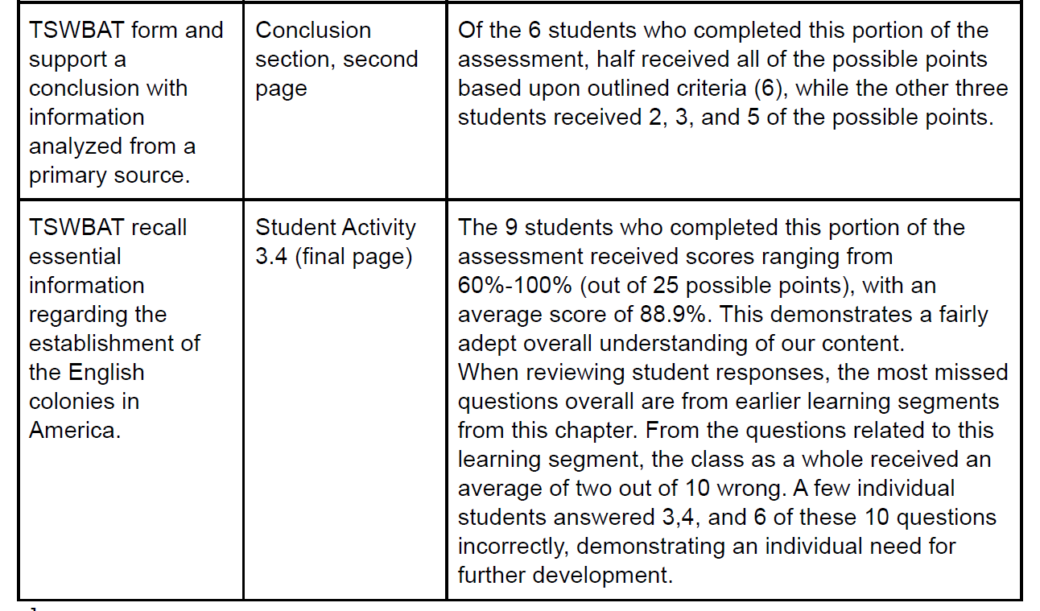
Task 3 – Assessment

Slide 62
Task 3 – Assessment – Patterns of Learning
Strengths and weaknesses!
What do you notice about their responses?
Use the rubric progression document to help.

Slide 63
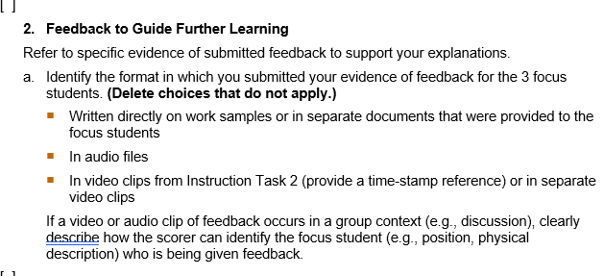
Task 3 – Assessment – Patterns of Learning
Task 3: Prompt 2 – Secondary ELAR example.

Slide 64
Feedback to Guide Further Learning
Refer to specific evidence of submitted feedback to support your explanations.
a. Identify the format in which you submitted your evidence of feedback for the 3 focus students. (Delete choices that do not apply.)
Written directly on work samples or in separate documents that were provided to the focus students
[ All feedback given to students was written directly on their papers and you can read my comments on the student work samples. ]
b. Explain how feedback provided to the 3 focus students addresses their individual strengths and needs relative to the learning objectives measured.
[ Focus Student 1 – This student is a wonderful participant in class and always scores well on any kind of assessment. She was one of the only students in all of my music classes that wrote in complete sentences. I commended her for using complete sentences and thanked her for being a good student in class.
Focus Student 2 – This student is a really good student and did well on her assessment but struggled with a couple styles and mixing them up. This student was one of the only students to mix up Country & Western and Bluegrass. However, I could see how she mixed them up. They can have very similar sounds. She was also a student to mix up Bebop and Big Band Swing.
Focus Student 3 – This is my focus IEP student. This student labeled two numbers as “bluegrass” so he lost a point on number 7. He was also one of the students that mixed up Avant-Garde and Bebop. I agreed that both styles can sound pretty random, but then talked about the instruments that each style usually uses. Also, this student was the only student in the entire class to give me a fact about a musical style that we did NOT talk about in class. For Country and Western this student wrote “George Strait, Rhinestone Cowboy”. And he’s totally right. Those two things would classify under the Country and Western category, so he got the point. I was proud that he could apply what we talked about in class to something he already knew. ]
c. Describe how you will support each focus student to understand and use this feedback to further their learning related to learning objectives, either within the learning segment or at a later time.
[ The next time I see these students, I’ll address the jazz styles along with the mix-up between Bebop and Avant-Garde. This will include drawing a Venn Diagram and asking them to help me fill it in during class. I will also be giving another assessment at the very end of this unit, so students can have a chance at redemption too!
For focus student 1, I’ll continue to encourage and challenge her to work towards learning even more for the next assessment. For focus student 2, I’ll be sure to walk through the Venn-diagram with her individually to help her distinguish all the styles. For focus student 3, I’ll continue encouraging “outside-the box” thinking (like his George Strait answer) and be sure he understands the difference between Bebop and Avant-Garde.]

Slide 65
Include strengths and weaknesses!

Slide 66
Feedback Example (audio format)
[ Student 1: With this student, who has autism, I was able to provide positive feedback to him first, which is highly important because he tends to engage in self-destructing, negative thoughts. I provided him with specific praise relative to the central focus, a “great job making connections.” I provided an example of how he did that and emphasized how doing such will make him a better reader, which aligns with the learning objective of explaining how connections helps someone to understand better. The student even thought about one additional example as we were discussing. I also highlighted his strength of stopping and making an image in his mind as he was connecting. Though he responds, “I don’t literally have a picture in my mind,” I was able to redirect him and tell him that though it is not a literal picture, he still activates his thinking while reading. He even recognized that he shared those ideas with me, which is a big step for him. Then, I shifted to goals as he continues to read. I stated these in a positive manner, telling him he can make connections to what he already knows even without me helping him and asking questions, giving him independence in the task. This expressed to him that he can make text-to-self connections by continuing to activate his thoughts even without prompts. I also encourage him to keep building on his ability to use the pictures to understand meaning. During his assessment, he needed a lot of prompts for words, so giving him a strategy, like looking at the pictures, will not only help him to connect to what the text is saying, but to also understand what it means. I make sure to reiterate the goals so he leaves knowing what he can work on. I allow him to reread the book, as well, so he can practice his goals.
Student 2: First, I explain what the student is doing well. I describe to him that he is reading fluently, even on a more difficult text. This ability to decode is one of the related skills required for the learning objectives. I acknowledge, specifically, that he is reading whole sentences even on a challenging text. I make sure he knows what that means by asking him a question. I emphasize that he is understanding the character’s feelings by the connections he is making, which is specific to the learning objectives. I positively share a goal for him to make connections without my prompting, fostering independence in the learning objectives. I also am specific in saying that he can apply the language function to his writing and speaking as he explains what he is reading and understanding. I have him reiterate the goals so that he can understand them for himself and remember what he is reading. I provide him with praise to conclude the conference.
Student 3: I begin this student’s feedback conference by specifically praising him for the connections he was making prior to reading. I emphasize that he is preparing himself to read by activating schema before reading, which is addressed by the learning objectives. I also highlighted how he would think about the connections during the reading process, which is also part of the learning objectives. I move on to explain a goal, but need to emphasize that goals help us to grow as readers when he becomes frustrated. This student was one who made some surface-level connections and became distracted by talking about what he knew, thought, and saw, so I explained that his goal is to balance his reading and thinking so that he doesn’t become distracted. I emphasize that he can do both during the reading process.]

Slide 67
Citing Research – Connect to your methods courses as well
As I continue to model the skills of making connections and explaining, I will be able to then “release” the students to practice in both a guided then an independent manner, as Focus Student 2’s needs represent. This aligns with the theory of the Gradual Release of Responsibility and Vygotsky’s Zone of Proximal Development and the practice of scaffolding. Through small group instruction, I can focus on students’ comprehension, connections, and explanations. I can provide the individualized support for the students who are struggling, but also provide higher-order task extensions for the students who are excelling, a practice supported by Bloom’s Taxonomy.
Carol Ann Tomlinson’s research and theory of differentiation according to students’ interests, learning profiles, and readiness specifically align with my particular adjustments and responses for my focus students. As for Student 1, I have thought of a way to engage his interest (drawing) in the reading process. Models and verbal sentence frame are differentiated according to his readiness in speaking and writing.

Slide 69
Evaluation Criteria
Task 3 will ask you to upload your evaluation criteria for the assessment you analyzed
They are looking for your rubric or your grading approach to the assessment.
How did you determine mastery?
What were you looking for?
This can just be a word document that you upload with this information

Slide 70
Rubric / Prompt Alignment
Rubric | Prompt
Rubric 1 | Planning Commentary – Prompt 1
Rubric 2 | Planning Commentary – Prompt 2, 3
Rubric 3 | Planning Commentary – Prompt 2, 3
Rubric 4 | Planning Commentary – Prompt 4, Lesson Plans
Rubric 5 | Planning Commentary – Prompt 5, Lesson Plans, Assessment Materials
Rubric 6 | Instruction Commentary – Prompt 2, Video Clips
Rubric 7 | Instruction Commentary – Prompt 3, Video Clips
Rubric 8 | Instruction Commentary – Prompt 4a, Video Clips
Rubric 9 | Instruction Commentary – Prompt 4b, Video Clips
Rubric 10 | Instruction Commentary – Prompt 5, Video Clips
Rubric 11 | Assessment Commentary – Prompt 1, Student Work Samples, Evaluation Criteria
Rubric 12 | Assessment Commentary – Prompts 2a-2b, Evidence of Feedback
Rubric 13 | Assessment Commentary – Prompt 2c, Evidence of Feedback
Rubric 14 | Assessment Commentary – Prompt 3
Rubric 15 | Assessment Commentary – Prompt 4

Slide 71
What’s Next?
You must stick around and work on your edTPA until 12:00
You can change rooms (THOM 111 and 113 are reserved)
Permission Slips!
It might be helpful to work with others with the same handbook
Rooms are reserved until 5:00
Stay on schedule. Pay attention to the due dates and reach out if you have questions.
Don’t wait until the week of February 26th to reach out with concerns!
Office Hours; Next optional writing day: this Saturday, February 17th.

