Slide 1
Clery Act Training: For a Campus Security Authority

Slide 2
Clery Act Training - Introduction
In 1986 Jeanne Clery was raped and murdered in her dorm room at Lehigh University.
The Jeanne Clery Disclosure of Campus Security Policy and Campus Crime Statistics Act (Clery Act) was enacted in her memory.
The goal of the Clery Act is to ensure students, prospective students, parents and employees have access to accurate information about crimes committed on campus and campus security procedures.
Notes:
.

Slide 3
Clery Act Training Table of Contents
The following information is general guidance for a Campus Security Authority (CSA).
Section 1: Clery Act Definitions and Requirements 06
Section 2: Campus Security Authority 12
Section 3: Responsibilities and Reporting 18
Section 4: Review and Guidance 31

Slide 4
Section 1: Clery Act Overview – Definitions and Requirements

Slide 5
What is the Clery Act?:
The Clery Act requires institutions of higher education receiving federal financial aid to report specific crime statistics on campus and provide safety and crime information to members of the campus community.
Law is tied to federal student financial aid programs and requires colleges and universities to make timely warnings, emergency notifications, and provide annual information about campus crime statistics and security policies.
Violators can be “fined” up to $54,789 per violation by the U.S. Department of Education, the agency charged with enforcement of the Act.

Slide 6
Why is this important?
Many crimes and incidents, especially sexual assaults, are not reported to the police.
To ensure that students know about dangers on their campuses, the Clery Act requires institutions to gather and publish data from three kinds of Campus Security Authorities.

Slide 7
Requirements of the Clery Act
Disclose, collect, classify and count crime reports and statistics
Issue Crime Alerts - timely warning for any Clery Act-specified crime that represents an ongoing threat to the safety of students or employees
Issue Emergency Notifications upon confirmation of significant emergency or dangerous situation involving immediate threat to health or safety
Publish Annual Security Report
Submit Crime Statistics to Department of Education
Maintain a publicly available daily crime log
Implement missing student notification procedures
Maintain Fire Safety information - including fire log, annual fire report with statistics and policy statements
Employees and students are notified by October 1 of each year that the campus annual security report is updated and available.

Slide 8
Section 1 Review
Many crimes, especially sexual assaults, are not reported to police
The Clery Act requires institutions of higher education receiving federal financial aid to report specific crime statistics on campus and provide safety and crime information to members of the campus community
Each campus is responsible for establishing appropriate procedures to implement these requirements
Employees and students are notified by October 1 of each year that the campus annual security report is updated and available

Slide 9
Section 2: Campus Security Authority

Slide 10
Who is a Campus Security Authority?
The Clery Act requires that the University gather and publish
crime data from multiple sources, including a
Campus Security Authority.
The law defines 4 categories of a Campus Security Authority:
University Police
Non-police security staff responsible for monitoring University property
People/Offices designated under our policy as those to whom crimes should be reported
“Officials with significant responsibility for student and campus activities”

Slide 11
Section 2: Campus Security Authority
How is a campus official designated as a Campus Security Authority (CSA)?
CSAs are defined by job function and not by title.
Functions
A CSA is anyone who has significant responsibility for student AND campus activities.
The law defines "significant responsibility” broadly and includes, but is not limited to:
Student Housing
Student Discipline and Campus Judicial Proceedings

Slide 12
Who are CSAs?
Examples of CSAs
Deans
Student Housing Staff
Athletic Coaches
Student Activities Coordinators
Officials who oversee a student center
Student Judicial Officers
Resident Assistants (RAs)
Student Advisors
Faculty Advisors to student organizations
NOT CSAs
Administrative staff not responsible for student activities (e.g., payroll, facilities)
Clerical staff
Individual faculty who DO NOT serve as advisors to registered student organizations
Doctors in the Student Health Center, or Counselors in the Counseling Center, who only provide care to individual students

Slide 13
Section 2: Campus Security Authority
CSA Reporting Exemptions
Licensed professional mental health counselors
Pastoral counselors (employed by a religious organization to provide confidential counseling) and are working within the scope of their license or religious assignment.
Although licensed professional mental health and pastoral counselors are exempt from Clery Act requirements, the University encourages such counselors to tell victims about the Confidential Reporting Process, if, in their judgment, it is appropriate to discuss crime reporting with the individual.
Victims have the option of reporting crimes confidentially to a CSA. This means the University will keep a record that a crime occurred but will not publish any identifying information. Reports filed in this manner are counted and disclosed in the annual crime statistics.

Slide 14
Section 2: Campus Security Authority
Review
CSAs are defined by job function and not by title.
A CSA is anyone who has significant responsibility for student AND campus activities.
Examples of CSAs include Deans, Student Housing Staff, Athletic Coaches, and Student Coordinators and Advisors.
Administrative, clerical staff, or faculty positions without responsibility for student activities or advising do not meet the requirements of a CSA.
Licensed professional mental health and pastoral counselors are exempt from Clery Act requirements.

Slide 15
Section 3: Responsibilities and Reporting

Slide 16
Section 3: Responsibilities and Reporting
CSAs are responsible for collecting and reporting on certain crimes that are reported to them by students and employees.
The following slides in this section will help CSAs know what crimes need to be reported and how to report them within the Clery Act provisions.

Slide 17
Section 3: Responsibilities and Reporting What is a CSA required to report?
Criminal homicide (non-negligent manslaughter, negligent manslaughter)
Sex offenses (Rape, Statutory Rape, Incest, Fondling)
Aggravated assault
Robbery
Burglary
Motor vehicle theft (See CSA Information handout for definitions)
Arson
Dating violence
Domestic violence
Stalking
Hate crimes, including any of the seven crimes listed above and the four below, or any other crime causing bodily injury, if motivated by race, gender, gender identity, religion, sexual orientation, ethnicity, national origin or disability.
● Larceny-theft ● Simple assault ● Vandalism ● Intimidation
Arrests and discipline referrals of students, staff, and faculty for liquor, drug and weapons law violations

Slide 18
Section 3: Responsibilities and Reporting Reporting depends on location
A CSA must report an incident if it occurred:
On campus(includes streets, grounds and parking lots within campus boundaries)
On campus, in residence halls
On public property adjacent to campus
On non-campus property owned or controlled by the University or a recognized student organization (includes Plum Creek ball fields)
Reporting depends on location – International
Foreign educational operations that are either owned or maintained by Concordia are governed by the Clery Act and have reporting requirements.

Slide 19
Section 3: Responsibilities and Reporting What Not to Report
As a CSA, you do not have to report the following:
A person tells you about a crime that occurred before he/she came to the University
OR
While he/she was away from campus and not involved in a UC activity (e.g., at home during Spring break)

Slide 20
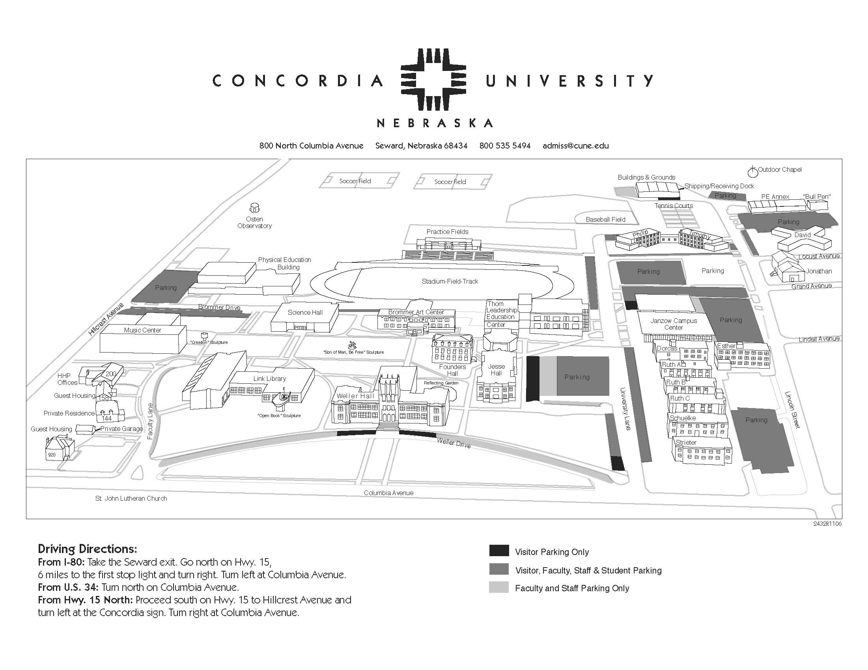

Slide 21
Section 3: Responsibilities and Reporting Reporting an Incident
As a Campus Security Authority
you are required to:
Get the facts - When, what, where, who, etc.
Report all Clery Act related crimes immediately to the Campus Security or Student Life so the campus can comply with timely warning policies and have accurate crime statistics for the annual security report
Inform victims of their options, including confidential reporting options and offer referrals to resources (e.g., campus assistance programs or counseling service, if appropriate)
Share how he/she can report to Police, including how to report anonymously
A person who talks to you may not want to talk to Police - and doesn’t have to

Slide 22
Section 3: Responsibilities and Reporting Reporting an Incident - Get the Facts Important Questions to Ask

Slide 23
Section 3: Responsibilities and Reporting Reporting an Incident - Next steps
Complete a Clery Act Crime Report Form (forms available from Clery Act Coordinator and online)
Describe the incident/crime as completely and accurately as you can
You do not need to make a judgment about or investigate what happened, just get the facts
Note: If the victim reports a crime to you, but wishes to remain anonymous, you still need to submit a Clery Act Crime Report Form (but do not need to identify the victim)

Slide 24
Section 3: Responsibilities and Reporting Reporting an Incident - Filling out the Report
Answering questions on the form will help determine the correct category (you don’t have to know the classification)
Write a brief description of the incident
Timely reporting is critical!

Slide 25
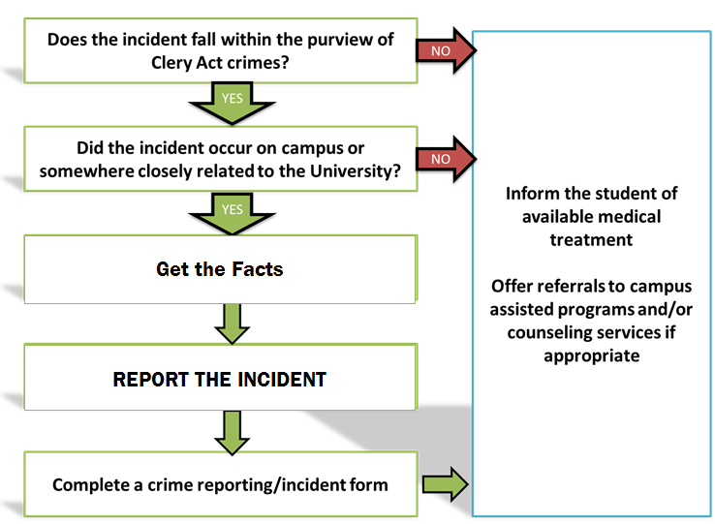
Section 3: Responsibilities and Reporting Review

Slide 26
Section 3: Responsibilities and Reporting
Reporting a Clery Crime at Concordia
For emergencies & crimes in progress, call 9-1-1
Fill out Clery Act Crime Report Form found on the portal: Click on the Employee Tab and scroll down to the bottom of the page. On the bottom right of the page you will find a section labeled Clery Act Compliance. Cliack on the link labeled 2017 Crime Report Form.
Send form immediately to Student Life Office: studentservices@cune.edu
and Security Department:
Need Assistance?
Gene Brooks, Vice President for Student Affairs and Athletics, 402-643-7373
Kirby Klappenback, Associate General Counsel; Title IX Coordinator, 402-643-7192

Slide 27
Section 4: Review and Guidance

Slide 28
Section 4: Review and Guidance Review
The Clery Act requires institutions of higher education receiving federal financial aid to report specific crime statistics on campus and provide safety and crime information to members of the campus community.
Each campus is responsible for establishing appropriate procedures to implement these requirements.
A Campus Security Authority (CSA) is anyone who has significant responsibility for student AND campus activities.
CSAs are required to: Get the facts, report all Clery related crimes to the Student Life Office and the Campus Security Department, inform victims of confidential reporting options and offer referrals to resources.

Slide 29
Section 4: Review and Guidance Additional Guidance and Resources
You can get additional information and advice from your campus Clery Act Coordinator: Kirby Klappenback; 402-643-7192; Kirby.Klappenback@cune.edu
Guidance is also available in the U.S. Department of Education Handbook for Campus Safety and Security Reporting. https://www2.ed.gov/admins/lead/safety/handbook.pdf

