Slide 1
Memory and Ministry
These slides were originally prepared for a congregational Stephen Ministry group who asked for some background on memory and applications for their service as care-givers.
The content includes two sections. The first section presents some biblical themes related to memory with some attention to Reformation themes such as incarnational theology and Christ as pro nobis. The second section offers some opportunity for discussion on selected topics related to memory and care-giving that can be examined further in readily available textbooks and research.

Slide 2
Memory and Ministry

Slide 3
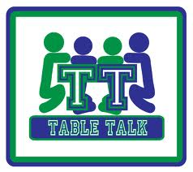
Some table talk:
What’s your earliest memory?

Slide 4
Some table talk:
What’s your earliest memory?
Did anyone cite a non-narrative example?
Three good candidates:
Your mother’s scent
Your accent
Remembering how to walk

Slide 5
Some Teaser Questions
T ? F Memory is learning that persists over time, that is, content that has been acquired, stored, and can be retrieved.
T ? F Millions of people among us can learn and remember 20 new vocabulary words per day without even trying.
T ? F Some anesthetics work not so much by blocking discomfort but by blocking the memory of that discomfort.
T ? F “There comes a time when for every addition of knowledge, you forget something you knew before.” – Sherlock Holmes
T ? F Big Pharma is investing in memory-altering drugs that can block selected memories and that can enhance overall memory.
T ? F Because of our acute facial recognition neural processing, eye- witness accounts in the courtroom are highly reliable.
T ? F “Photographic memory” remains a vague and unsubstantiated concept among neuro-scientists.
T ? F Important “flashbulb” memories (9/11) are highly accurate because they are so vivid.
T ? F Even God has a bad memory: he forgets our sins, and this leads to a miscarriage of justice.

Slide 6
Some Teaser Questions
T ? F Memory is learning that persists over time, that is, content that has been acquired, stored, and can be retrieved.
T ? F Millions of people among us can learn and remember 20 new vocabulary words per day without even trying.
T ? F Some anesthetics work not so much by blocking discomfort but by blocking the memory of that discomfort.
T ? F “There comes a time when for every addition of knowledge, you forget something you knew before.” – Sherlock Holmes
T ? F Big Pharma is investing in memory-altering drugs that can block selected memories and that can enhance overall memory.
T ? F Because of our acute facial recognition neural processing, eye- witness accounts in the courtroom are highly reliable.
T ? F “Photographic memory” remains a vague and unsubstantiated concept among neuro-scientists.
T ? F Important “flashbulb” memories (9/11) are highly accurate because they are so vivid.
T ? F Even God has a bad memory: he forgets our sins, and this leads to a miscarriage of justice.

Slide 7
The Memorial Stones—Israel Crossing the Jordan River into Canaan
When all the nation had finished passing over the Jordan, the LORD said to Joshua, Take twelve men from the people, from each tribe a man, and command them, saying, ‘Take twelve stones from here out of the midst of the Jordan, from the very place where the priests’ feet stood firmly, and bring them over with you and lay them down….
(not the original!)
When your children ask in time to come, ‘What do those stones mean to you?’ then you shall tell them that the waters of the Jordan were cut off before the ark of the covenant of the LORD. When it passed over the Jordan, the waters of the Jordan were cut off. So these stones shall be to the people of Israel a memorial forever. - Joshua 4:1-7
Cf. also various other cairns: piles of rocks set up as memorials

Slide 8
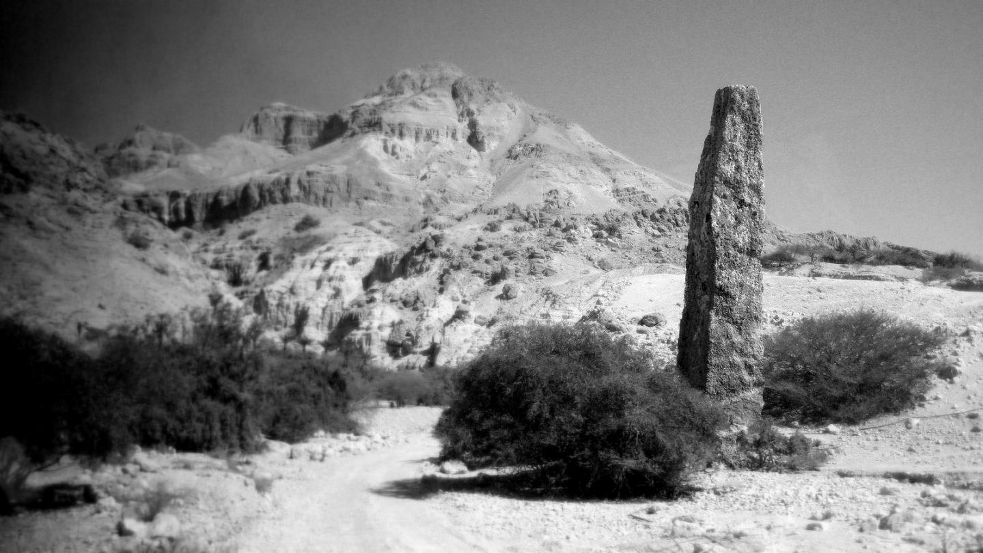
The Ebenezer (“stone of help”) Memorial Stone
Then Samuel took a stone and set it between Mizpah and Shen, and named it Ebenezer, saying, “Thus far the LORD has helped us.” So the Philistines were subdued and they did not come anymore within the border of Israel. 1 Sam 7:12-13
(not the original!)

Slide 9
Amos addressing Jeroboam II, king of the Northern Kingdom, Israel, c. 750 BC:
Hear this, you who trample on the needy and bring the poor of the land to an end, saying, “When will the new moon be over, that we may sell grain? And the Sabbath, that we may offer wheat for sale, that we may make the container small and the shekel great and deal deceitfully with false balances, that we may buy the poor for silver and the needy for a pair of sandals, and sell the chaff of the wheat?”
The LORD has sworn by the pride of Jacob: “Surely I will never forget any of their deeds.”
- Amos 8:4-7

Slide 10
Jeremiah’s Promise of a New Covenant (cf Hebr. 8:12)
“Behold, the days are coming, declares the LORD, when I will make a new covenant with the house of Israel and the house of Judah, not like the covenant that I made with their fathers on the day when I took them by the hand to bring them out of the land of Egypt, my covenant that they broke, though I was their husband, declares the LORD. For this is the covenant that I will make with the house of Israel after those days, declares the LORD: I will put my law within them, and I will write it on their hearts. And I will be their God, and they shall be my people. And no longer shall each one teach his neighbor and each his brother, saying, ‘Know the LORD,’ for they shall all know me, from the least of them to the greatest, declares the LORD. For I will forgive their iniquity, and I will remember their sin no more.”
Jer. 31:31-34

Slide 11
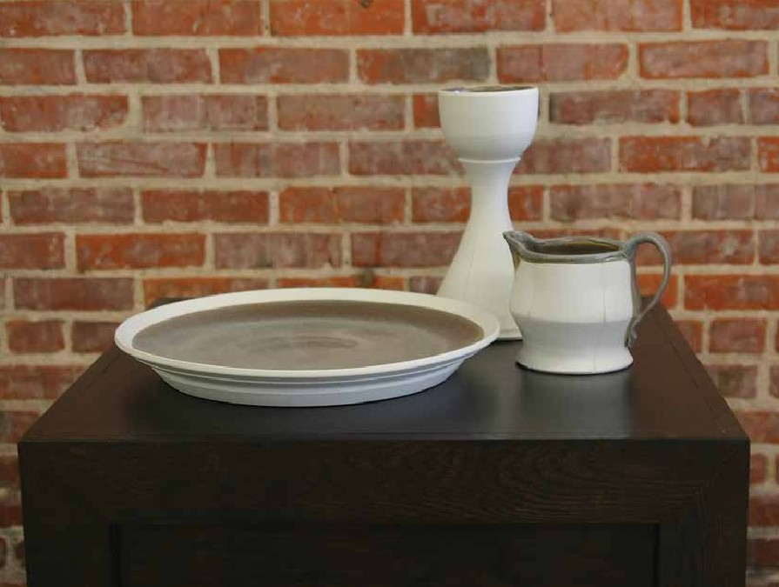
Do This in Remembrance
And he took bread, and when he had given thanks, he broke it and gave it to them, saying, “This is my body, which is given for you. Do this in remembrance of me.” And likewise the cup after they had eaten, saying, “This cup that is poured out for you is the new covenant in my blood.
But behold, the hand of him who betrays me is with me on the table. For the Son of Man goes as it has been determined, but woe to that man by whom he is betrayed!” And they began to question one another, which of them it could be who was going to do this. - Lk. 22:19-23

Slide 12
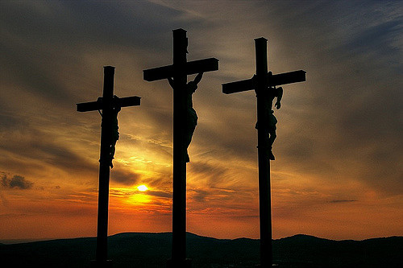
Remember Me
One of the criminals who were hanged railed at him, saying, “Are you not the Christ? Save yourself and us!” But the other rebuked him, saying, “Do you not fear God, since you are under the same sentence of condemnation? And we indeed justly, for we are receiving the due reward of our deeds; but this man has done nothing wrong.”
And he said, “Jesus, remember me when you come into your kingdom.” And he said to him, “Truly, I say to you, today you will be with me in paradise.” - Lk. 23:39-43

Slide 13
Any other biblical texts, themes, or events that you connect to memory?

Slide 14
As Alzheimer’s runs its course, the person becomes emotionally flat, then disoriented, then disinhibited, and finally mentally vacant—a sort of living death, a mere body stripped of its humanity.
- Christian psychologist David G. Myers
Agree? Or disagree?

Slide 15
Perhaps Our Chief
Spiritual Issue
Lurking behind many/most/all of the daily and ongoing distress that we encounter among those we work with is the question,
“Does God care? Is he paying any attention? Does he remember us?”
On Maundy Thursday, Jesus begins his closing discussion with the remaining eleven, promising to remember them:
Let not your hearts be troubled. Believe in God; believe also in me. In my Father’s house are many rooms. If it were not so, would I have told you that I go to prepare a place for you? And if I go and prepare a place for you, I will come again and will take you to myself, that where I am you may be also. Jn. 14:1-3

Slide 16
In an incarnational theology, memory is integral to how we experience, understand, and connect the world to what God is doing in the world.
Memory
Identity
Personality and disposition
Sensation and perception
Cognition, Intelligence
Pathology and disorders
Learning

Slide 17
A List-of Ten: Memory Matters for Ministry
(Two topics we won’t attend to: “photographic” memory; amnesia)
Each of these is an entire field of study in itself.
Memory and the young child, the young adult, and the aging adult
Narrative or episodic memory is always constructed and reconstructed—not “recorded” (remembering 3 x 8 = 24 remains pretty constant; our specifics about 9/11 do not remain intact)
Eyewitness accounts
The frequency of false memory and the issue of “repressed memories”
Rumination and depression
Captive to memory: PTSD, OCD, perfectionism, and over-achieving
Pain as a memory problem: the peak-end rule, abrupt ends vs. diminishing ends, and a case for closure
Sleep and memory
Stress and the Four-to-Fix: Nutrition, Sleep, Exercise, and Routine
___________________________________

Slide 18
Models of Memory: the Three “Boxes”
A simple and useful approach.

Slide 19
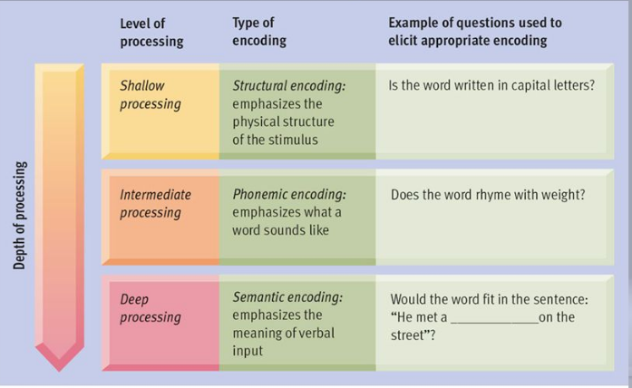
Models of Memory: the Levels of Processing Theory
Memory is organized and stored depending on the degree to which we analyze the experience or content.

Slide 20
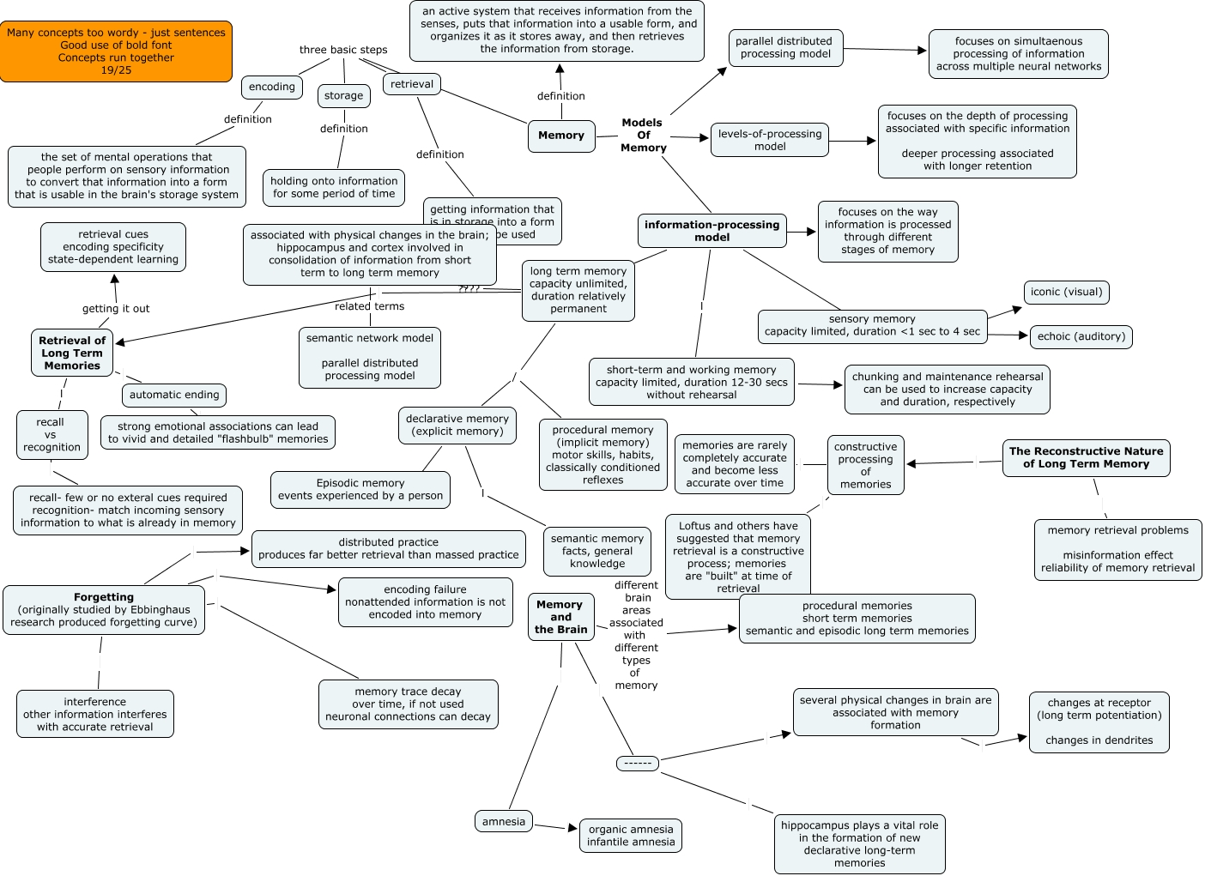
Models of Memory: the Connectionist or Network Model
Influenced by:
Sensory processing
Emotions
Nutrition
Prior experience
Illness and disease
Fatigue
Motivation
Language
Vocabulary
Temperament and disposition In other words, everything about us!

Slide 21
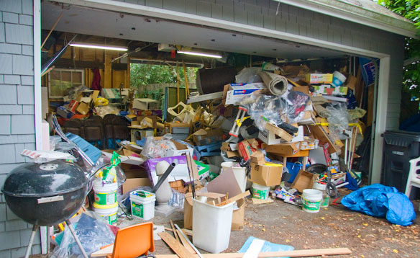
Models of Memory: What it Really Looks Like!

Slide 23
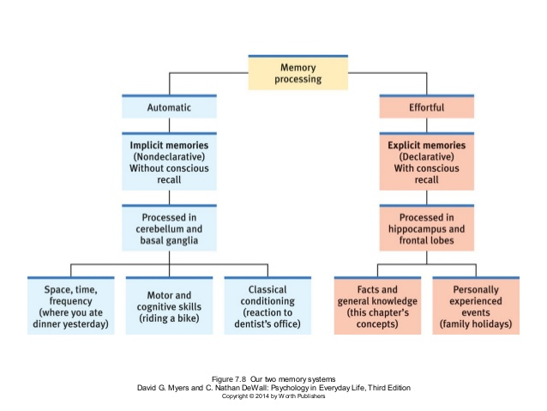

Slide 24
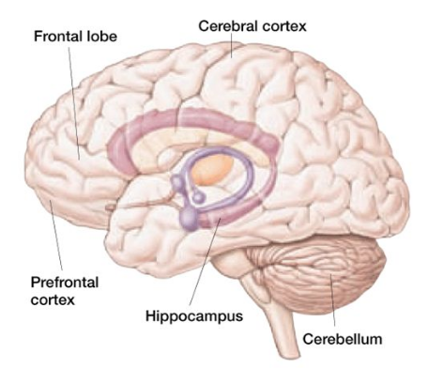
short term and
working memory
Association areas for pulling content together; storing long-term memory
Encoding words and images; monitoring your surroundings
Amygdala
switchboard for long-term declarative memory
emotional
memories
forming, managing motor memory and conditioned responses

Slide 25
MEMORY: HOW RELIABLE?
Chaos
Precise Accuracy
the real range
Our Fallibility Factors:
Decay (the neuron’s chemistry change is not sustained)
Emotions
Interference from other stimuli
Contamination from others
The “constructive” and networked combination of countless other contributions from the brain
The sculpting and economizing benefits of forgetting
So, don’t be too cynical or too confident. Memory is approximate and serviceable. It is not a camcorder or computer.

Slide 26
Well, it depends…
Three Important Influences on Remembering
Context-Dependent Memory: we remember better in the location of that experience or learning.
Mood-Dependent Memory: we remember better when we are in the same mood in which we learned that content or had that experience.
State-Dependent Memory: we “remember” more vividly, selectively, and often inaccurately when we are in the same psychotropic condition: normal, drunk, manic, desperate, terrified, etc.

Slide 27
The Memory Wars
and Creating False Memories
False Memories: These are very common. Such confabulation is relatively easy to induce in most of us. The process is well-researched, well-documented, and verified by replication. (See Elizabeth Loftus) The Key Issue: A series of claimed child abuse cases in the 1980s and 90s in which therapists used leading questions, loaded language, and suggestive case examples to provoke retrieval and recall of content the client inferred from the therapy, not their real past (confusing memory of their perception and rehearsing that perception with an event that never happened). Our Concern: Care receivers who pick up out-of-date notions about repressed memory from unreliable sources, or who thrive on drama and sensationalism. Our Dilemma: Distinguishing cases that have merit from cases of “imagination inflation.”

Slide 29
The Memory Wars and
Fake News, Alternate Facts, and Post-truth
Two Key Concepts:
The Misinformation Effect: a memory distortion in which a person’s existing and valid (if not entirely accurate) memory is altered when the person is exposed to misleading information.
Again, memory is always constructive to some extent.
Source Confusion: a memory distortion that occurs when the true source of the memory is forgotten or replaced.
In our times of Twitter and 24/7/365 filler news, information is difficult for all of us to sort and organize.
The Point: The point is not for us here to focus on politics but to be aware of the cultural shifts and influences that set up those around us for confusion and misdirection.

Slide 30
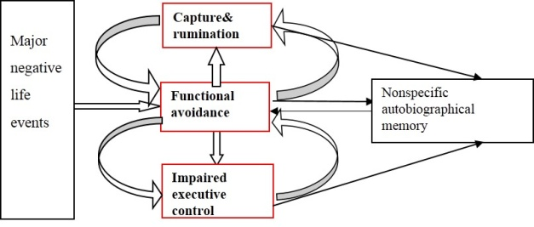
Rumination: the Memory’s “Groundhog Day”
Rumination, a behavior related to depression, refers to repetitively going over a thought or a problem without any resolution. Compare also to cognitive distortions. Females and esp. young adol females are susceptible.
Negative life events—perhaps major or cumulative minor
Note also co-rumination: the behavior of talking too much with another person about problems, stressors, and anxieties—specifically when girls rehash their complaints excessively, reinforcing one or both of them in negativity, depression, and hopelessness.

Slide 31
A Case for Closure: The Peak/End Rule, Abrupt
Ends vs. Diminishing Ends, and a Case for Closure
1. When we think of a bird, we think of a robin, not a kiwi. We use representative heuristics, not analytical algorithms, when we think about things.
2. Our memories of events that have beginning and ending periods—especially an extended process such as an unpleasant medical procedure, a firefight battle, a natural disaster, or a family breakdown—are governed not by the entirety of the experience but by feature moments.
3. Two features or factors dominate our memory of these events:
● the peak moment ● the period at the end
4. Example application: rather than ending the pain quickly (such as with an opioid), if the dentist or doctor prolongs the process a little longer but increases the comfort level up to and at the close, we experience and remember the entire event much more positively.
5. Takeaway: while many of us are skeptical about all the talk about “closure,” this process can be generalized to many life events.

Slide 32
Memory, Sleep, and Dreams
Replicated studies confirm the association sleep with memory consolidation and long-term memory.
Sleep, and esp. REM dream sleep, links our day’s experiences with stored experience in complex, webbed, and highly integrative ways—not like Lego blocks or merely in series or parallel patterns. (Our dreams are weird!)
An impaired or disrupted sleep cycle limits the brain’s system cues, the neuro-chemical activity, and the neural network connections: new and old content fail to combine or combine in ways we can use.
Adolescents and young adults are notorious for disrupted sleep cycles.
Lots of somatic, health, and personal problems interfere with the sleep and memory cycle for older adults.
Eye Movement Desensitization Therapy or EMDR aims to leverage these processes through a wakeful series of eye movement exercises and mental imaging while awake. (EMDR remains somewhat controversial.)

Slide 33
Summary: Ten Insights and Practical Takeaways
God keeps and does not forget his promises to us in Christ: Lo, I am with you always (Mt. 28:20), and I will come again and take you to myself, that where I am you may be also (Jn. 14:3).
Researchers use different models for studying memory, but the neurosciences now confirm that memory is extremely complex, includes several different but related systems (any one of which can go awry), and is distributed across the brain and body, not contained in any single structure or area of the brain.
Narrative memory is approximately reliable but not very precise.
Our experiences are genuine but can “set us up” for misrepresentative perceptions and misleading memory.
Creating or self-generating false memories is relatively common and easy to do.
Some sorts of trauma and abuse therapies, though perhaps well-intended, have led to false memories and accusations.
Watch for those struggling with rumination, which can trap them in “memory loops.”
A reasonably good sleep cycle promotes memory consolidation and organization.
Easing out of painful or troubling incidents can help form less troublesome memories.
Alzheimer’s affects about 3% of the population, age 65 or younger. The incidence goes up somewhat after 65.

Slide 34
A Perceptual Set Demo
Directions: In some quick, simple way divide the large group into two smaller groups, Group A and Group B. Have Group A follow the first series of four cartoon figures of a man’s face while Group B closes or averts their eyes. Reverse the process for Group B for the four cartoon figures of the woman seated. Then use the slide with only the last two drawings of each figures to have the members of the two groups tell each other what the figure is. Watch the confusion.
The entire group is usually quite impressed with how reasonable people can be ‘”set up” to look at the same content, then perceive it and, so, remember it in distinctly different ways.

Slide 35
Two groups, one at a time.
Group B, look away.
Group A, follow the next few slides

Slide 36
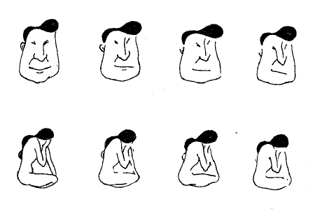

Slide 40
Okay, next group:
Group A, look away.
Group B, follow the next few slides

Slide 45
Now please tell someone in the other group what this figure is:

Slide 47
This is just a cartoon. What if the issue is political, personal, theological, or financial?
Now you can see the power of perceptual sets and how we can be set up to perceive and remember the same or similar content and information in different ways—and then get into pointless arguments.

Slide 48
Saved as an extra master if needed.

